Slide 1
VNS Tomography Phoenix Training
XtremeGeo LLC
Fall 2025

Slide 2
Comments
You will almost certainly create more than one model!
It’s generally recommended that the first model be somewhat coarse:
Large horizontal node spacing, 50m or so
Not too many vertical nodes, 30 or less
Inversion run with large decimation, 5 or more
One key reason for a coarse initial model is to ensure that the model is deep enough

Slide 3
Steps
Create an initial model
Define the starting velocity using the moveout trend (optional but highly recommended)
Run an inversion. It’s likely more than one will be run using different offsets, decimations, etc.
QC the solution:
View the “Pick QC” display
Shot/station tomo stacks (very important!!!)
View profiles
Map displays
Apply the solution in a picker window, ensure flatness
Model editing, if needed
Generate statics

Slide 4
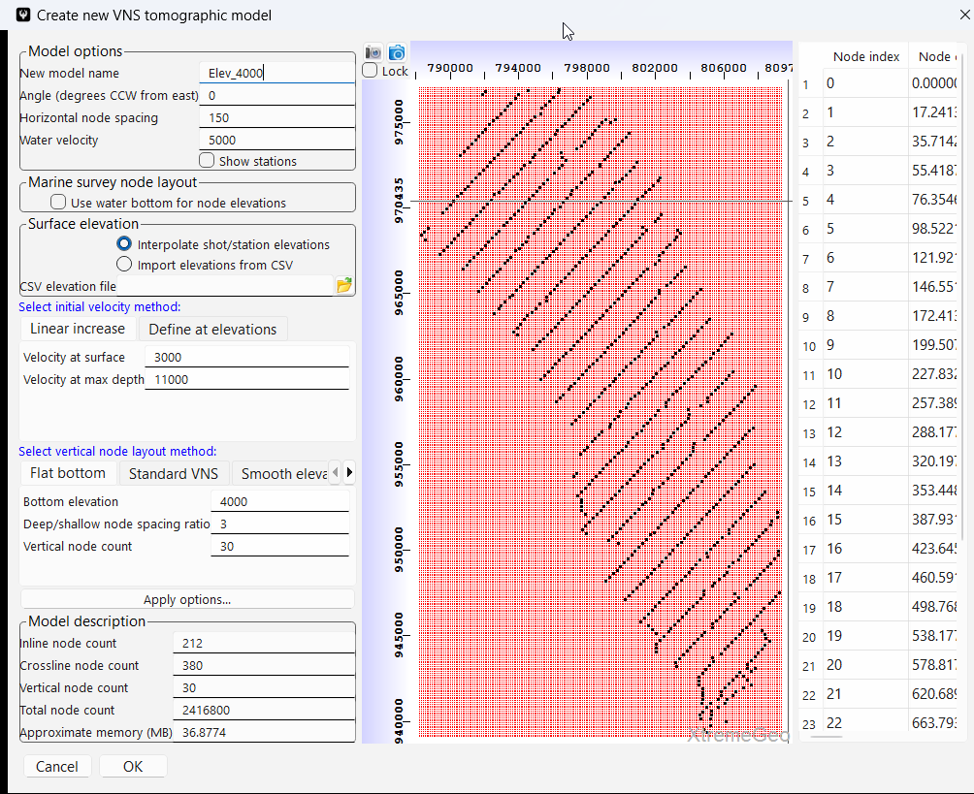
New model
Click “VNS” then select “Create new VNS model”
Be sure to give the new model a memorable, clear name. You will soon have more than one model!
Horizontal node spacing is 150 feet, quite large – recall that this is a “test” model
Optionally, left-click and drag on the map to define grid angle.
The initial velocity field in not important since it will be defined using the moveout trend curves
The node layout method is important. The “Flat bottom” layout method generally works very well. In this example the bottom elevation is set to 4,000 feet

Slide 5
Define initial velocity field using moveout trend
If needed, define an accurate moveout trend
In the tomography window click “Modifications” then select “Import: Generate velocity field from moveout trend picks”
You will be given the option to create a new model. There’s no need to create a new model at this point, just overwrite existing velocity field
The application will generate first break picks along the trend curves and perform a 1D Eikonal inversion at each picked location. This inversion yields an accurate velocity field at each location
The velocity to interpolated to the rest of the model
The result is a high-quality initial velocity field
Some contractors will deliver this as a final product – please don’t!

Slide 6
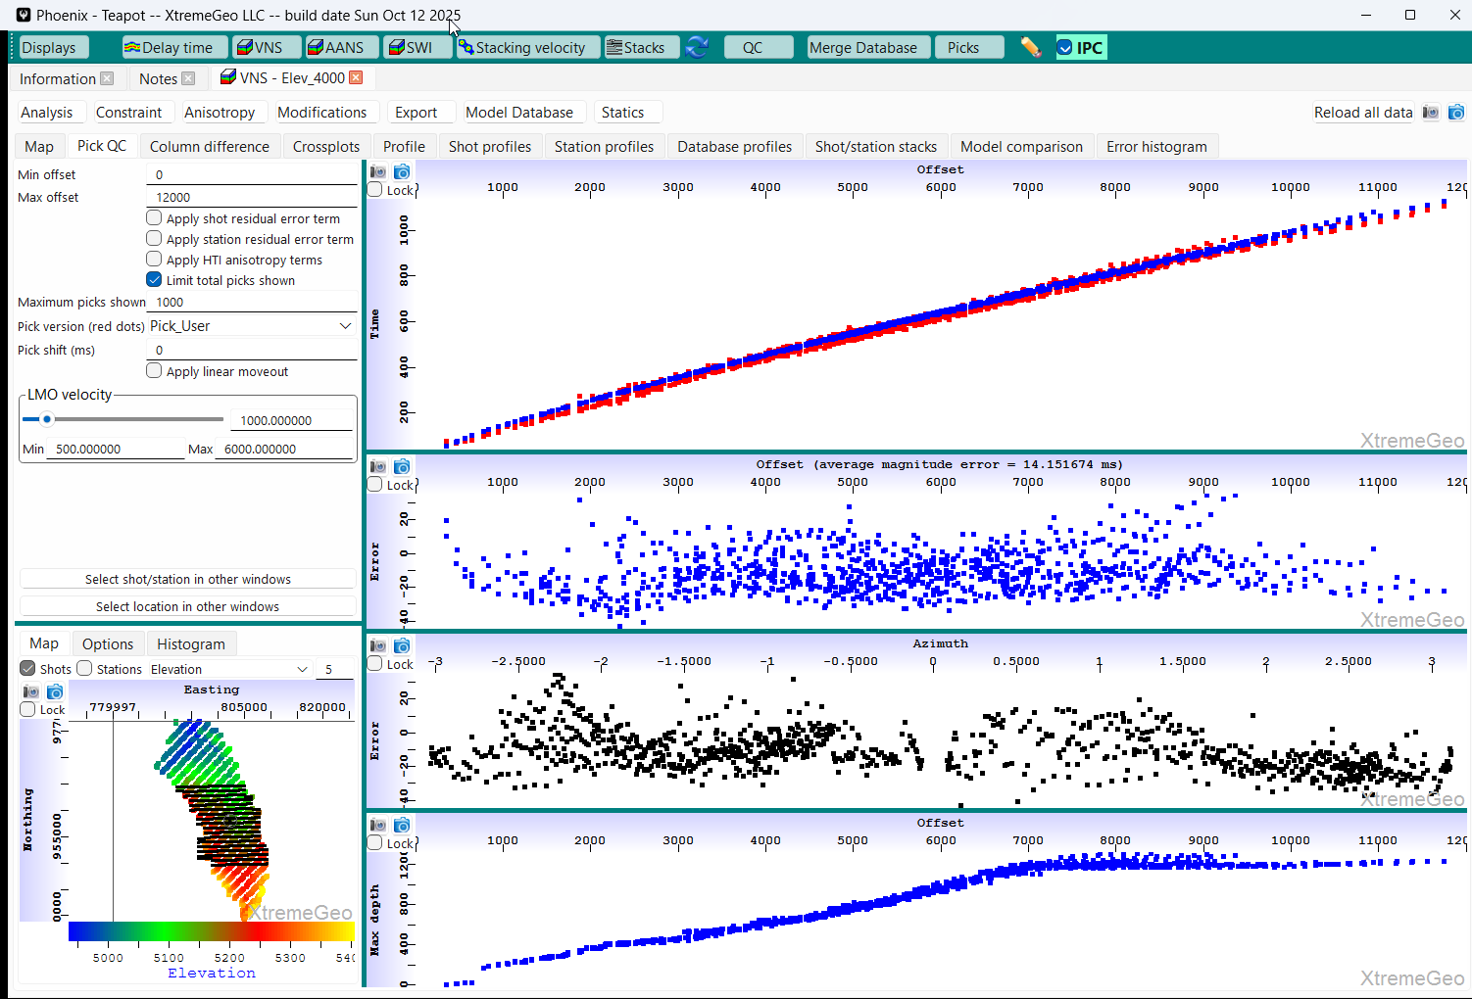
Before running inversion, look at Pick QC display
Red are user picks, blue predicted by model
Left-click on a shot

Slide 7
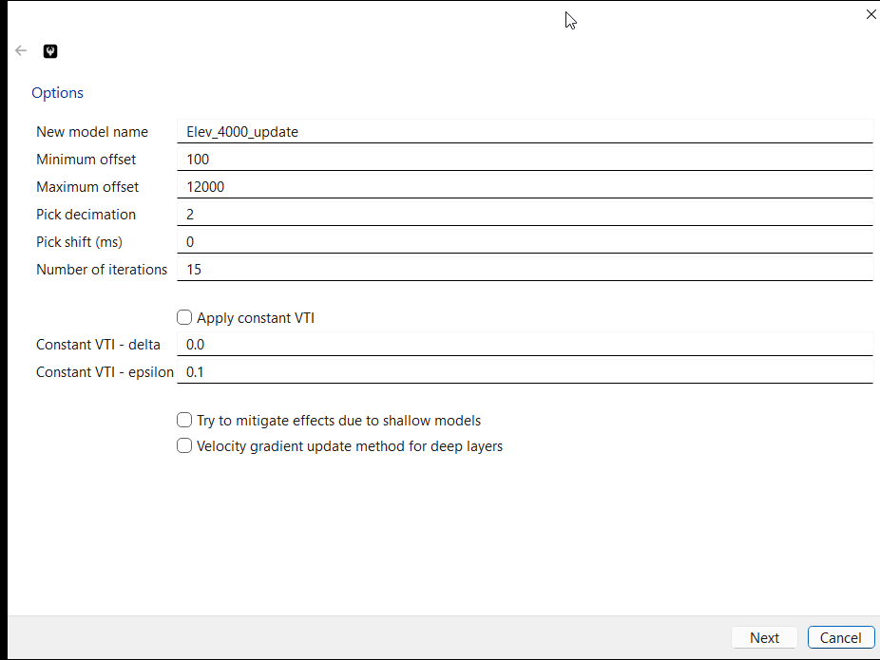
Inversion
Click “Analysis” then “Model update – standard approach”
Modify the name, if desired. Running the inversion will not overwrite the current model
Select the desired offset range
A decimation of “1” means no decimation!
Select decimation greater than 1 for the first pass
Ignore VTI for now. Be aware though that including VTI can have a significant impact
Leave the bottom two options unchecked – We want to understand how “good” the initial model is

Slide 8
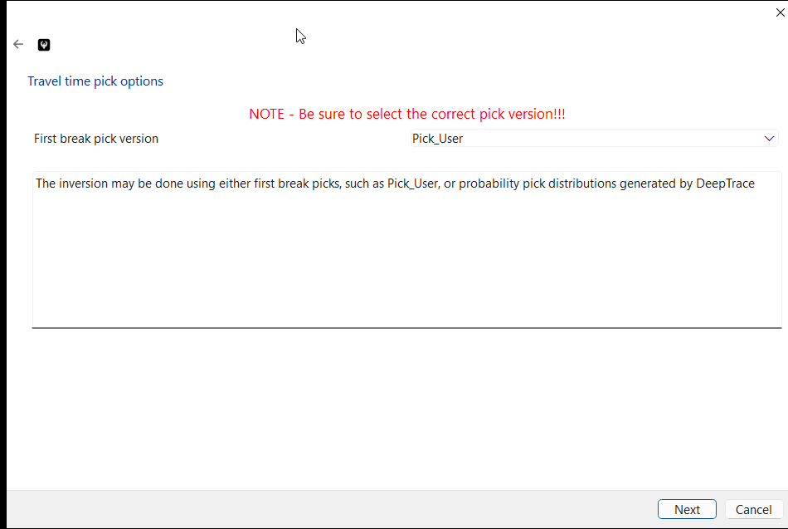
Inversion
Select correct pick version

Slide 9
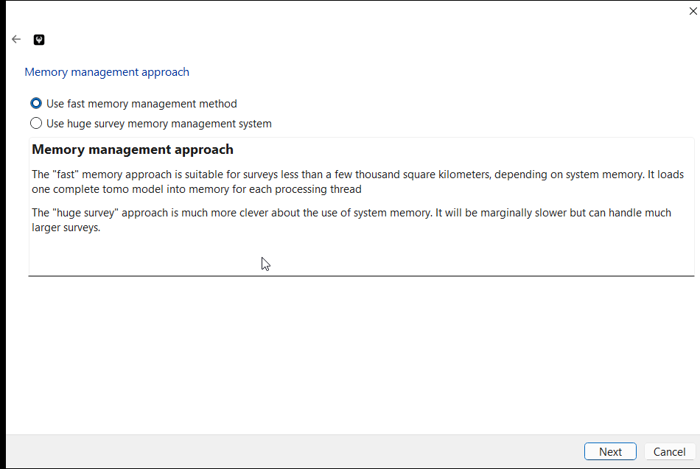
Inversion
The “huge survey…” option is useful for the largest surveys, especially when running on an MPI cluster
The huge survey approach tiles the survey, based on thread availability

Slide 10
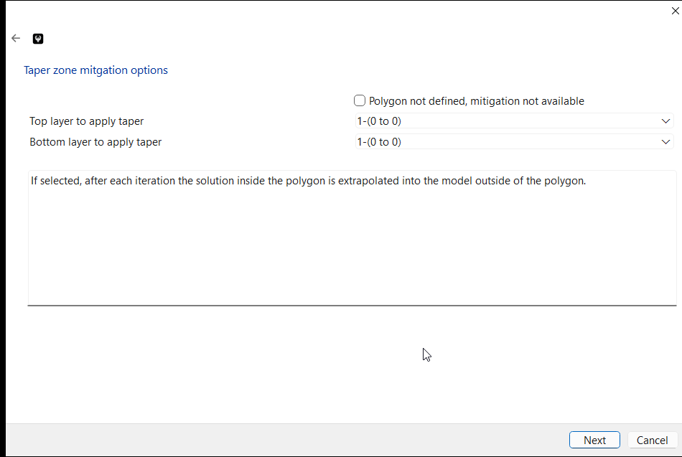
Inversion
This option is useful if, for example, there are regions of receivers without nearby shots.

Slide 11
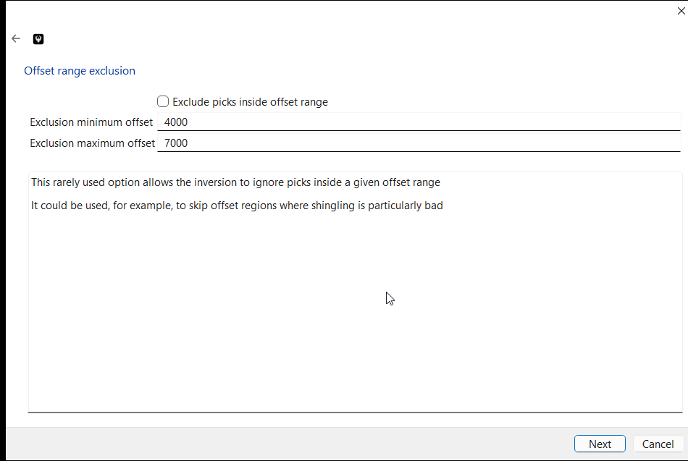
Inversion
This rarely used option can be used to ignore offset ranges where the picks have issues. For example, heavily shingled data

Slide 12
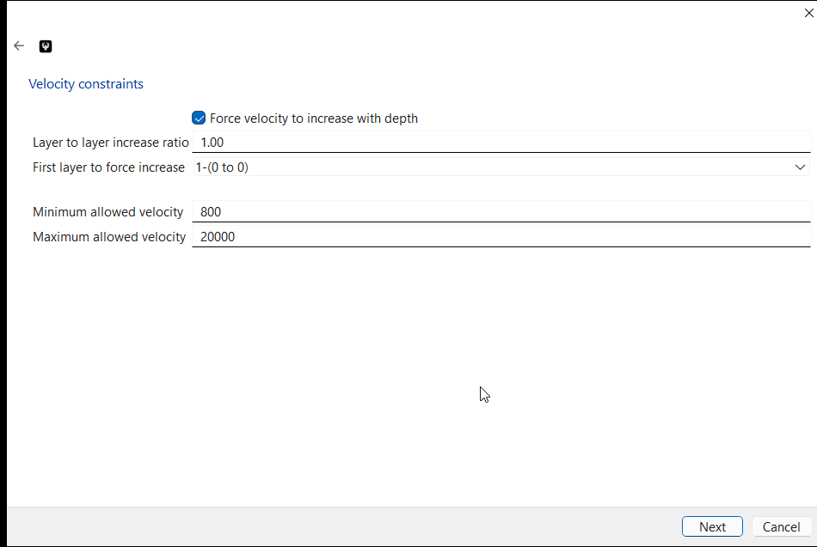
Inversion
During the first inversion it may be a good idea to force the velocity to increase with depth.
Otherwise, usually allow inversions

Slide 13
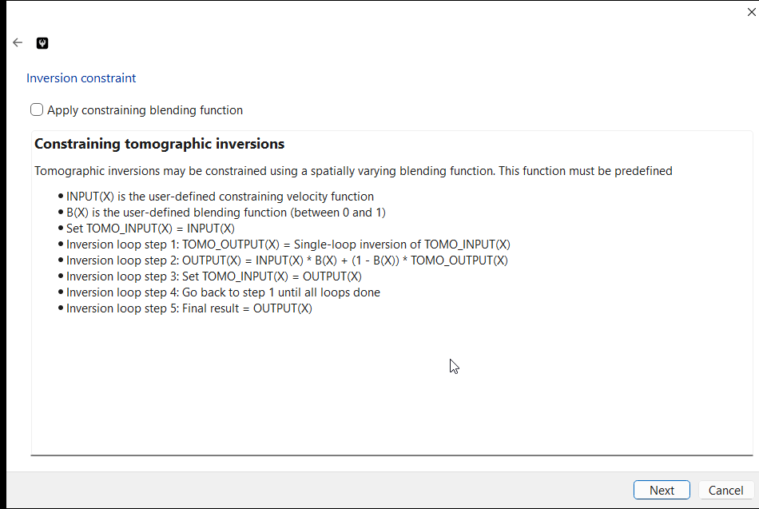
Inversion
Constraining inversions is covered in another document

Slide 14
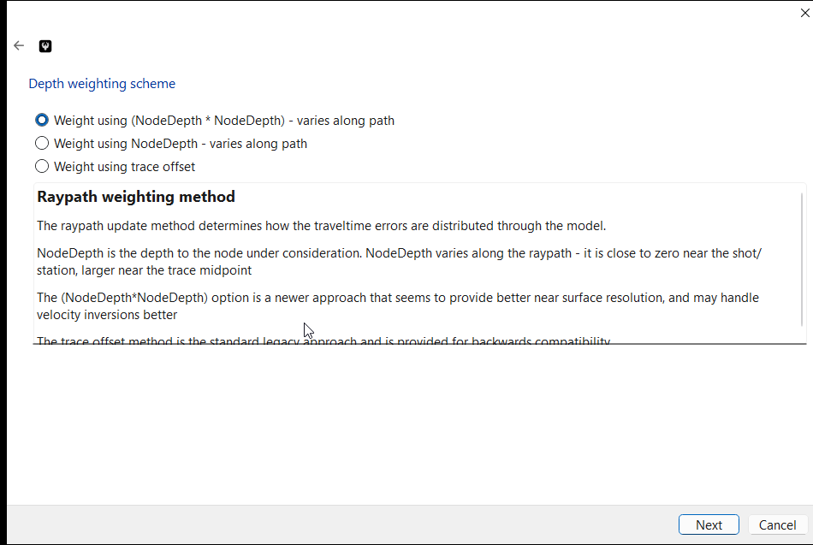
Inversion
The default depth weighting scheme usually converges fastest

Slide 15
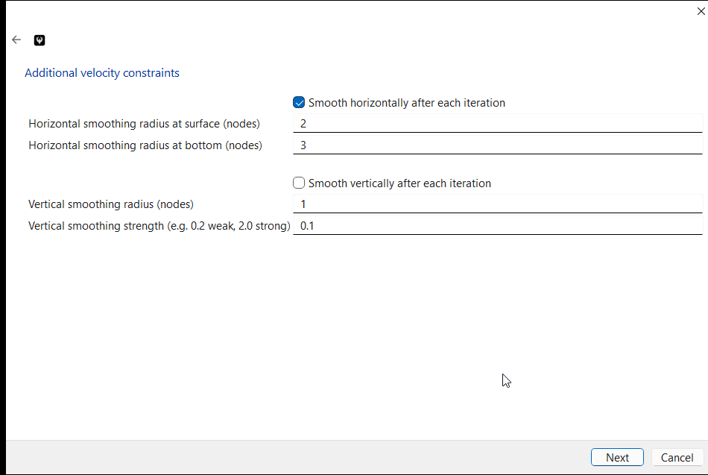
Inversion
Vertical smoothing is usually not recommended, but may be needed to help stabilize the solution
Horizontal smoothing can help avoid artifacts.
Not much at the surface, “0” or “1’
At the bottom, usually around “3” to “6”

Slide 16
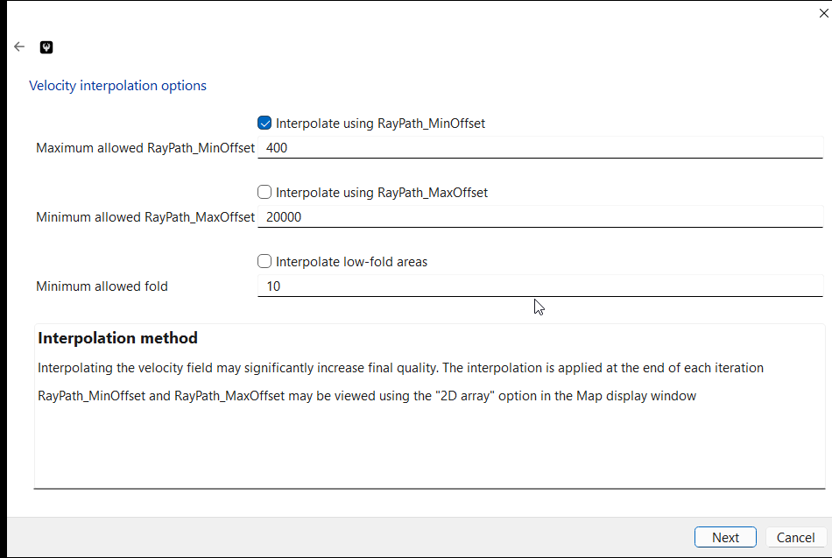
Inversion
These options help avoid artifacts caused by low fold or incomplete offset range coverage.
Usually only the first option is used
Will revisit this in a bit…

Slide 17
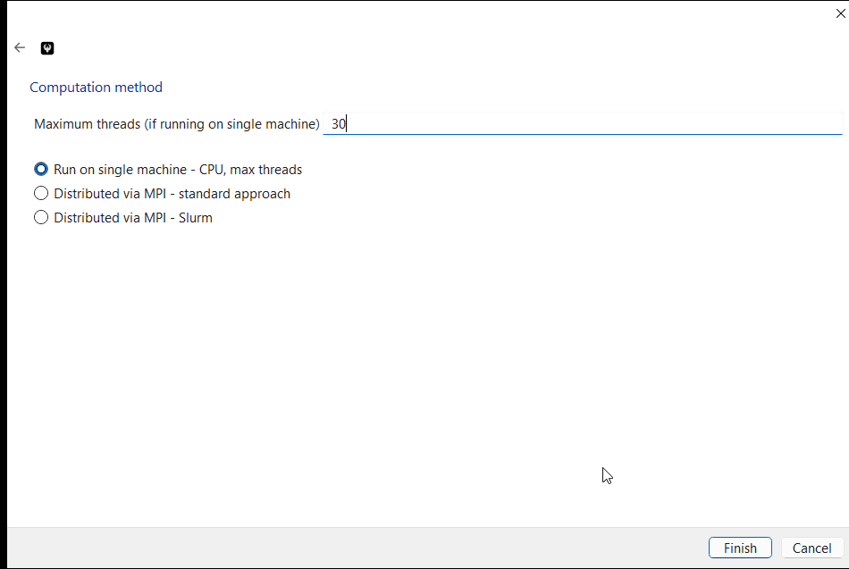
Inversion
If running locally be sure to specify the number of threads
Selecting one of the MPI options will open another dialog

Slide 18
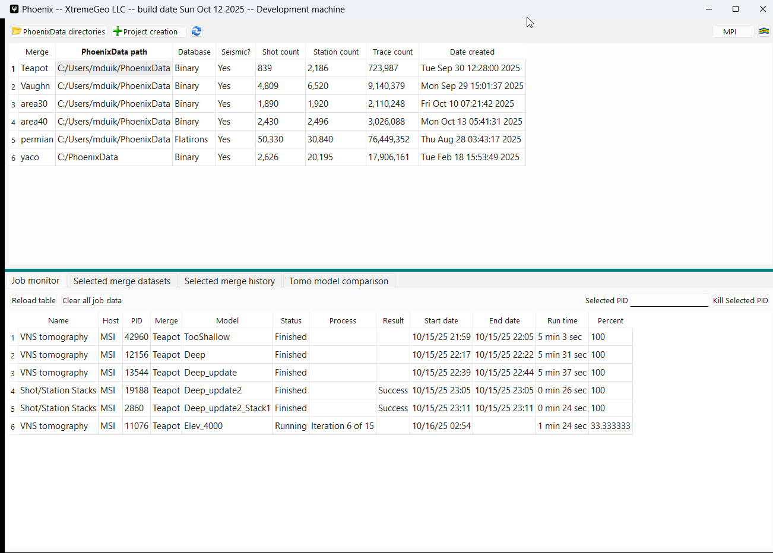
Inversion
The inversion runs as a batch job

Slide 19
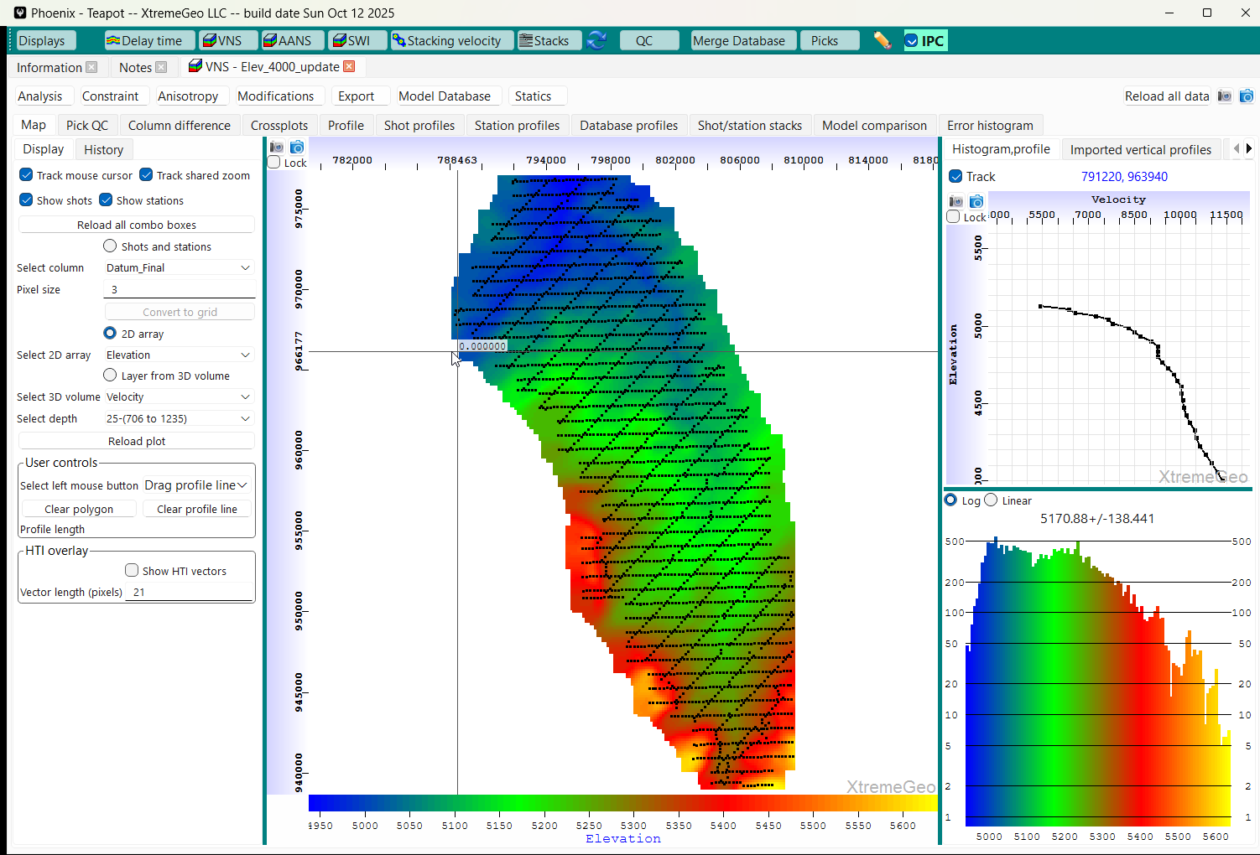
Open the new model
Click “VNS” → “Reload list of models”
The click “VNS” and select the new model
The next step is to QC the model…

Slide 20
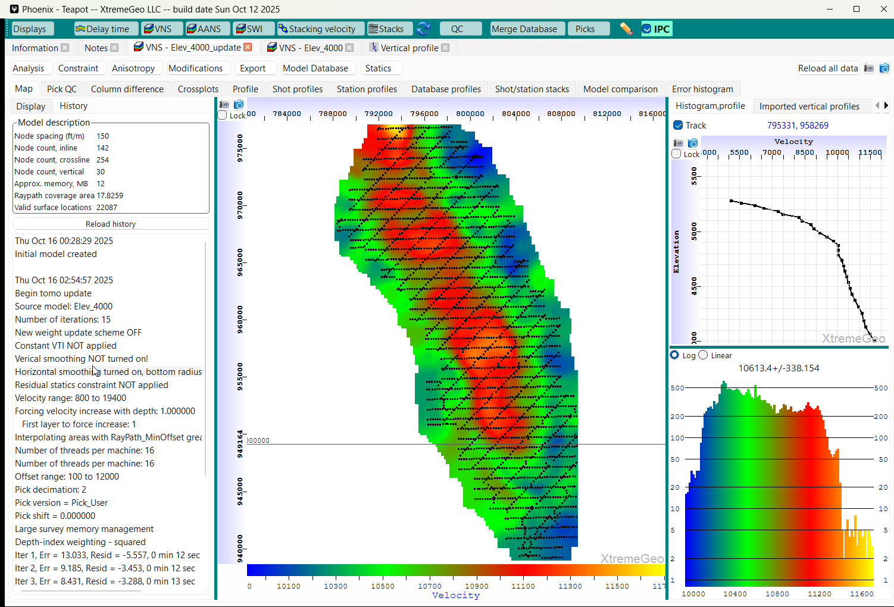
View the model history

Slide 21
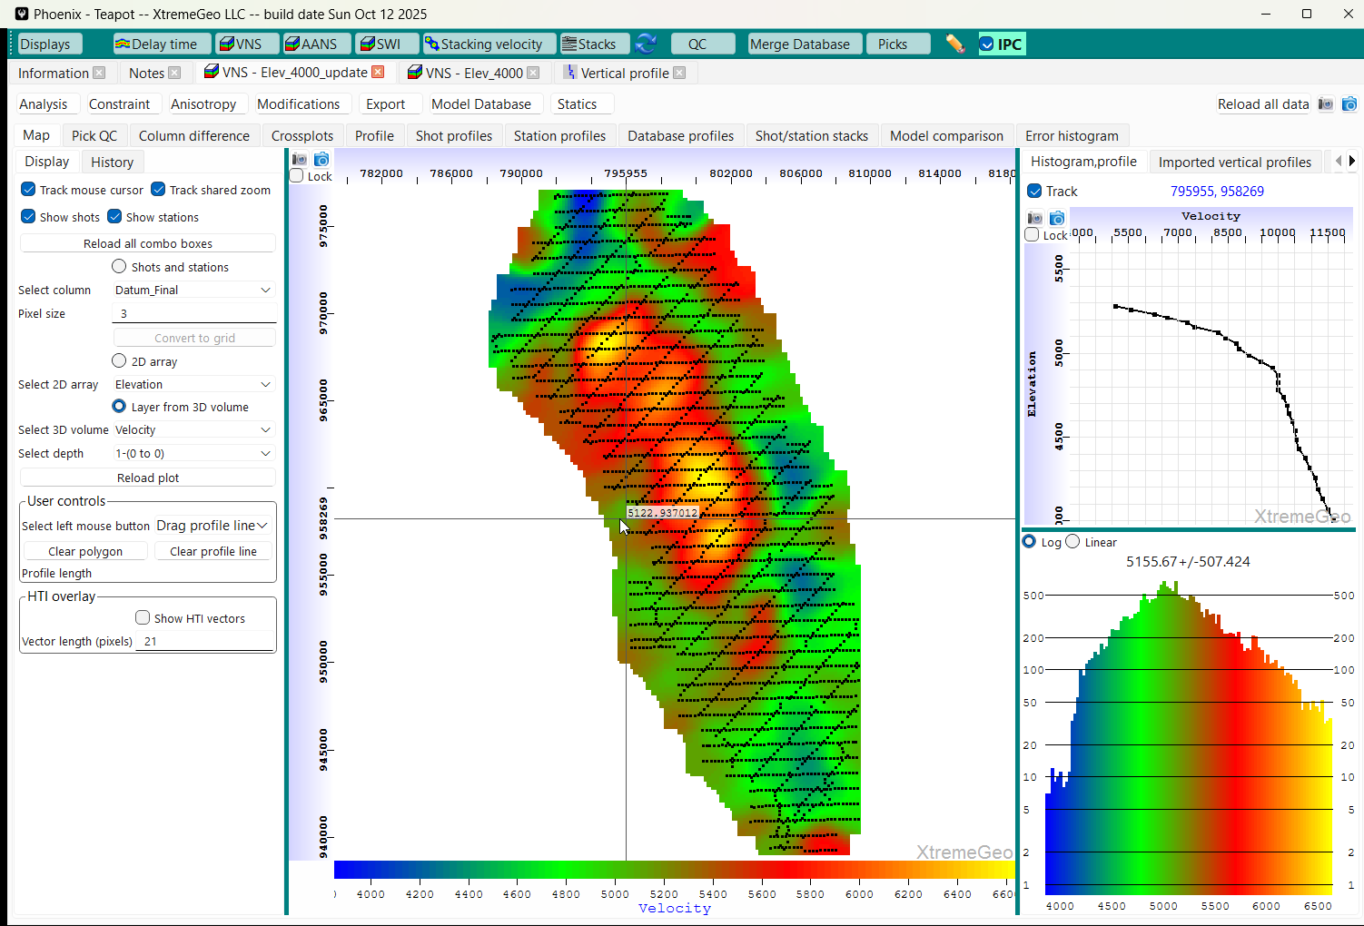
View the velocity field at several depths
Select “Layer from 3D volume”
Then view different depths

Slide 22
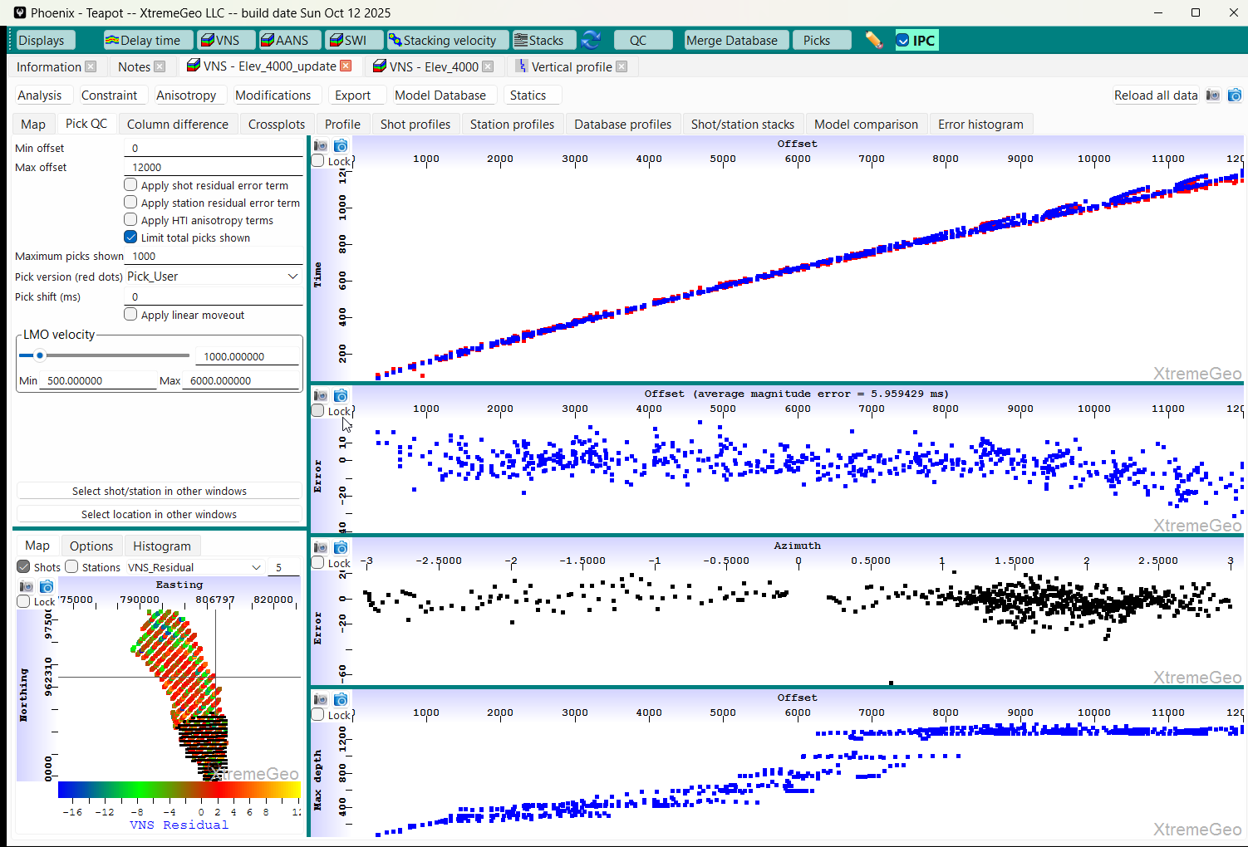
Pick QC display
Red are user picks, blue predicted by tomo
Select the “Pick QC” tab
Select the pick version used to
run the inversion
Color the basemap by the
VNS residual error term

Slide 23
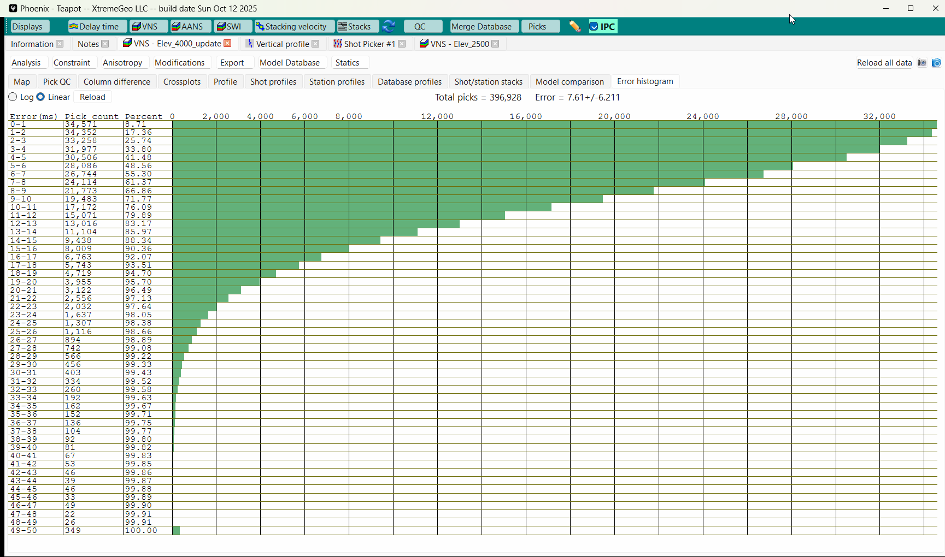
Error histogram
Note the Average Error is 7.6 Milliseconds

Slide 24
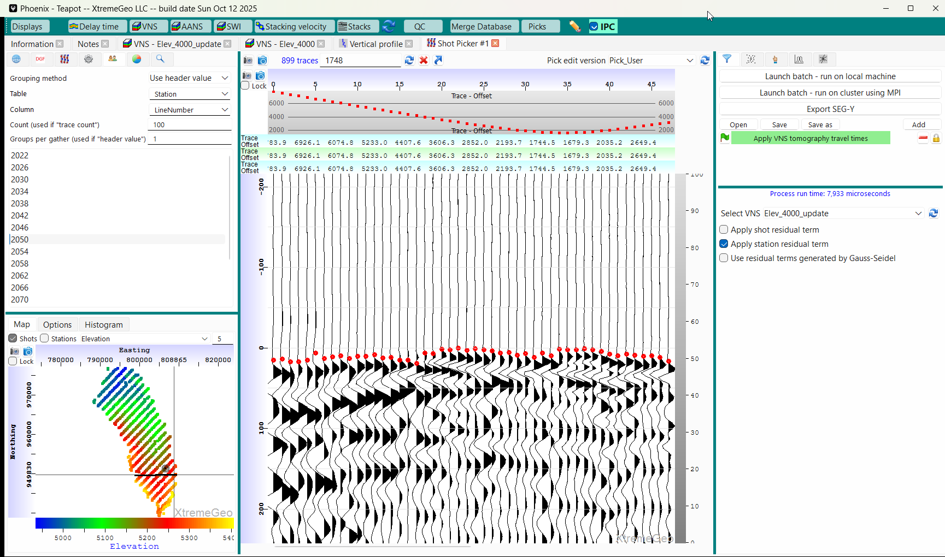
Shot picker QC -
Open a new Shot picker display
In the flow builder add “Apply VNS tomography travel times”, found under the “Moveout options”
Experiment with the residual terms
Under the basemap “Options” tab select the VNS model, then color by the VNS error term
View several shots

Slide 25
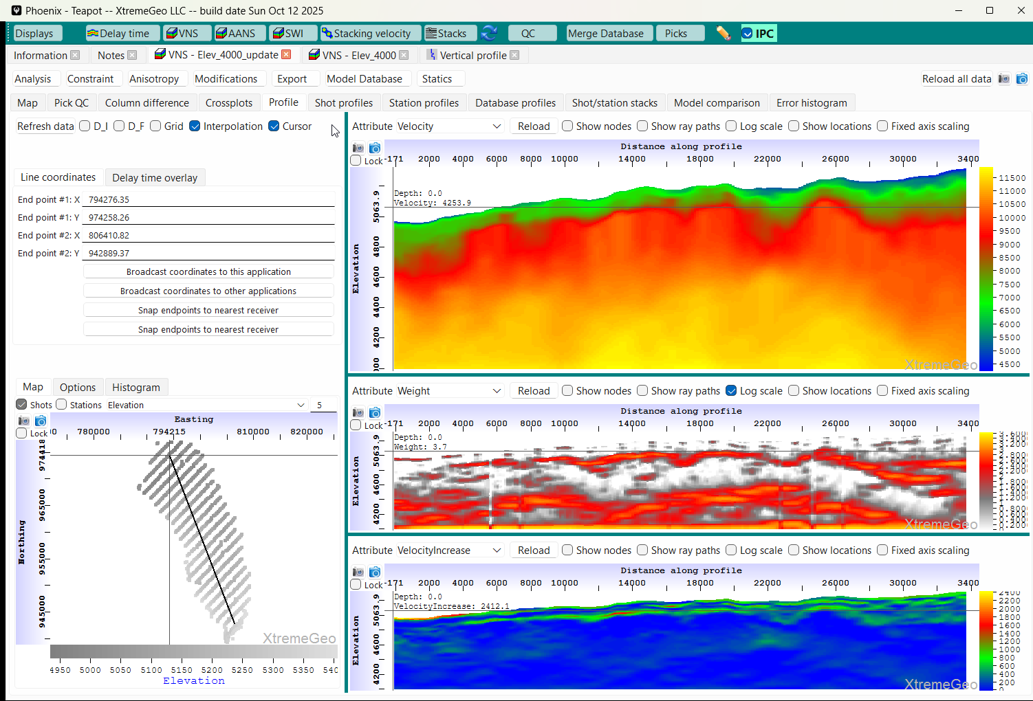
Profiles
Select the “Profile” tab
This is a serious issue – the raypath coverage is very high along the
bottom of the profile. This means the model is not deep enough!!!
We need to create a new model…
The “Weight” attribute shows raypath coverage. Be sure to select “Log scale”
Left-click and drag profile lines

Slide 26
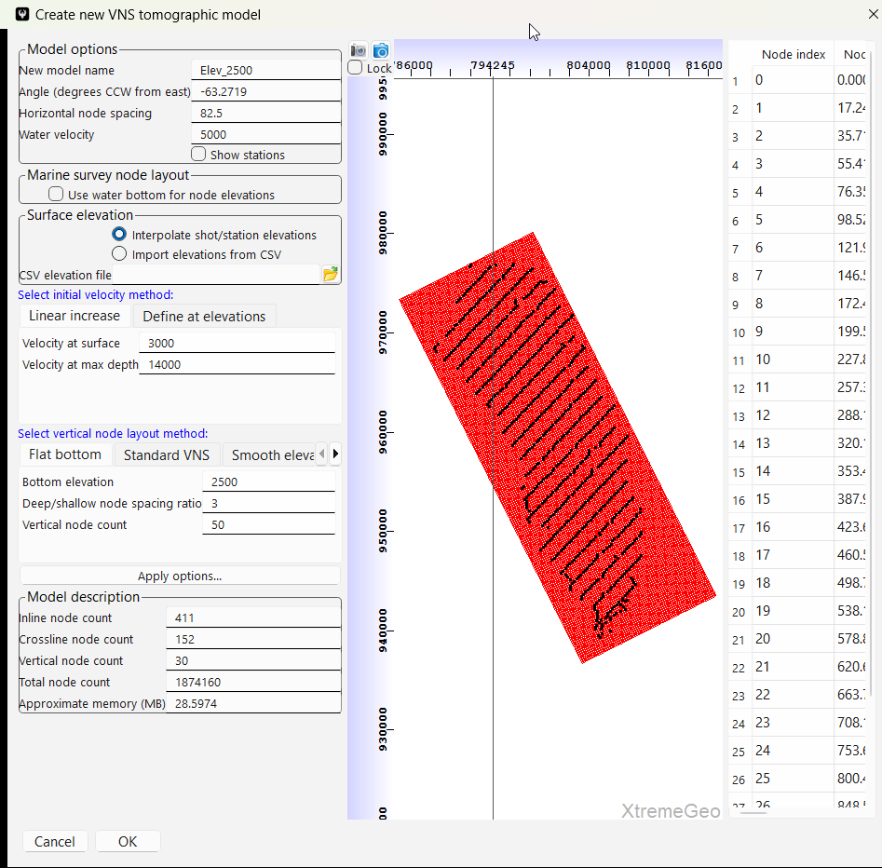
Initial model not deep enough!
Create a new model
Reduced horizontal node spacing to 82.5 feet
Increased vertical node count to 50
Decreased bottom elevation to 2,500 feet (from 4,000 feet)
After creating the model run an inversion
using the same options

Slide 27
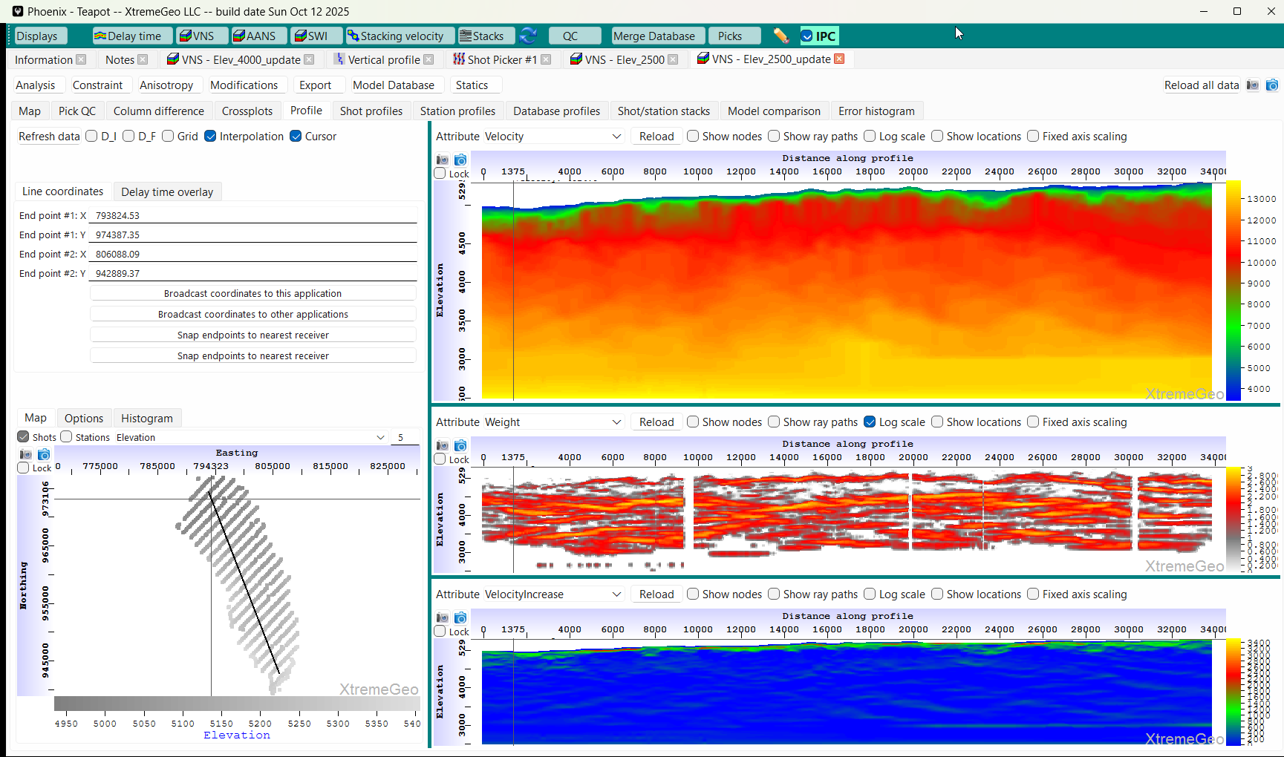
Open the new model and select the Profile tab
Note that the raypaths did not reach the bottom of the model – good news!
The lowest valid elevation is about 3,000 feet. The intermediate datum should not be less than that.

Slide 28
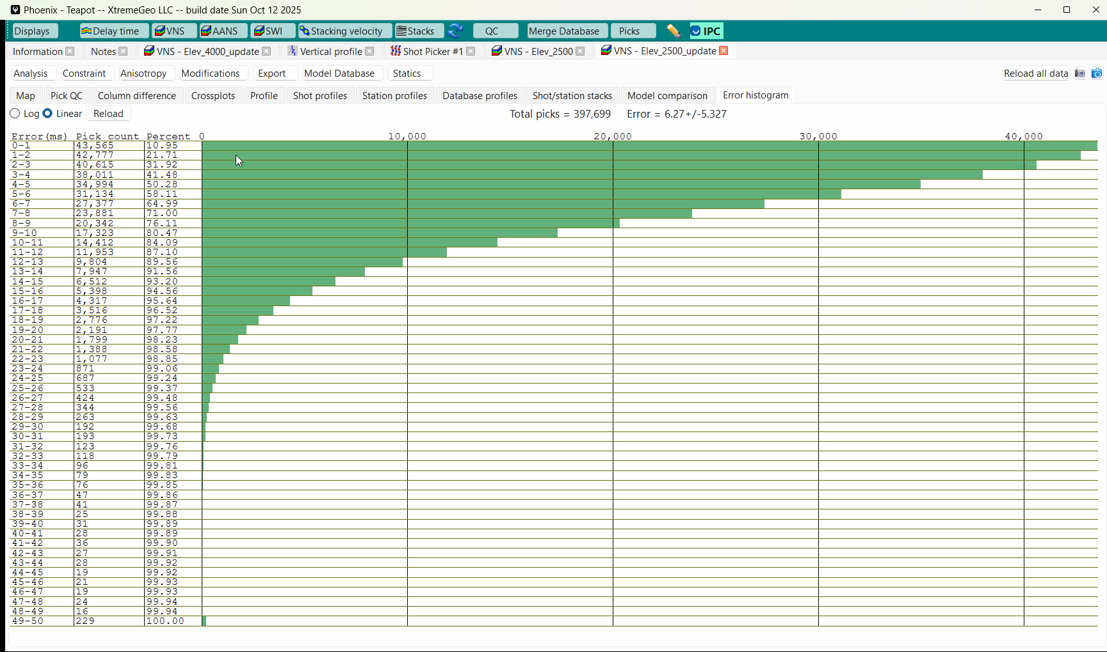
Histogram plot of new model,
Error Reduced to 6.3 Milliseconds

Slide 29
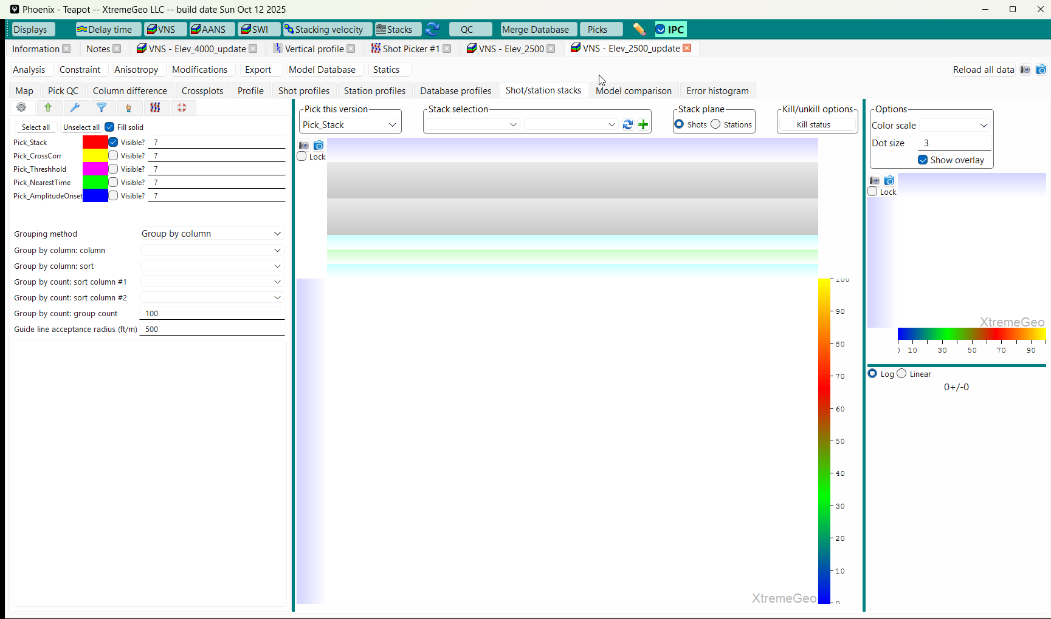
Create shot/station stacks as a final QC and to optionally update the shallow velocity field
The new model looks better
Select the Shot/station stacks tab
Then click the green “+”

Slide 30
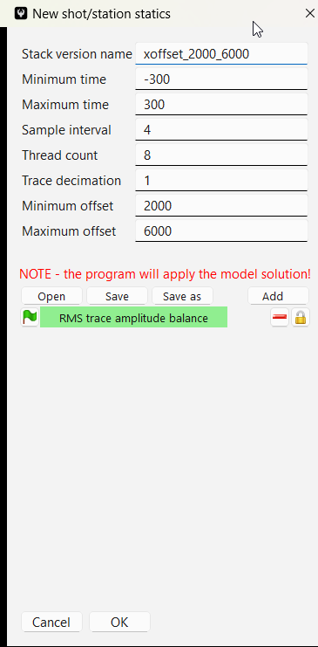
Stack options
You will likely have more than one stack, so use a descriptive name
The stack runs on the local machine as a batch job, the more threads the better
A decimation of “1” means no decimation!
Select an offset range
The Residual term is NOT applied
when creating the stacks!!

Slide 31
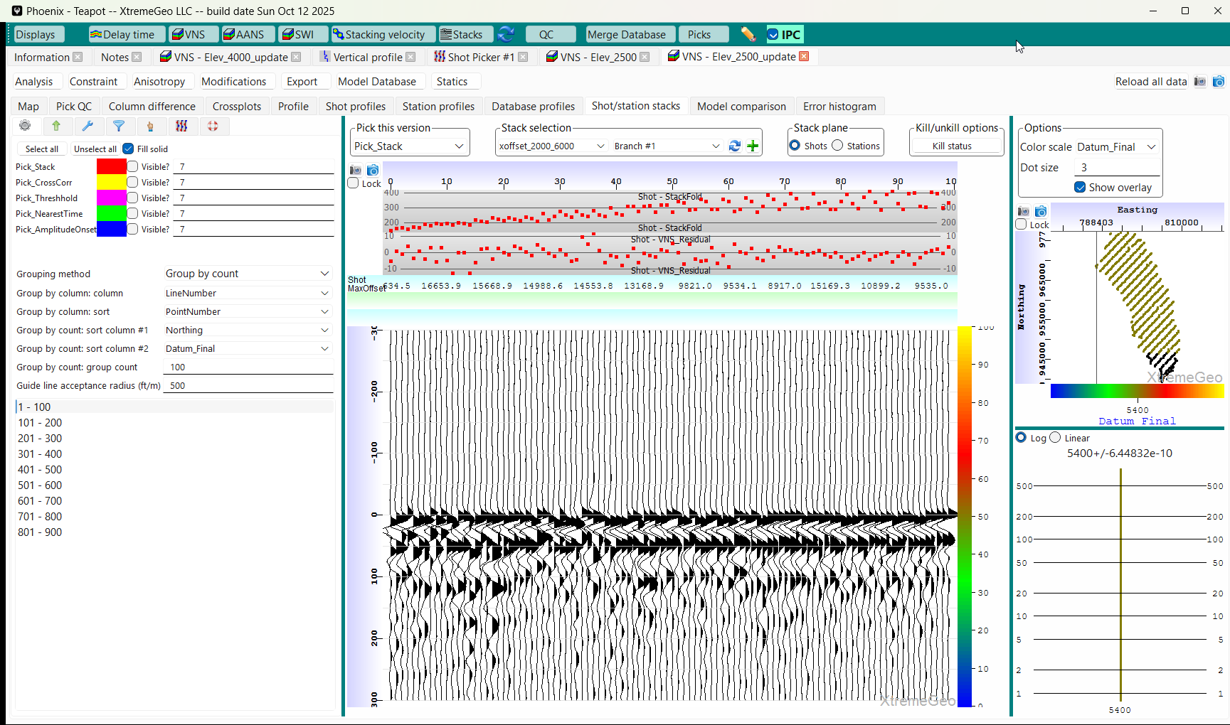
Stacks
Short wavelength variation is mostly caused by unresolved very shallow velocity field
Experiment with different
grouping methods

Slide 32
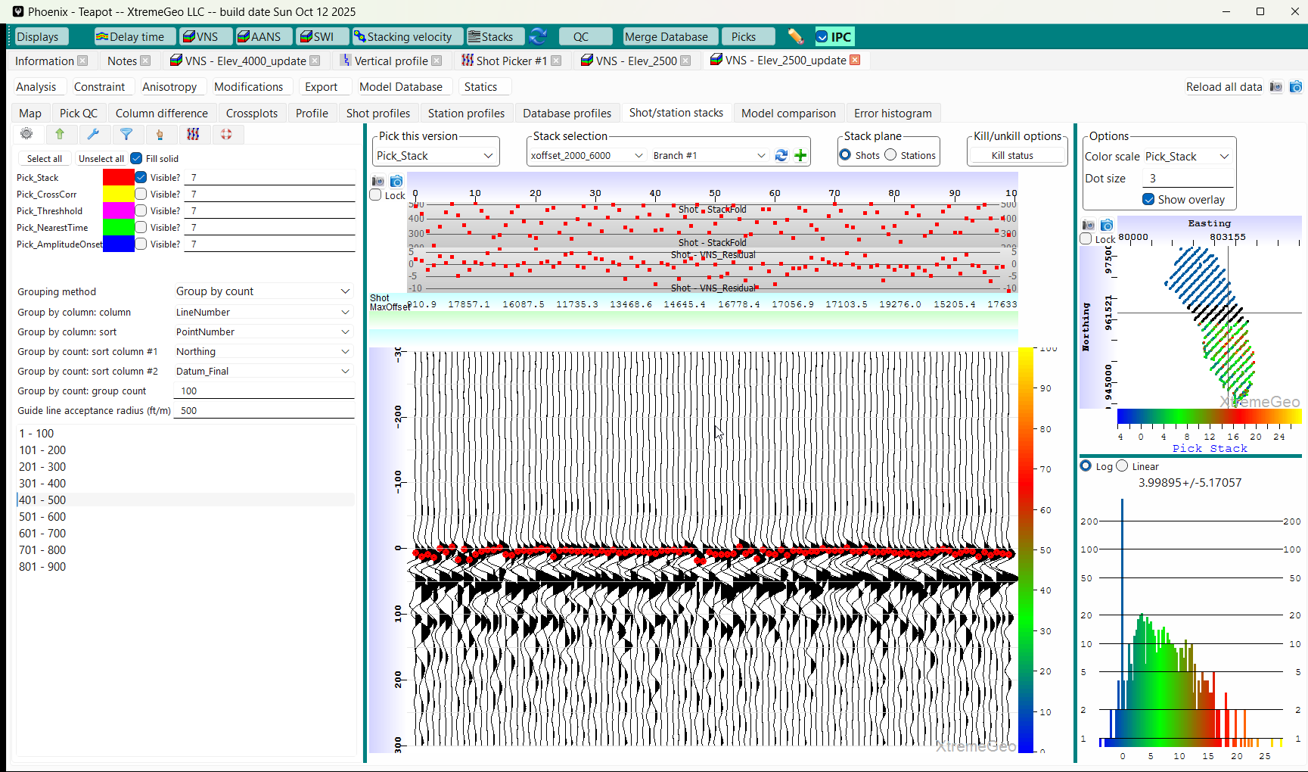
Pick the stacks
The pick times are a measurement, in milliseconds, of the
error of the shallow velocity field

Slide 33
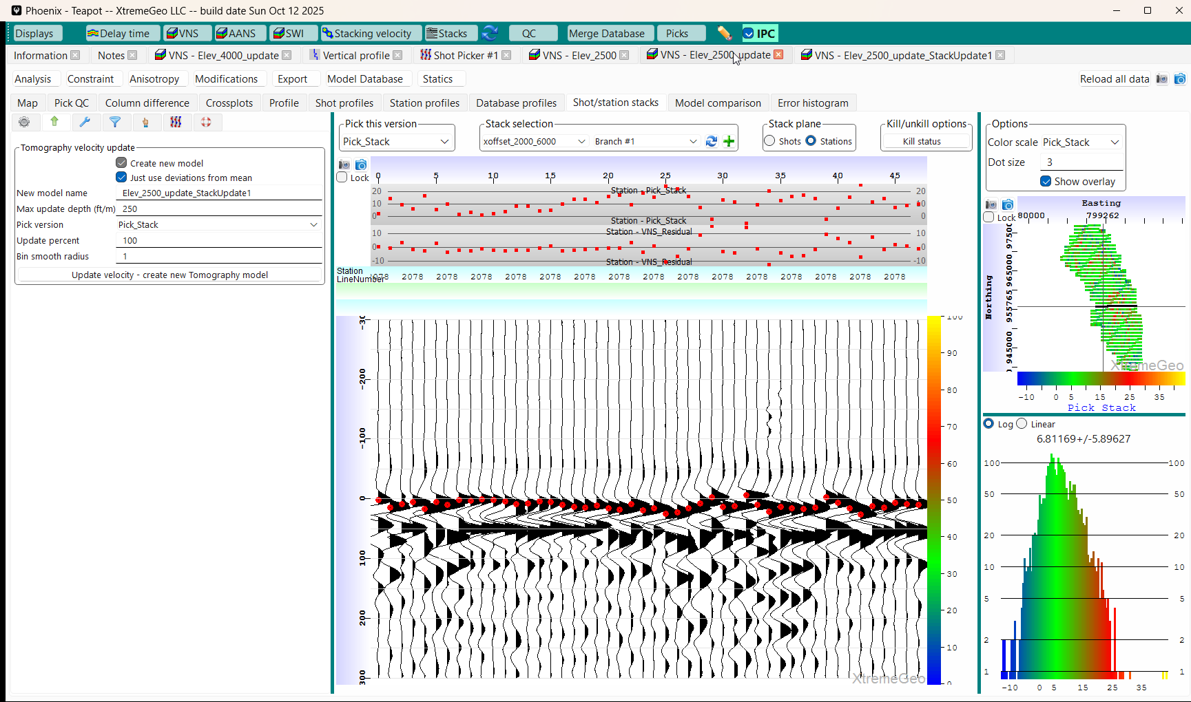
Create a new model
Modify the Velocity Field Using the Stack Pick Times
Select the update tab
Give the new model a name
Select the “Just use deviations from mean” to avoid bulk shifts.
Select a modification depth. Phoenix will compute a modification to the velocity field at each shot and station that accounts for their pick times, and blend that change into the model

Slide 34
Open the new VNS model
We expect that the stacks on the new model will have fewer short wavelength artifacts
Reload the list of VNS models and open the new model
QC the new model –
View the velocity field on the map
Pick QC display
Create shot/station stacks
Then pick the stacks again

Slide 35
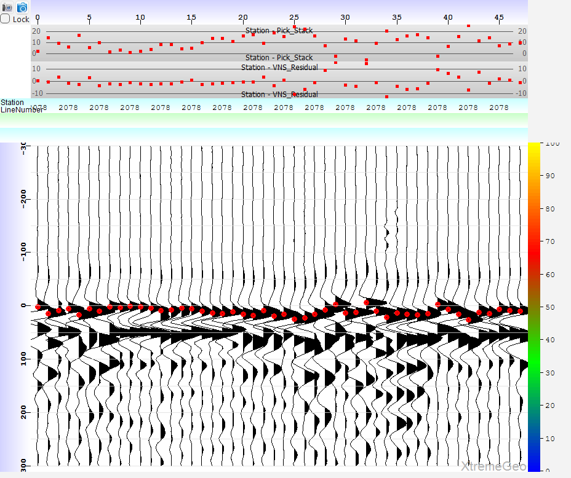
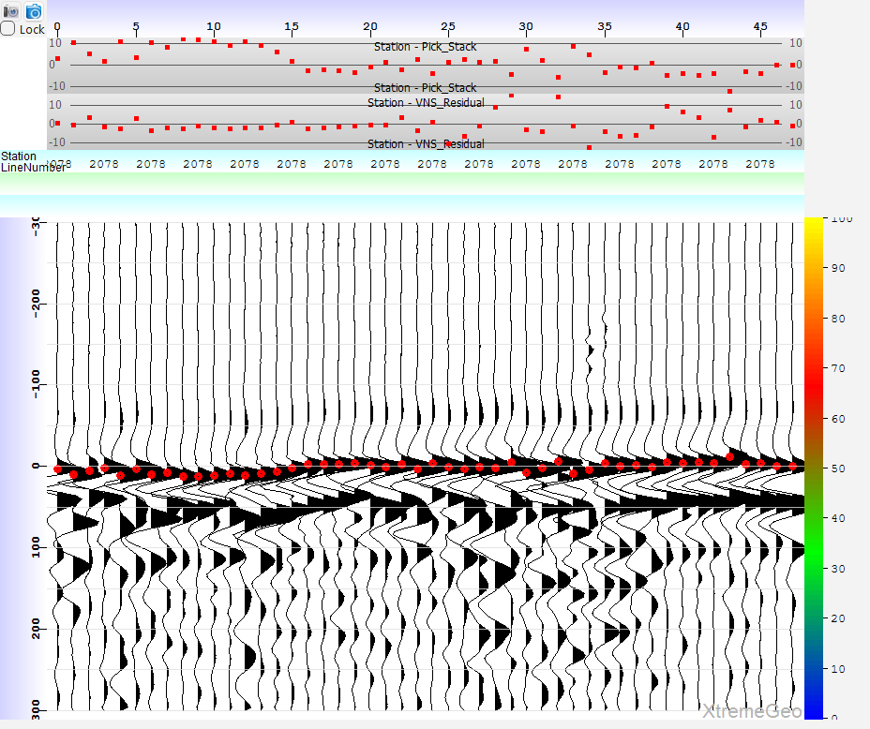
Stack comparison on receiver line 2078
Initial stacks
After velocity update

Slide 36
Comment
The new model might do a better job estimating the shallowest layers and produce flatter stacks
But this is no guarantee that it will produce better statics!

Slide 37
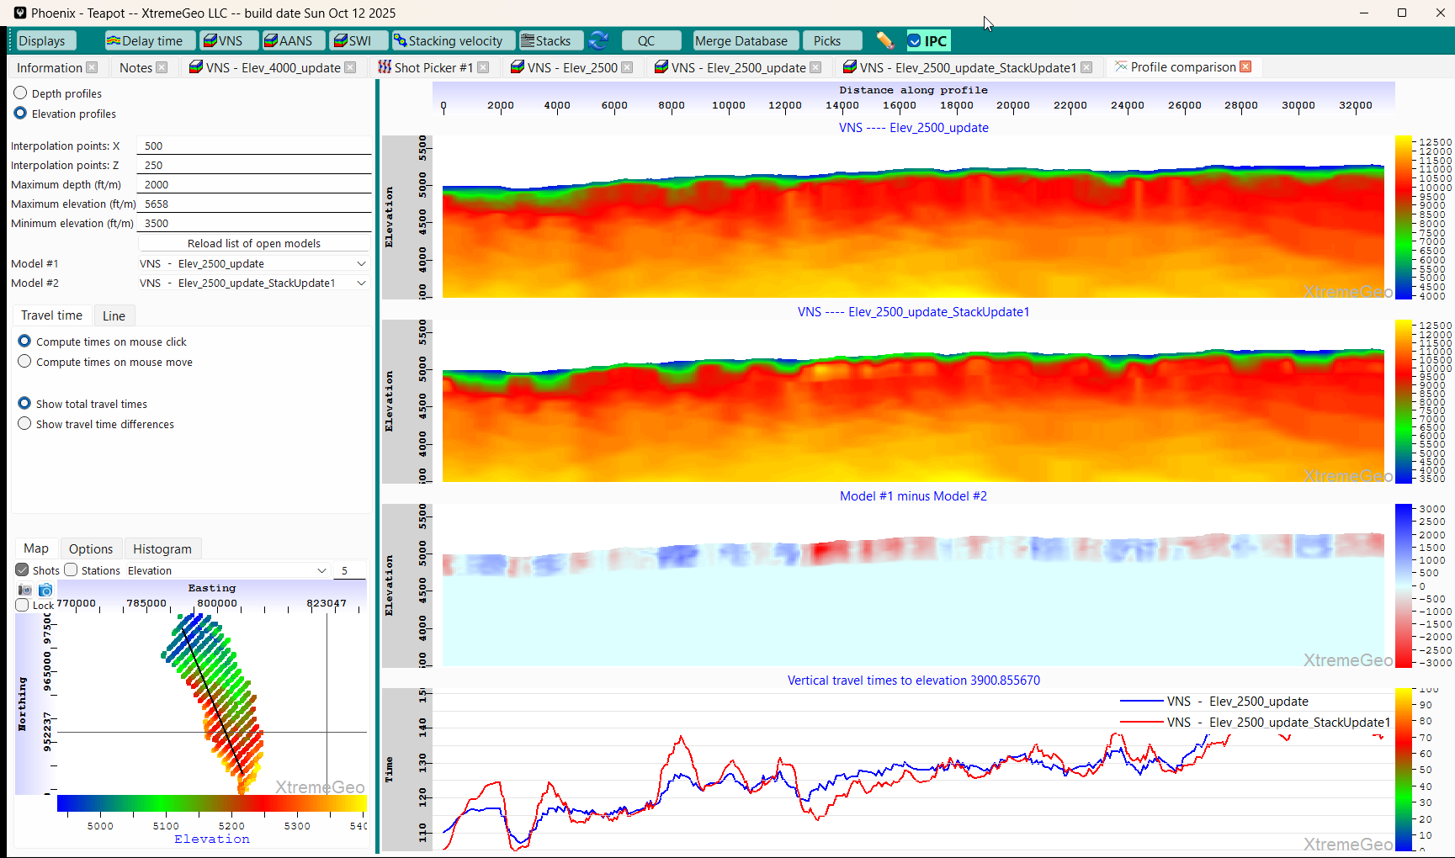
Comparing models in profile view Select “Displays” and select “Profile comparison display”
Choose “Elevation” profiles
Select the two models of interest
Left-click and drag profiles on map

Slide 38
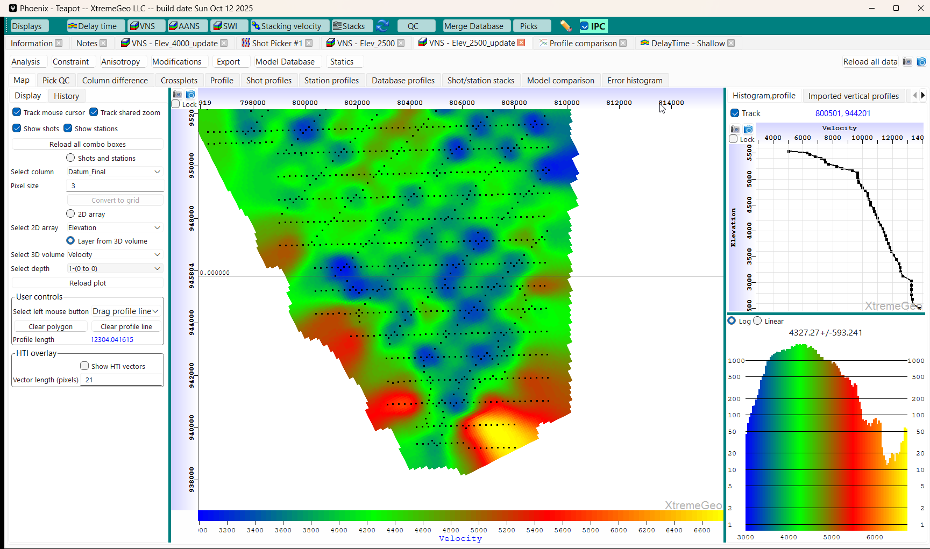
Model editing using polygon
Note that the velocity field at the surface
is very large.
This error is caused by lack of low offset
traces

Slide 39
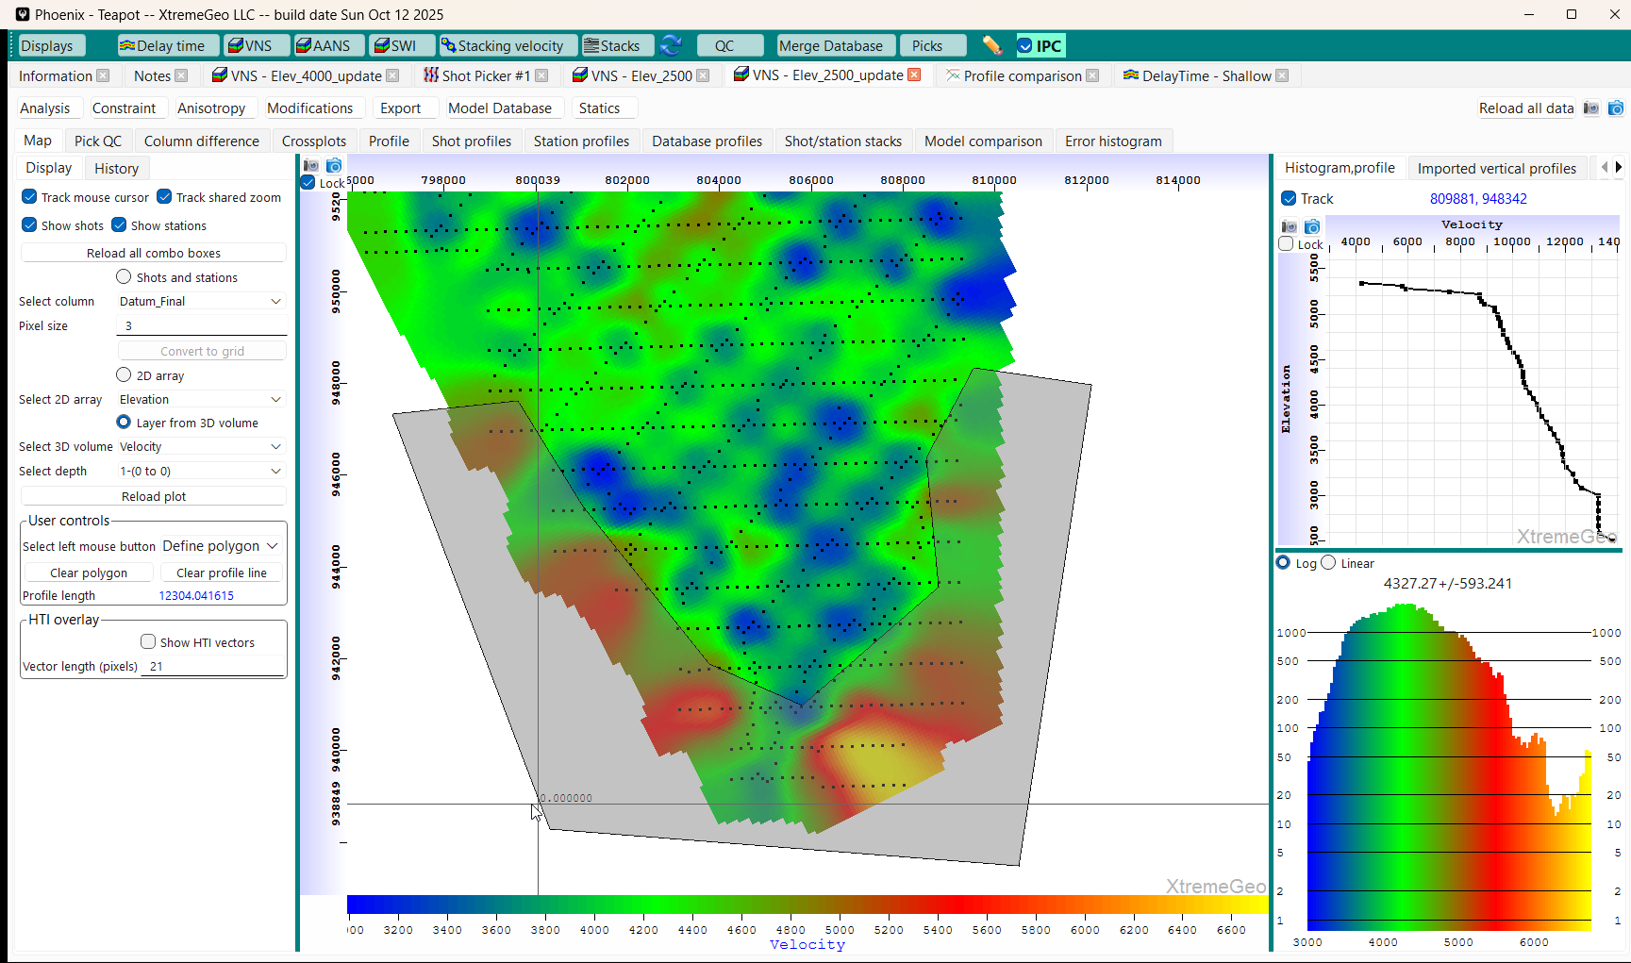
Model editing using polygon
Select “Define polygon”
Then surround the bad zone with a polygon

Slide 40
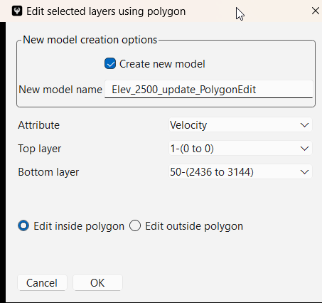
Model editing using polygon
Click “Modifications” → “Polygon edit – any attribute”
Be sure to create a new model!!!
Select the attribute, Velocity in this case
Choose “Edit inside polygon”
After clicking “OK” reload the list of VNS models and open the new model

Slide 41
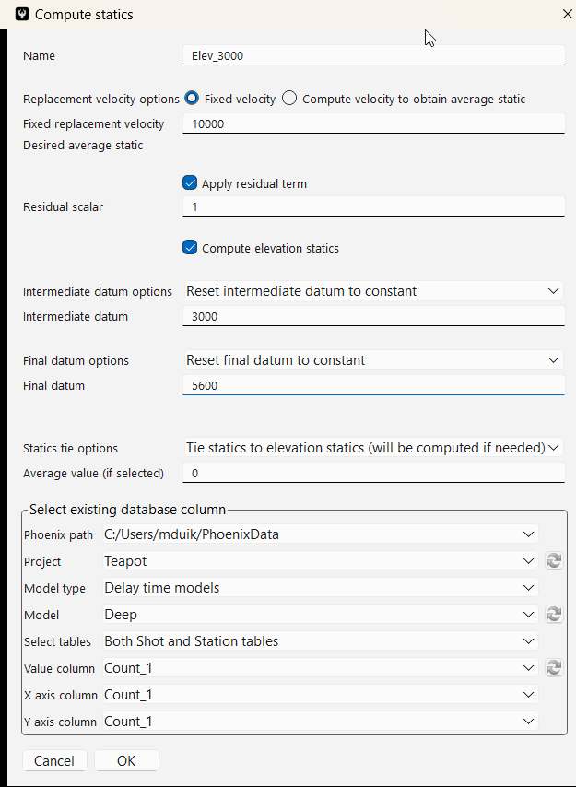
Statics computation
Navigate back to the VNS model window and select “Statics” → “Shortcut”
It is usually a good idea to tie the statics to the elevation statics – this ensures that the two fields have the same average value, making stack comparisons easier

