Slide 1
Pick-free Delay Time Analysis
Phoenix Training
XtremeGeo LLC
Fall 2025

Slide 2
Procedure
Create a new delay time model
Define refractor offset ranges (AKA branch assignment)
Interpolate the branch velocities and delay times to the shots and receivers
Create shot/station stacks using the current delay time solution
“Pick” the stacks
Update the delay time field using the picks
Satisfied with the stacks? If not, back to step 4
Generate a delay time model in the usual way

Slide 3
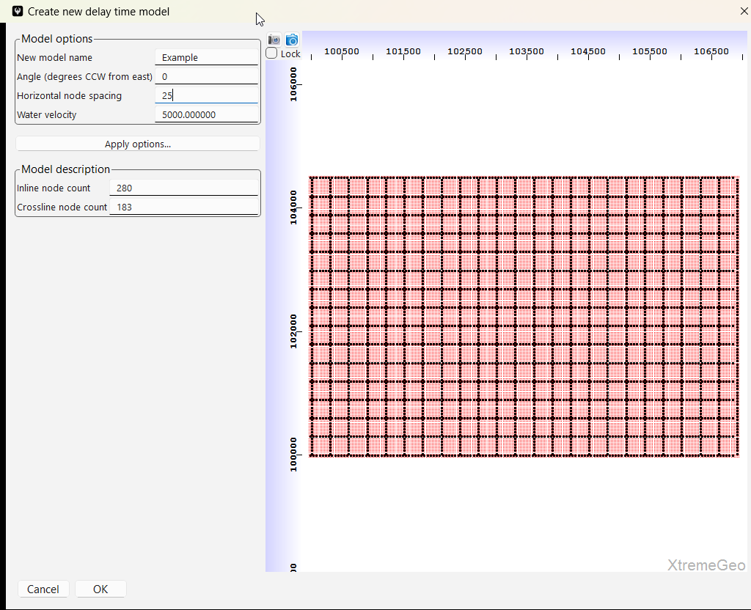
Create a new delay time model
Open the merge window
Select “Delay time” ➔ “Create new delay time solution model”
Aside, you will likely have more than one delay time model!
Give the model a name
The node spacing isn’t terribly important, it’s just used for interpolation and smoothing
You might want to click and drag a line on the basemap to define the angle

Slide 4
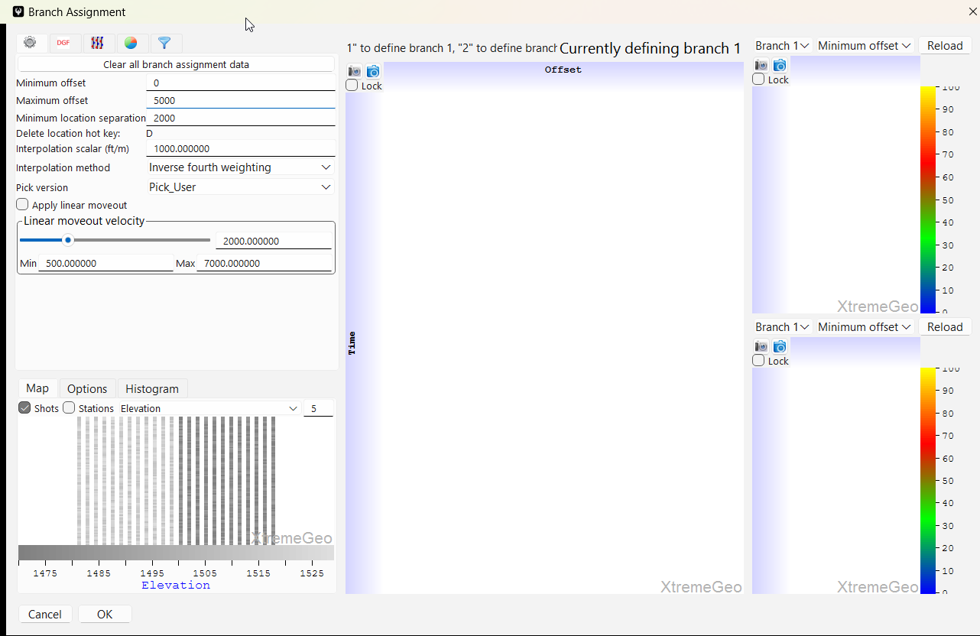
Branch assignment
Make sure the delay time window is open and click “Branch” →“Open branch assignment dialog”
Change the location separation to “2000”
Be sure to select “Apply linear moveout”
Select a shot

Slide 5
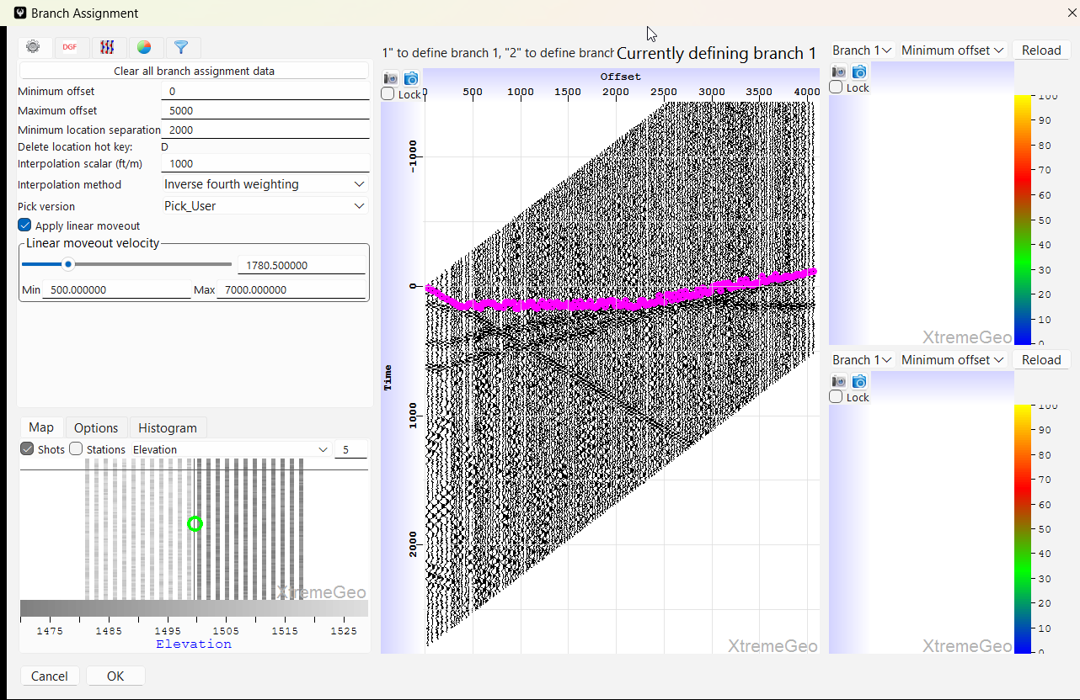
Branch assignment
Drag the slider until the first arrivals of the
refractor of interest are flat
Next, left-click and drag on the time axis to
zoom in to the first arrivals
The mouse wheel may be used to scroll the
time axis up and down

Slide 6
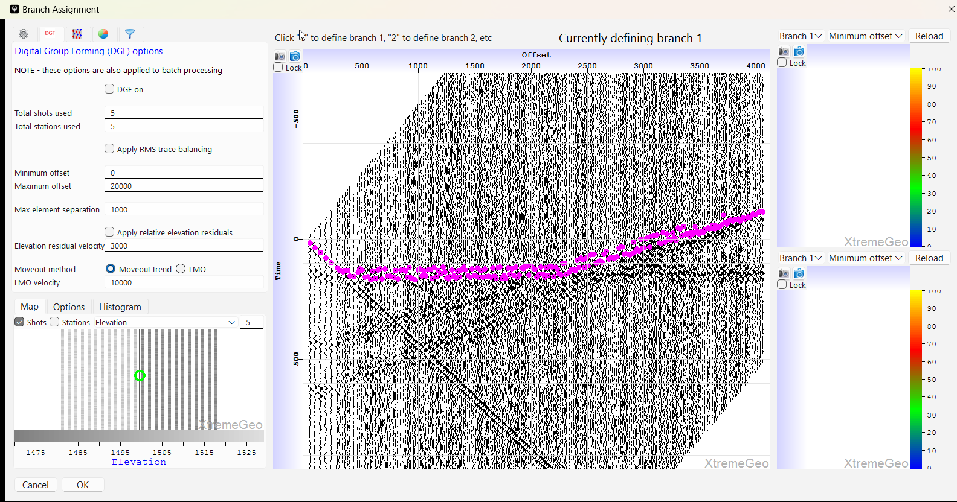
Branch assignment
Applying DGF may help with noisy data

Slide 7
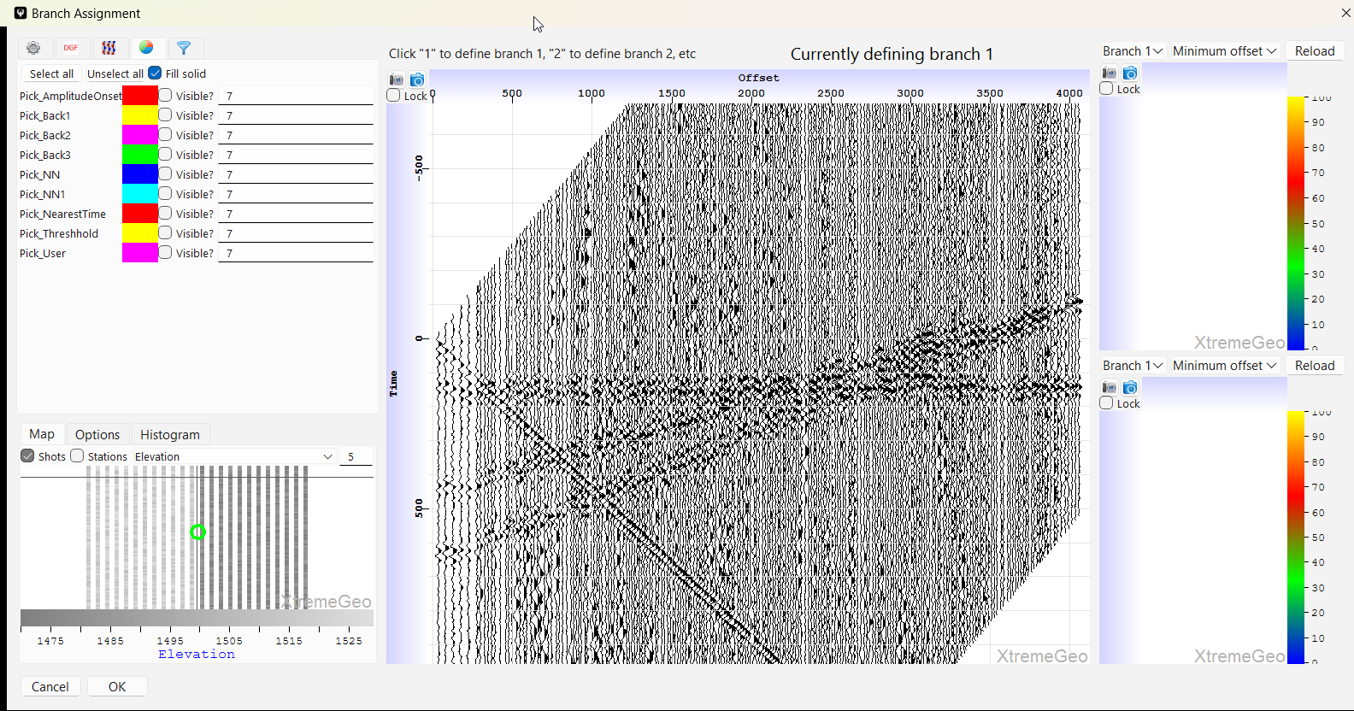
Branch assignment
For this exercise, turn off all picks

Slide 8
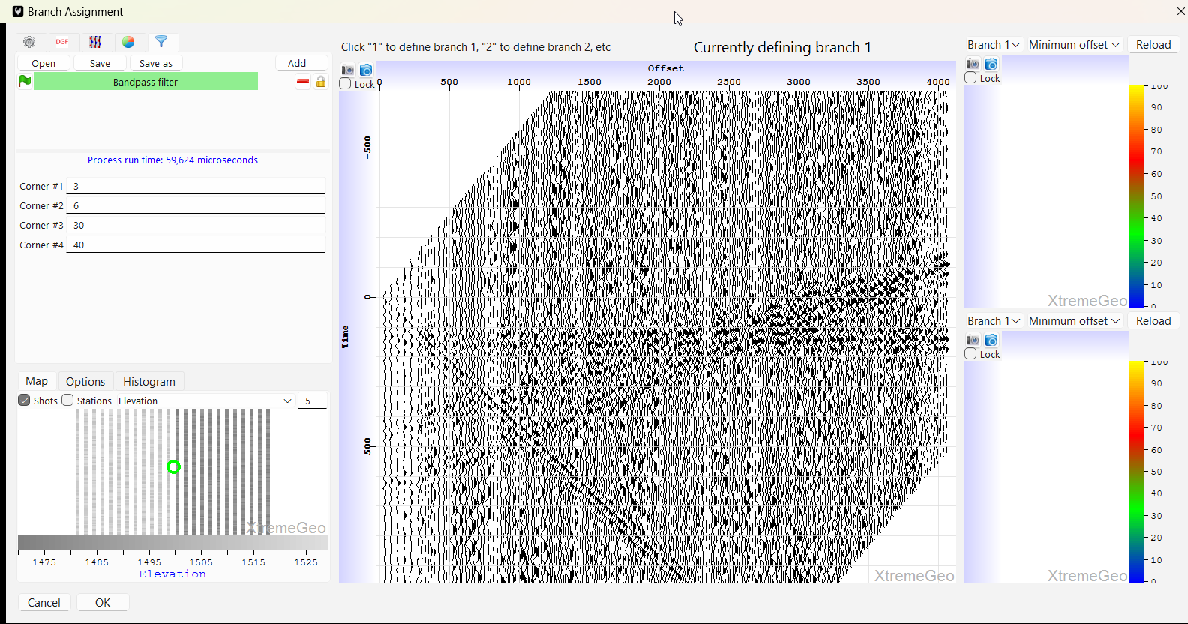
Branch assignment
Applying AGC and/or filters may help make first arrivals more clear

Slide 9
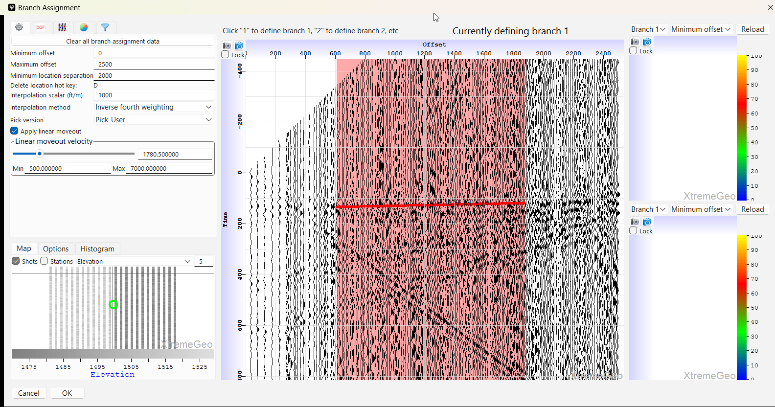
Branch assignment
Define the offset range – left-click and drag on the first arrivals
Be sure to not cross any refractor boundaries!
Try to be consistent and always choose either peaks or troughs
In addition to selecting an offset range you are also defining a refractor velocity and delay time field!
This field will be interpolated to the shots and receivers

Slide 10
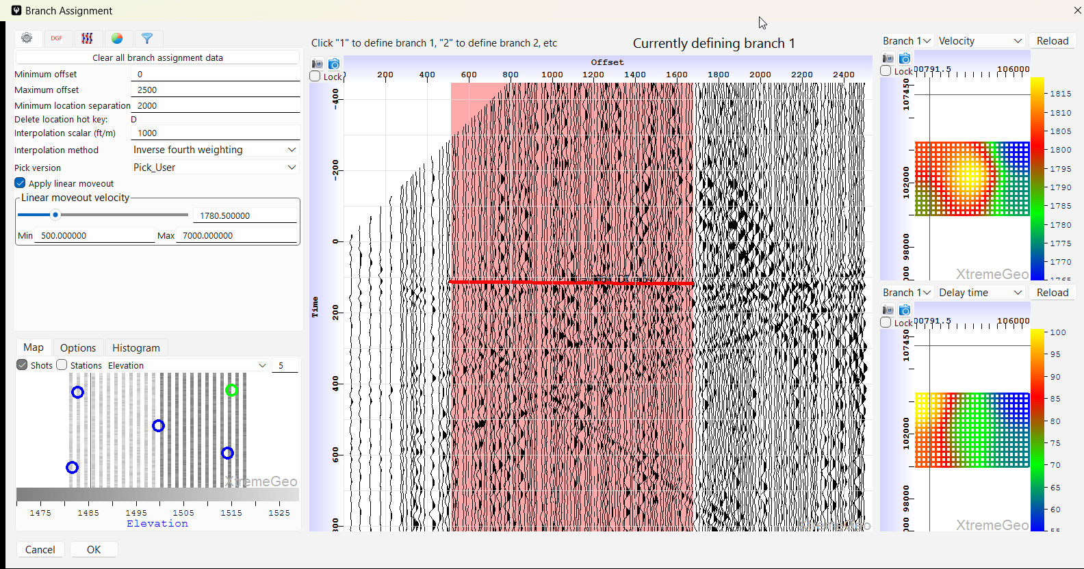
Branch assignment
Select several shots across the survey to make sure the selected refractor is somewhat consistent
In the basemaps on the right select “Velocity” for the top plot and “Delay time” for the lower. The plots don’t reload automatically, click “Reload” when a refresh is needed
This initial solution will be interpolated to the shots and receivers
When satisfied, click “OK”

Slide 11
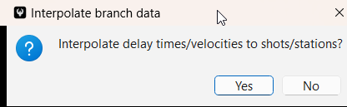
Branch assignment
Be sure to select “Yes”!
This step may take a few seconds for large surveys
Each shot and station will have a refractor velocity and delay time
The delay time values will be incorrect at this point
Use stacks to “fix” the delay times!

Slide 12
Create a shot/station delay time stack
Output – a stacked trace for each shot and station
Procedure:
  For each shot and station, select all the traces within the refractor offset range
  For each trace compute the travel time. The travel time is a function of the refractor velocity at the shots and receivers, the shot and receiver delay times, and any uphole/marine correction terms.
  Shift each trace by its travel time
  Stack the traces
Each stack contains a snapshot of the delay time solution used to create the stack
If the delay times are accurate the stacks will align on zero time.
A given delay time solution can have any number of stacks

Slide 13
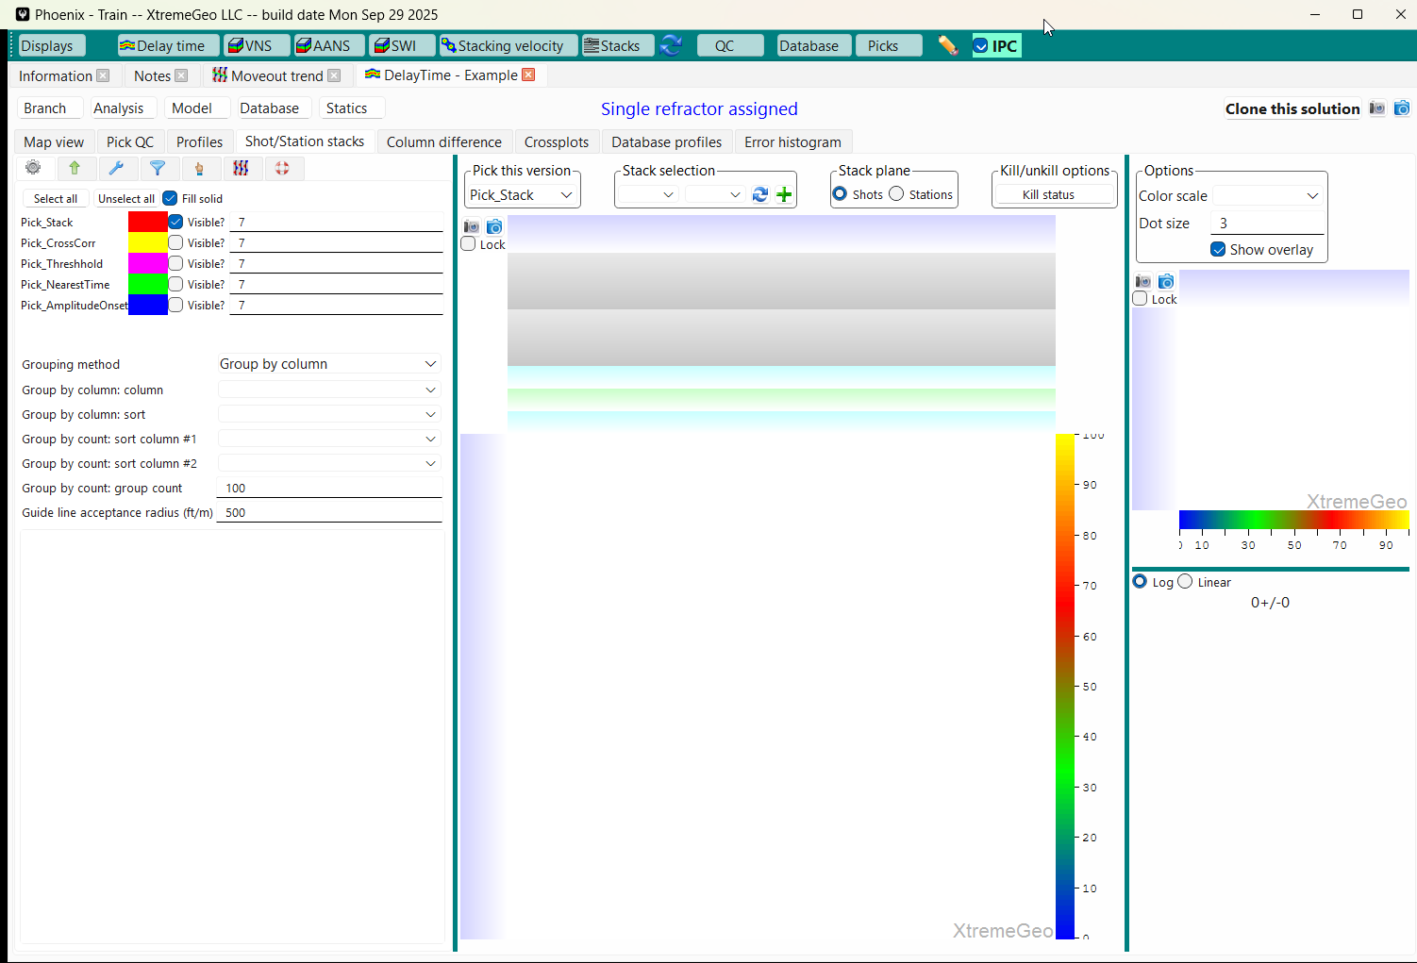
Create a shot/station delay time stack
Select the “Shot/Station stacks” tab
Next, click on the green “+” button

Slide 14
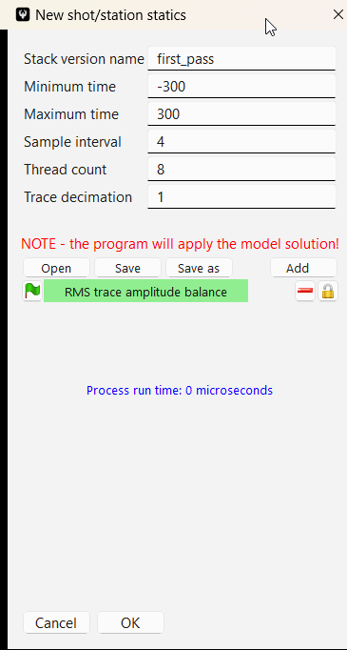
Create a shot/station delay time stack
Give the stack a name,
The default time range and sample interval will usually be fine
Threading may help, although this process tends to be limited by how fast the data can be read from disk
Applying RMS trace balance may be a good idea

Slide 15
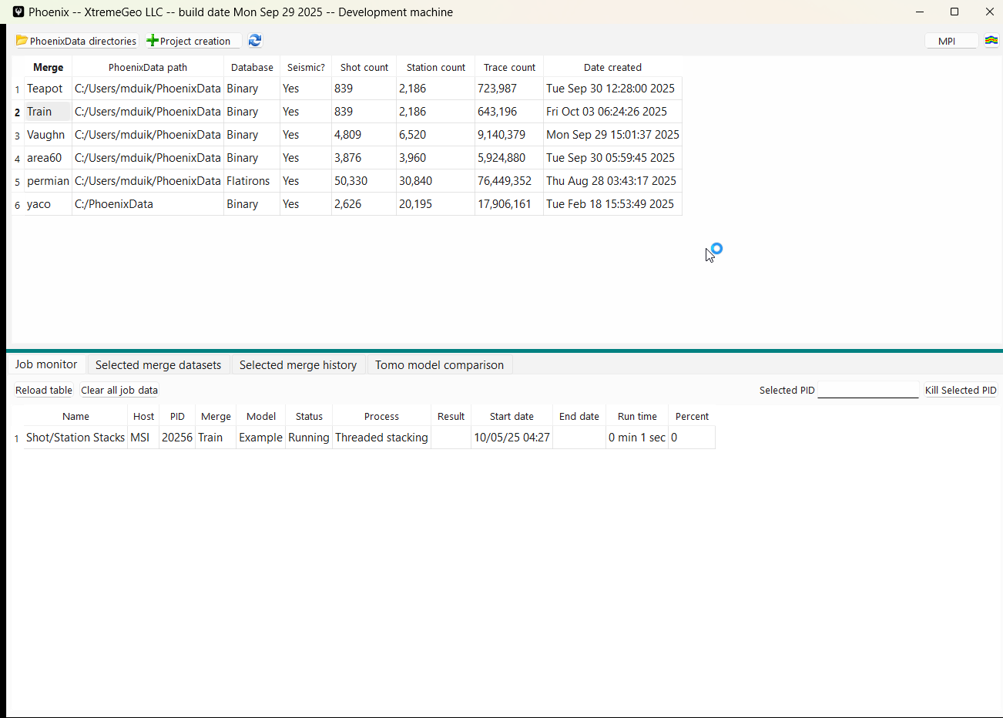
Create a shot/station delay time stack
Stacking progress may be
viewed in Phoenix

Slide 16
Picking the stacks
NOTE!!! In Flatirons, when a pick is made the delay times are immediately updated
Phoenix does not work the same way - users must explicitly choose to update the model delay time
There are several options for picking
  User picking. This option may be best to find and fix geometry issues such as polarity flips
  Threshold picker. This can save a lot of time on huge surveys, but the data must not be too “dirty”
  Pick event nearest time. Works great on later passes

Slide 17
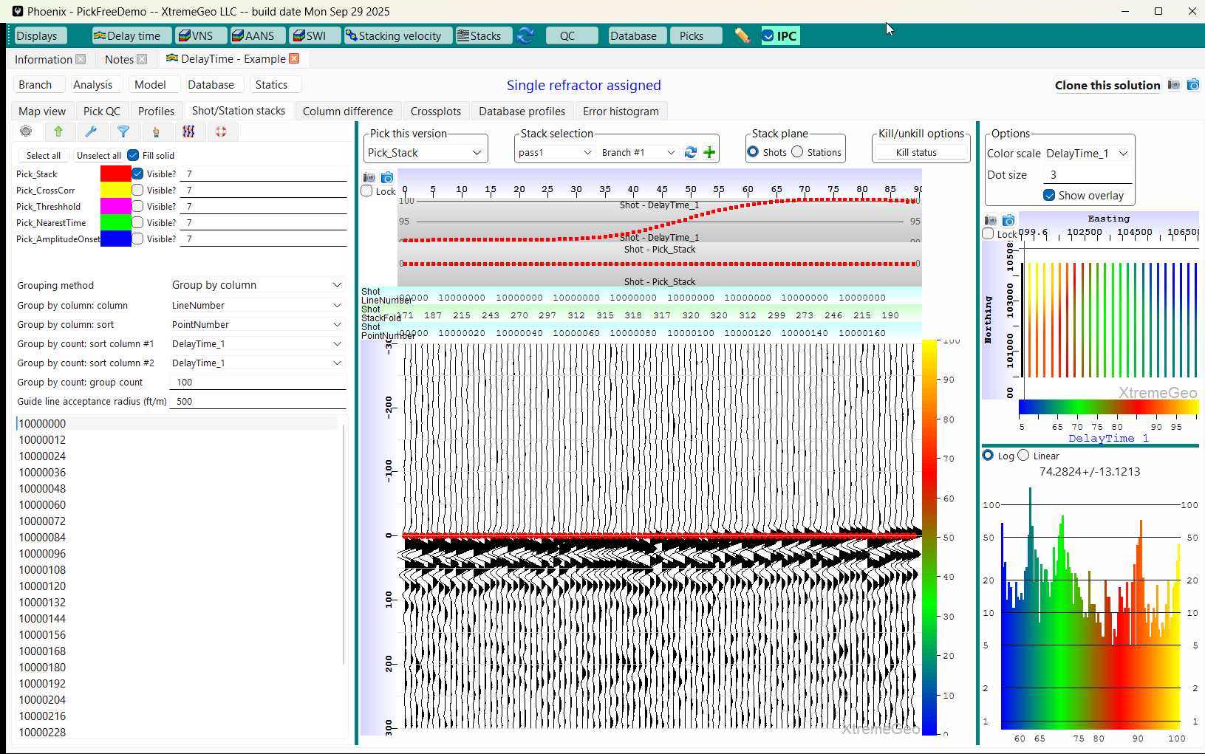
Picking the stacks
The “jitter” in the stack indicates error in the delay times
Remember that each trace represents on shot
For this survey, select “Group by column”
For most surveys “Group by column” is
the better option

Slide 18
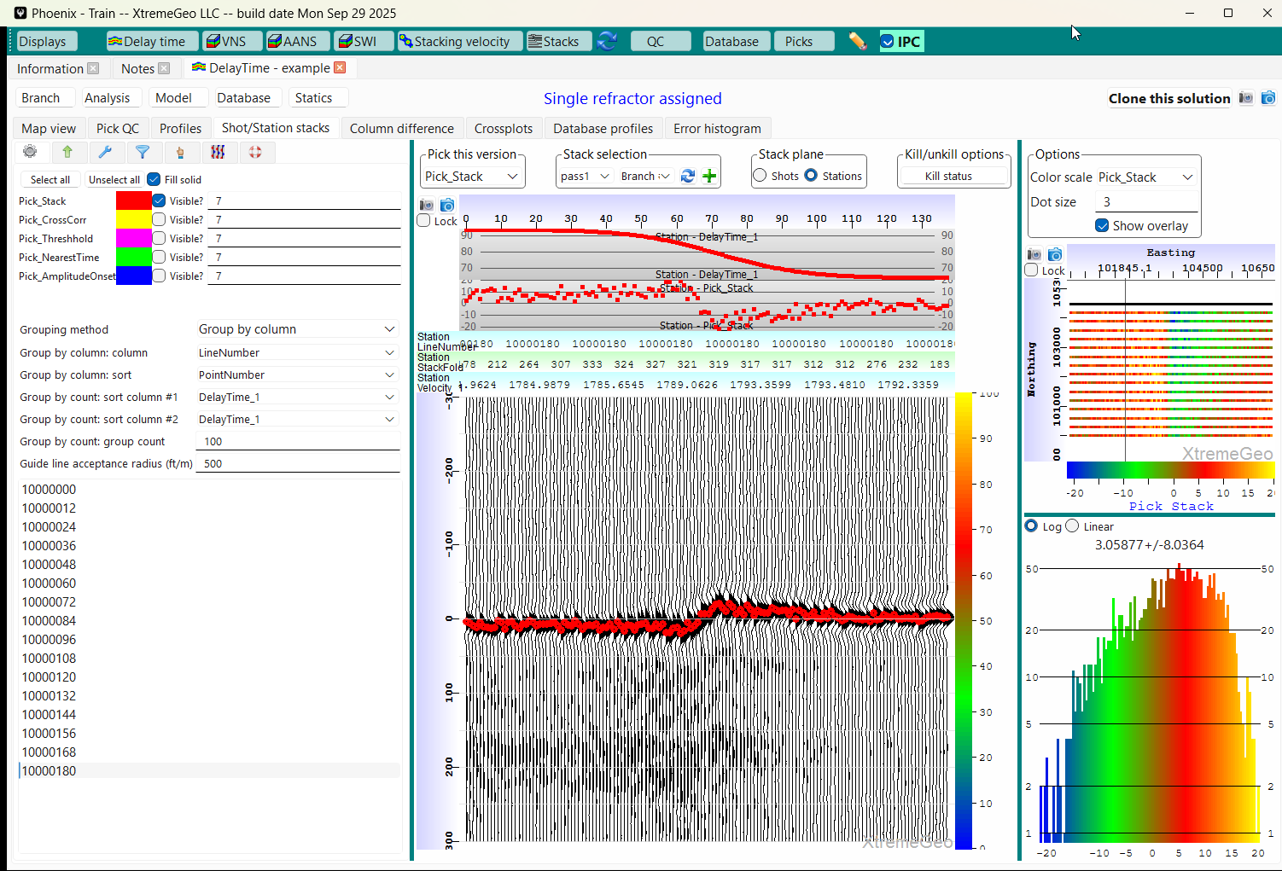
Picking the stacks
The station delay times failed to describe the elevation change
in the middle of the survey. This indicates that we need to
update the delay times with the picks
Pick both the shot and station stacks
The picker works just like the first break picker
All the usual hot keys function in this display

Slide 19
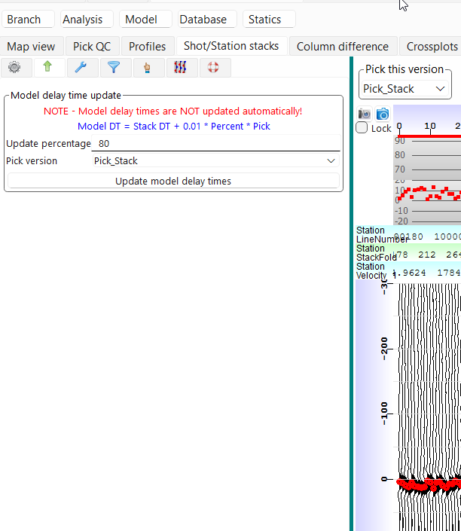
Update the delay time field
Select the update tab (the “up” arrow)
If desired, change the update percentage
Click “Update model delay times”

Slide 20
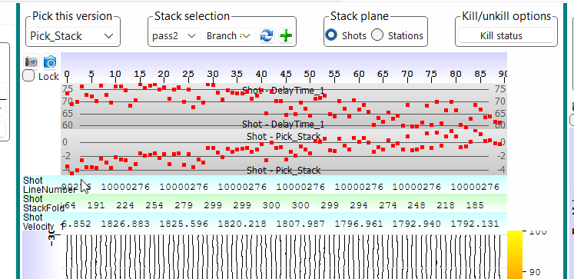
At this point you’re going to repeat steps you’ve already done
Create a new stack called “pass2”, although you can choose a different name
When the stacking process is done be sure to select the new stack
How does the new stack look? Flat enough?
If not, then pick the stacks, update the model delay times again, and go back to step 1 above

Slide 21
Delay times and refractor velocities have been determined – what’s next?
At this point you have two options:
A model may be generated from the delay times and velocities. Once the model looks satisfactory it may be used to generate statics
The delay times and velocities may be used to generate first break picks. The picks may be used to run delay time analysis, which may improve both the velocities and delay times somewhat

Slide 22
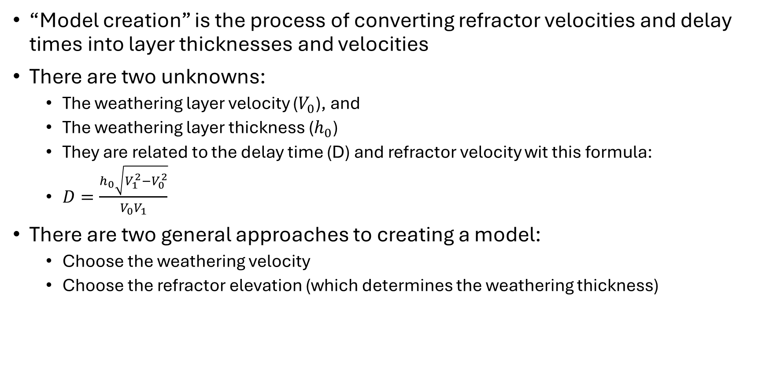
Model creation
“Model creation” is the process of converting refractor velocities and delay times into layer thicknesses and velocities
There are two unknowns:
  The weathering layer velocity ($V_{0}$), and
  The weathering layer thickness ($h_{0}$)
  They are related to the delay time (D) and refractor velocity wit this formula:
  $D=\frac{h_{0}\sqrt{V_{1}^{2}−V_{0}^{2}}}{V_{0}V_{1}}$
There are two general approaches to creating a model:
  Choose the weathering velocity
  Choose the refractor elevation (which determines the weathering thickness)

Slide 23
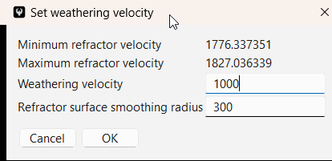
Model creation
Select the “Map” tab in the delay time model window
Create a new model by clicking “Model” ➔ “Shortcut – assign weathering velocity”
Choose a weathering velocity that’s roughly half of the refractor velocity
The smooth radius determines how much the refractor elevation is smoothed after it is computed

Slide 24
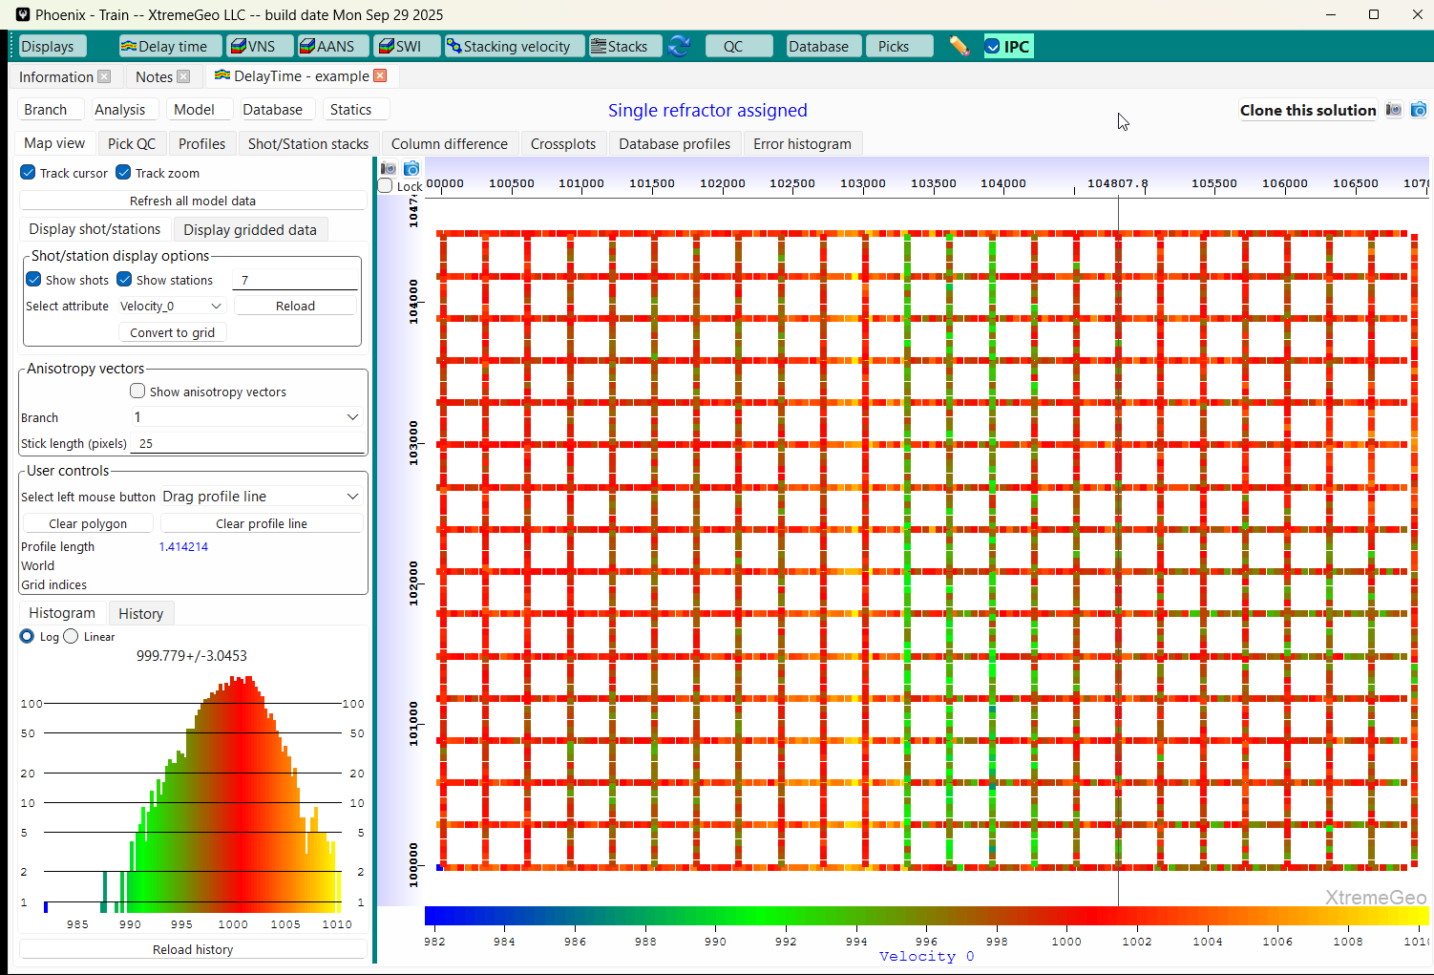
Model creation
Make sure the “Map” tab is selected and view the newly created model data:
  Velocity_0, the weathering velocity
  Elevation_1, the refractor elevation

Slide 25
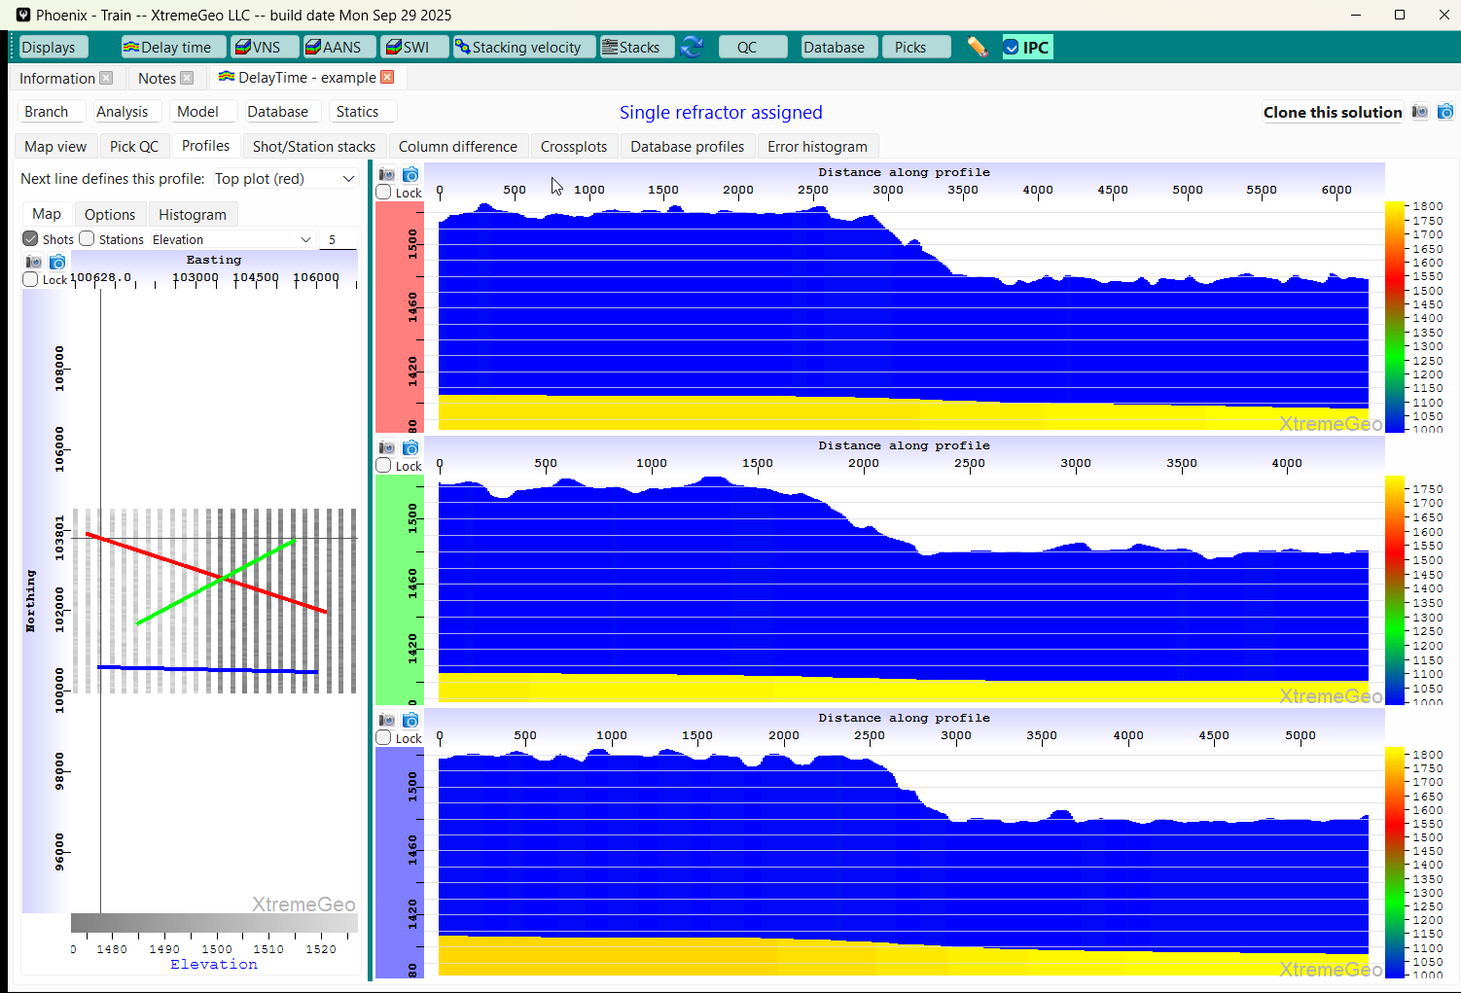
Model creation
Select the “Profiles” tab
Left-click and drag several lines on the basemap
Do the model profiles look OK?

Slide 26
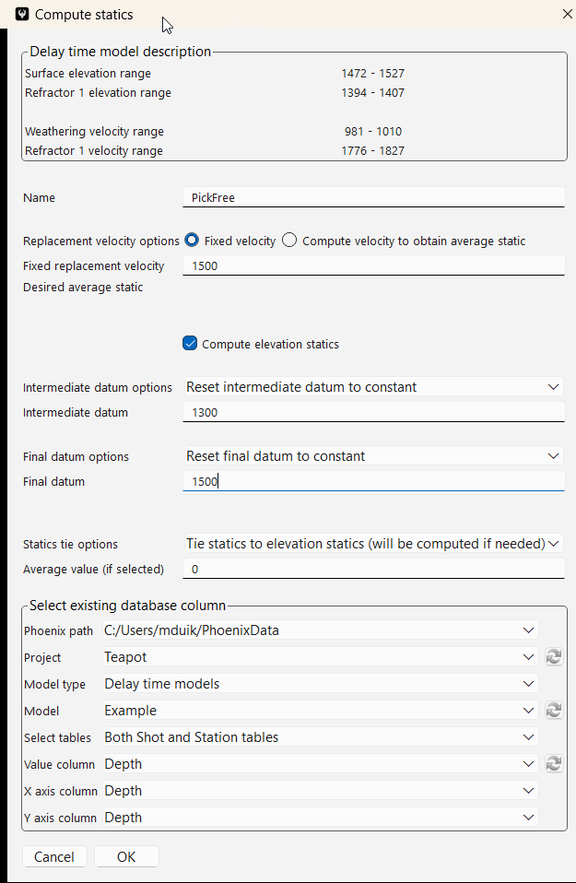
Statics creation
Click “Statics” then select “Shortcut”
The intermediate datum was chosen to be completely beneath the refractor surface
The final datum and replacement velocity will usually be supplied by the client
By default, the final statics are tied to elevation statics, meaning they will have the same average value

Slide 27
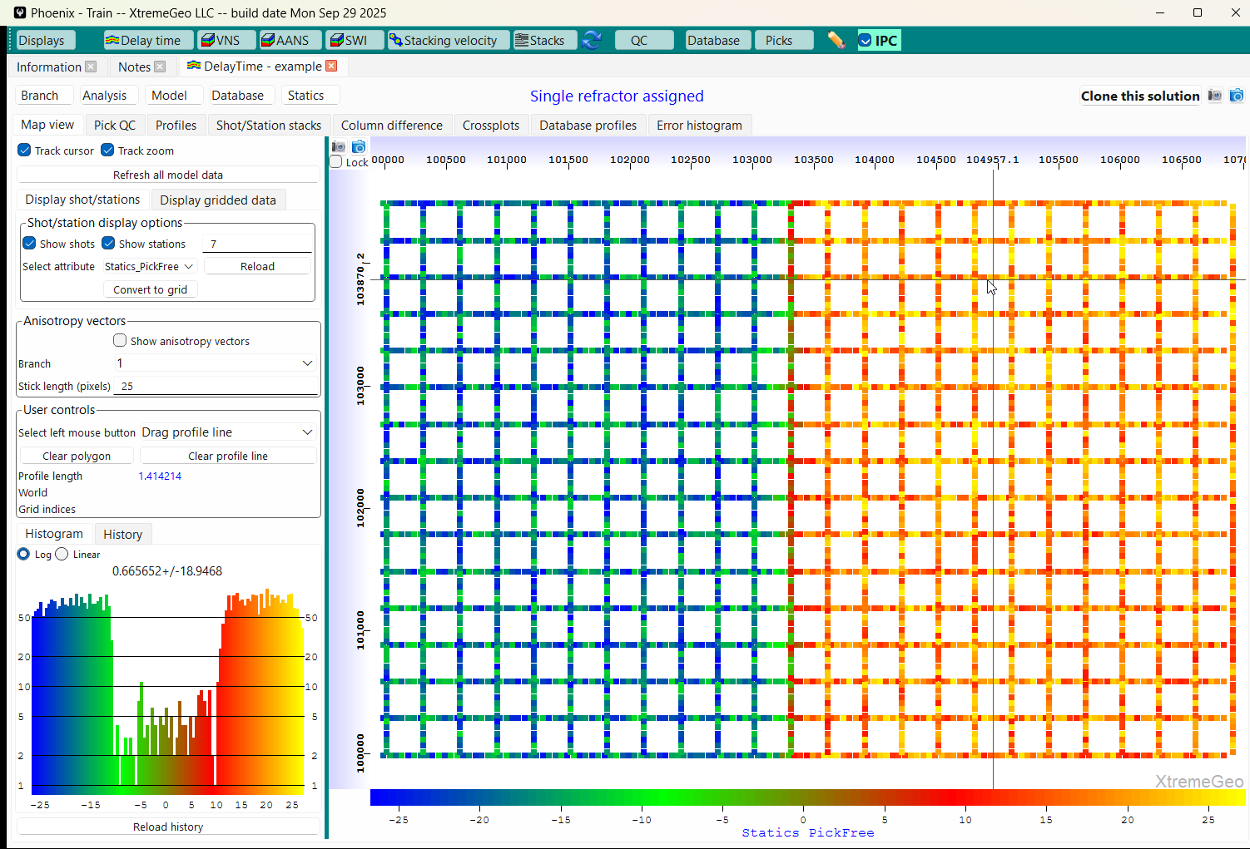
Statics creation
View the statics in the Map display

Slide 28
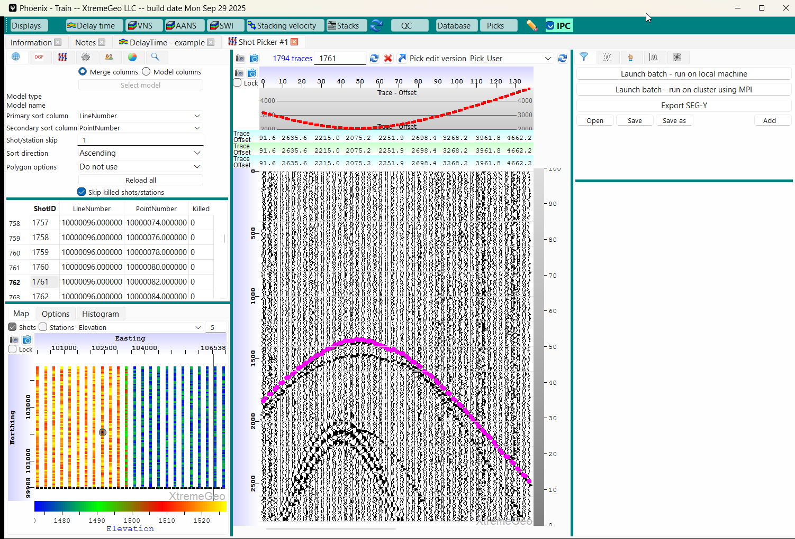
Creating first break picks using the delay time solution
Open a Shot picker window and click on the basemap to select a shot

Slide 29
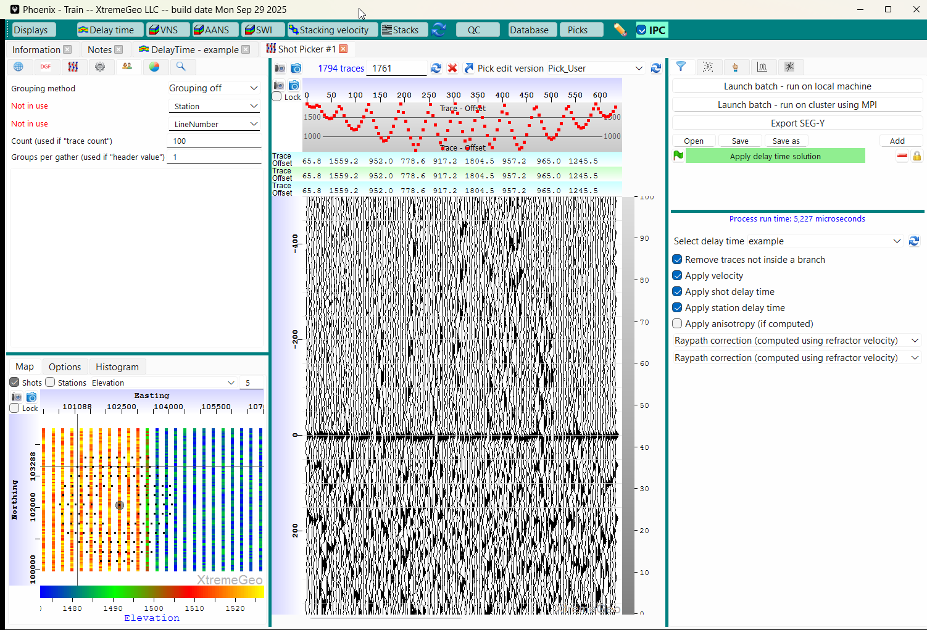
Creating first break picks using the delay time solution
Turn Grouping off
Add the delay time solution

Slide 30
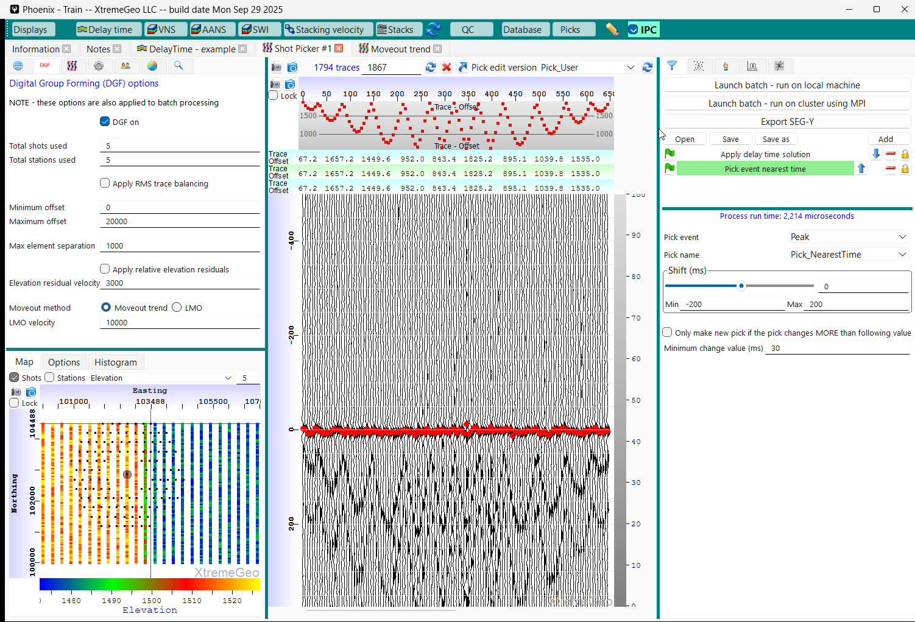
Creating first break picks using the delay time solution
Apply DGF if needed (may need moveout trend!)
Add Pick event nearest time

Slide 31
Creating first break picks using the delay time solution
When everything looks OK start the batch pick job by selecting “Launch batch – run on local machine”
The batch job runs in a separate executable
When the batch job is done a dialog will pop up
At that point you might want to use the new picks to run delay time analysis
  In the delay time model window click “Analysis” ➔ “Standard analysis sequence – gridded velocities not used”

