Slide 1
Phoenix Refraction Statics

Slide 2
Phoenix Tutorial
SEG-Y Import
XtremeGeo LLC
Fall 2025

Slide 3
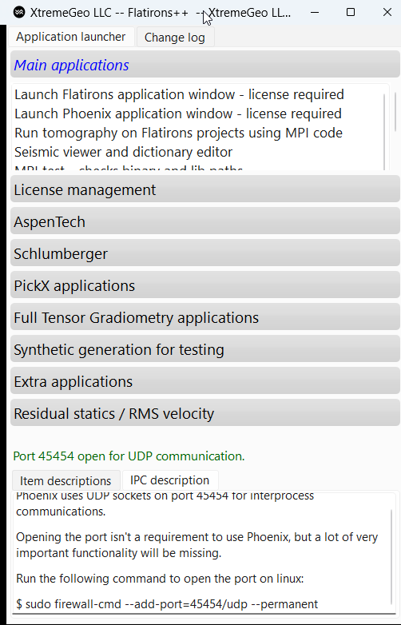
Define SEG-Y dictionary file
A header dictionary is required to import SEGY data
The dictionary, also called a “map”, defines the location of the required and optional headers
Start Flatirons++ and click “Seismic viewer and dictionary editor”
Any number of editors may be open

Slide 4
Shot and Station identification numbers
Phoenix and Flatirons both use the SPS standard to uniquely identify shots and stations
The SPS standard is defined in documentation on the SEG website
Three numbers are used for identification:
  LineNumber. Optional but very strongly suggested for 3D surveys
  PointNumber. Required
  PointIndex. Optional, usually FFID is used for shots
The combination (LineNumber, PointNumber, PointIndex) must be unique

Slide 5
Required and optional headers
Please review documentation available at www.seg.org for default header locations
Table | Column
Trace | TraceCode | Required. Byte offset 29, 2-byte int. Valid traces have value “1”
Trace | ElevationScalar | Optional. Byte offset 69, 2-byte int. Should usually be included. See SEG docs
Trace | CoordinateScalar | Optional. Byte offset 71, 2-byte int. Should usually be included. See SEG docs
Shot | Easting | Required
Shot | Northing | Required
Shot | Elevation | Required
Shot | PointNumber | Required
Shot | LineNumber | Optional, but strongly recommended for 3D surveys
Shot | PointIndex | Optional. Rarely used for replant codes
Shot | Depth | Optional. Used for dynamite, marine and OBC surveys
Shot | Uphole | Optional. Used for dynamite
Shot | WaterDepth | Optional. Used for marine and OBC surveys

Slide 6
Required and optional headers, continued
Table | Column
Station | Easting | Required
Station | Northing | Required
Station | Elevation | Required
Station | PointNumber | Required
Station | LineNumber | Optional, but strongly recommended for 3D surveys
Station | PointIndex | Optional. Rarely used for replant codes
Station | Depth | Optional. Used for marine and OBC surveys
Station | WaterDepth | Optional. Used for marine and OBC surveys

Slide 7
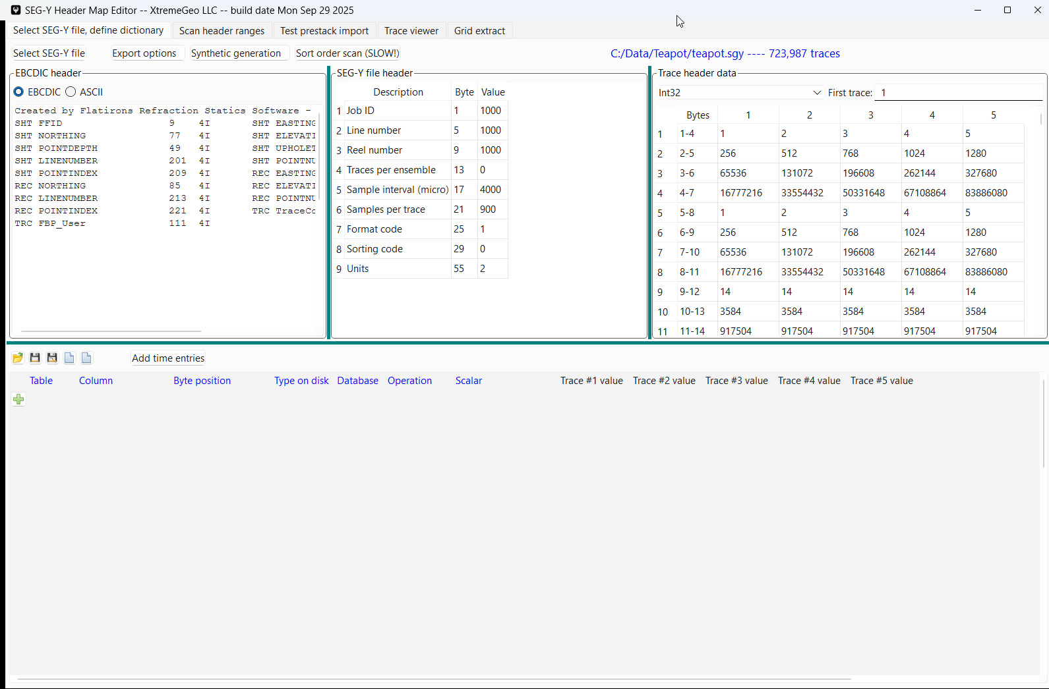
Dictionary creation
First, open a SEG-Y file
Next, create a new dictionary:
Click “New map – prestack entries”

Slide 8
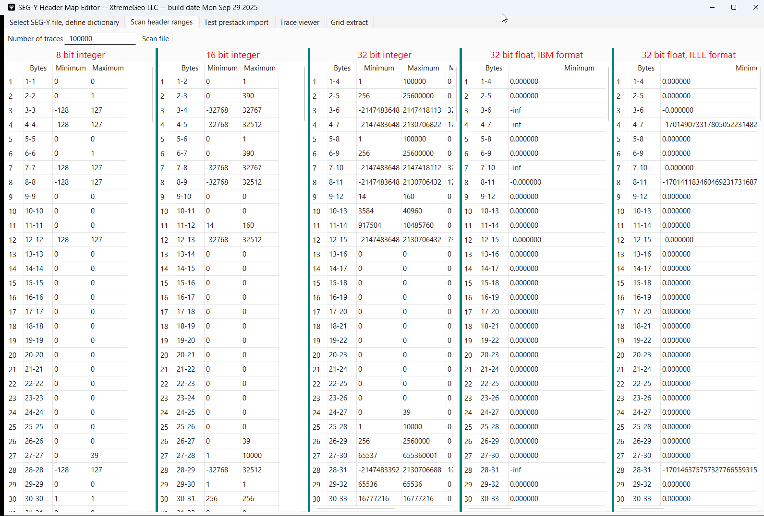
Dictionary creation
Scan traces to find “lost” headers
Sometimes you will get a SEGY file without any clear information about the location of the data in the headers
The “Scan header ranges” tab can help solve this problem

Slide 9
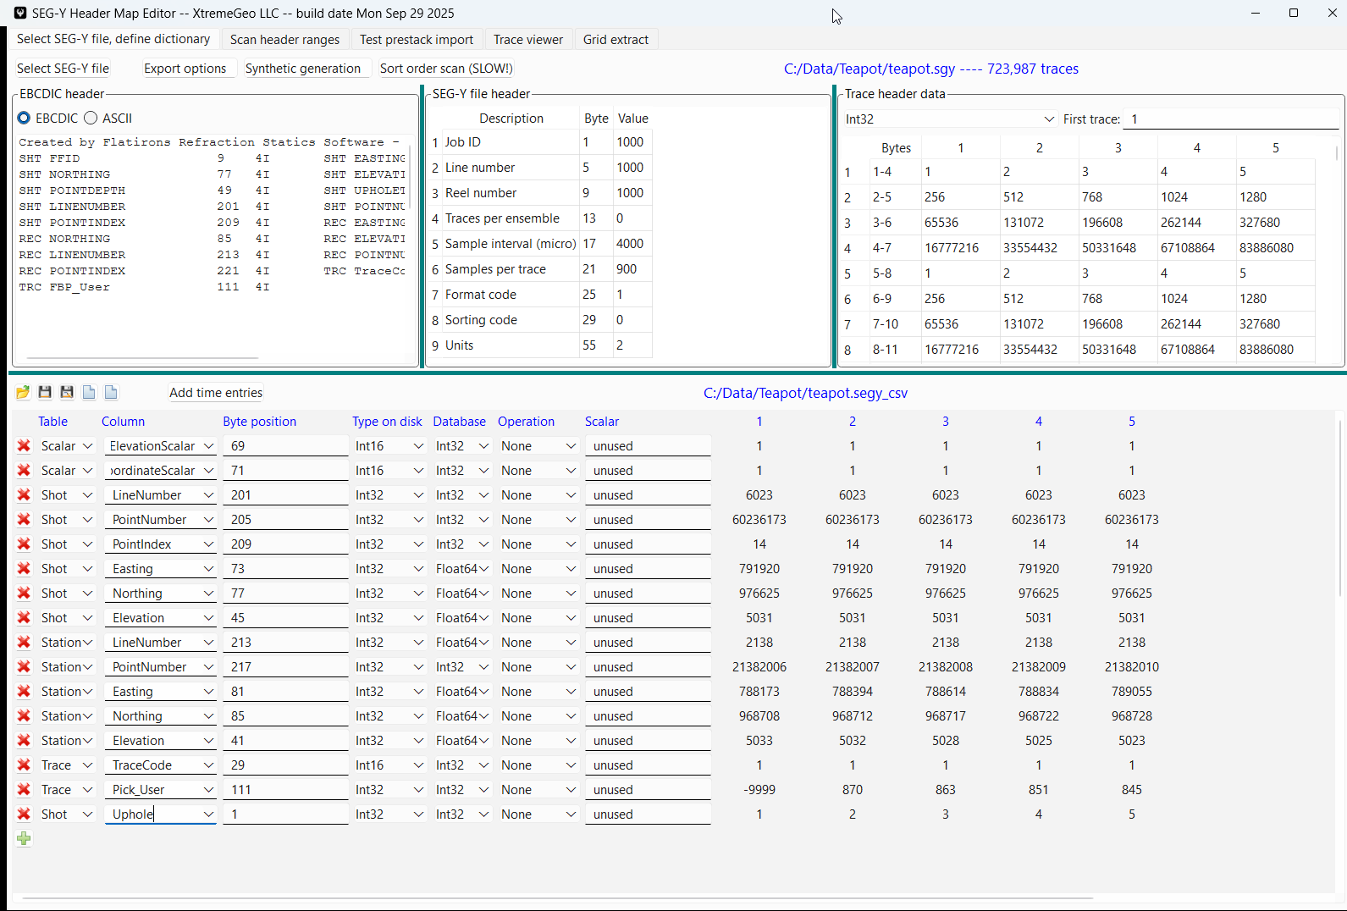
Dictionary creation
Modify the header entries
Make sure the interpreted header values make sense

Slide 10
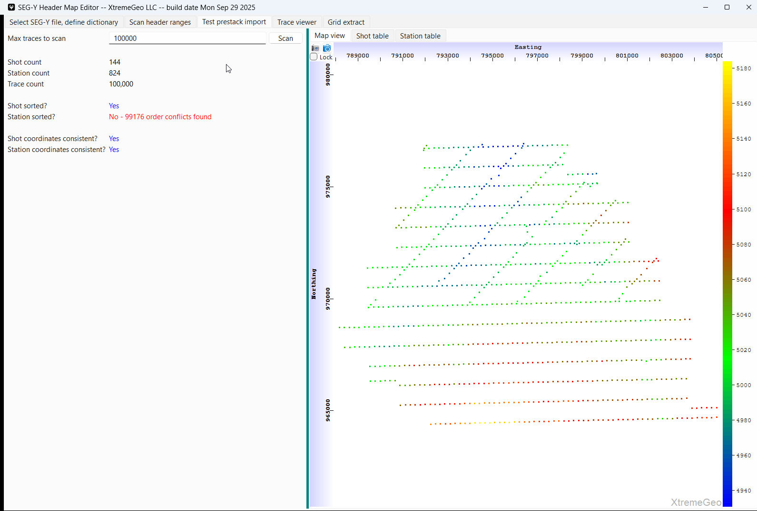
Dictionary Creation
After defining the header locations, you should consider scanning the SEGY traces to ensure everything is correct

Slide 11
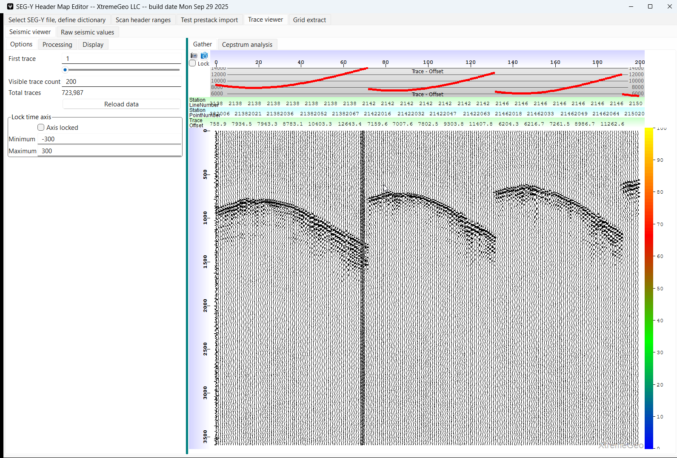
Next, view the traces with headers displayed as a further map QC
DICTIONARY CREATION

Slide 12
Save the file and close the display
DICTIONARY CREATION

Slide 13
Start Phoenix
Open the Flatirons++ display
Click “Launch Phoenix application window”

Slide 14
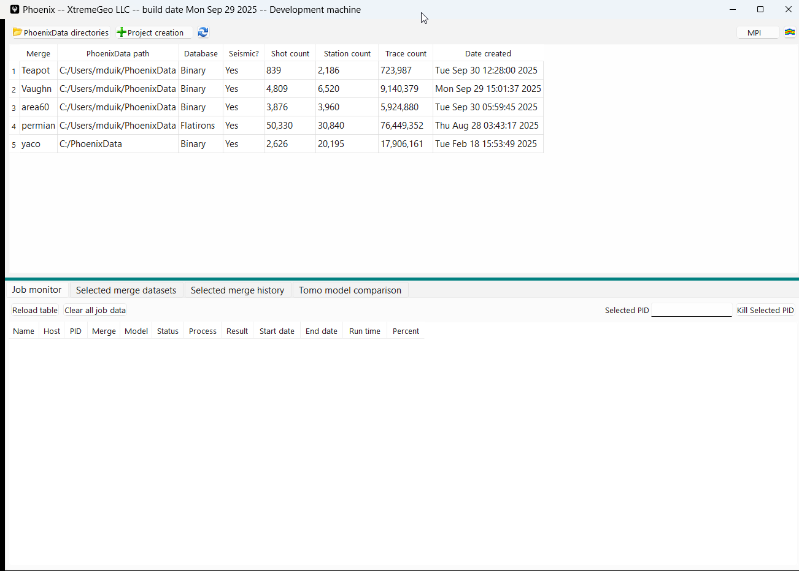
Start the import wizard
Click “Project creation” then
select “SEGY”

Slide 15
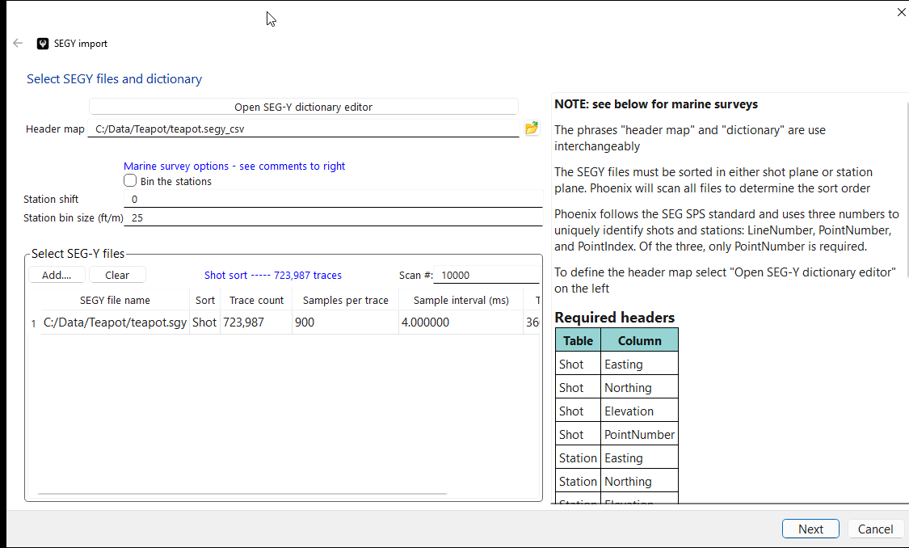
Specify the header map and the SEGY file name(s)
NOTE, the wizard will scan the first 10,000 traces of each file to determine the sort order.
This can be slow if adding hundreds of files!

Slide 16
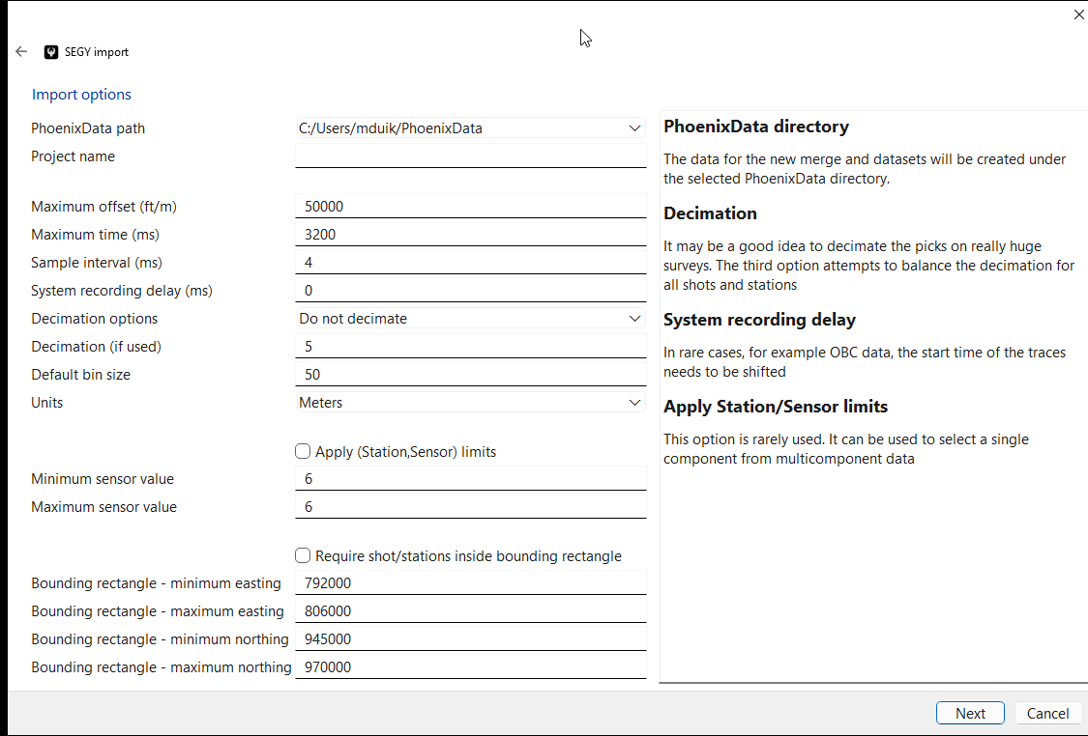
Additional import options
Be sure to enter the correct values, especially for
  Name
  Max offset
  Max Time
  Sample interval (usually best to leave as 4ms)
  Decimation. Can be a great idea for huge dense surveys
  Units
  Default bin size

Slide 17
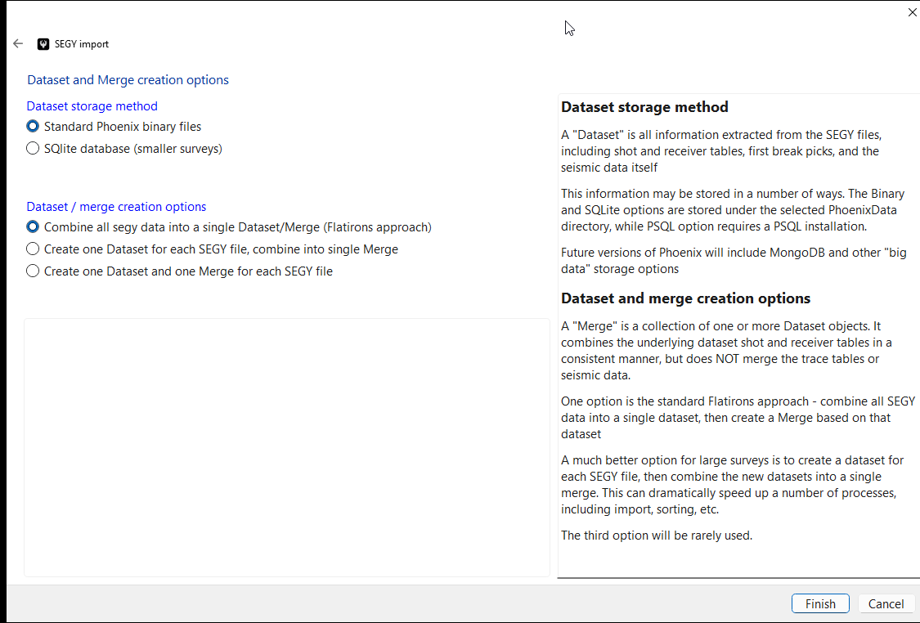
Final wizard page
If importing more than one SEGY file it can be a good idea to select “Create one dataset for each SEGY file…”
This causes the import to run in threads, which speeds things up
This option will also speed up several other processes later

