Slide 1
First Break Picking Phoenix Training
XtremeGeo LLC
Fall 2025

Slide 2
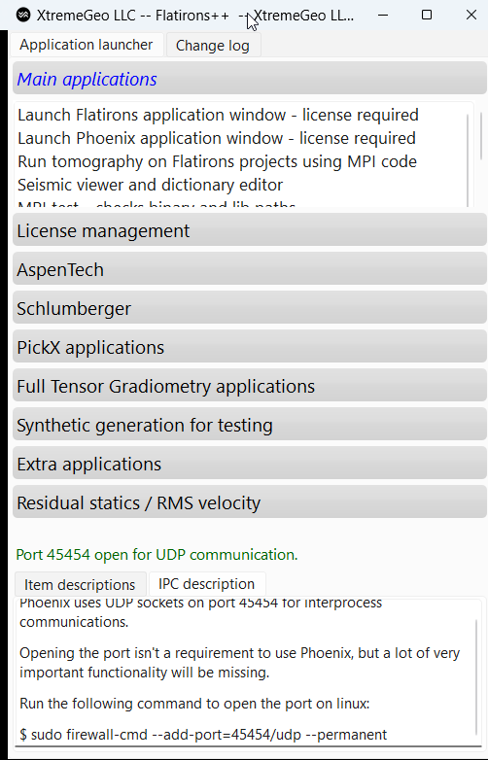
Open Flatirons++
If not already open, please start Flatirons++ as explained in the installation instructions
Make sure the FlexLM license manager is running
Click on “Launch Phoenix application window”

Slide 3
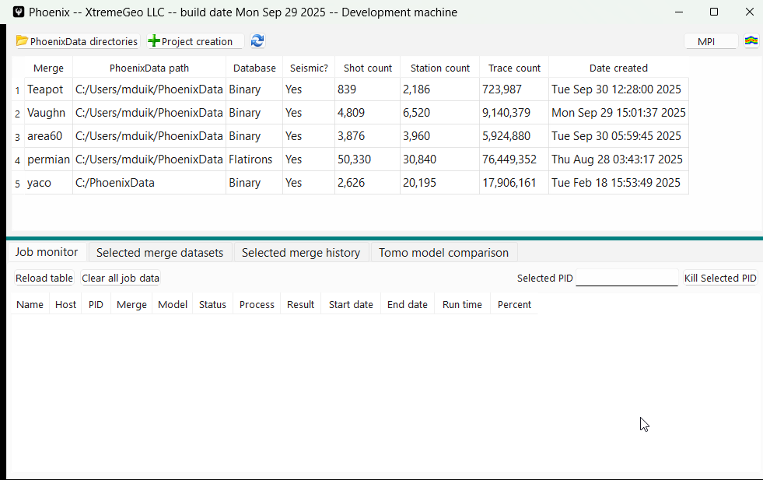
Open the “Merge” window
Right-click on the merge and select “Merge manager window”
Each Merge runs in its own application
Any number may be open simultaneously
Should only have one open for a given merge

Slide 4
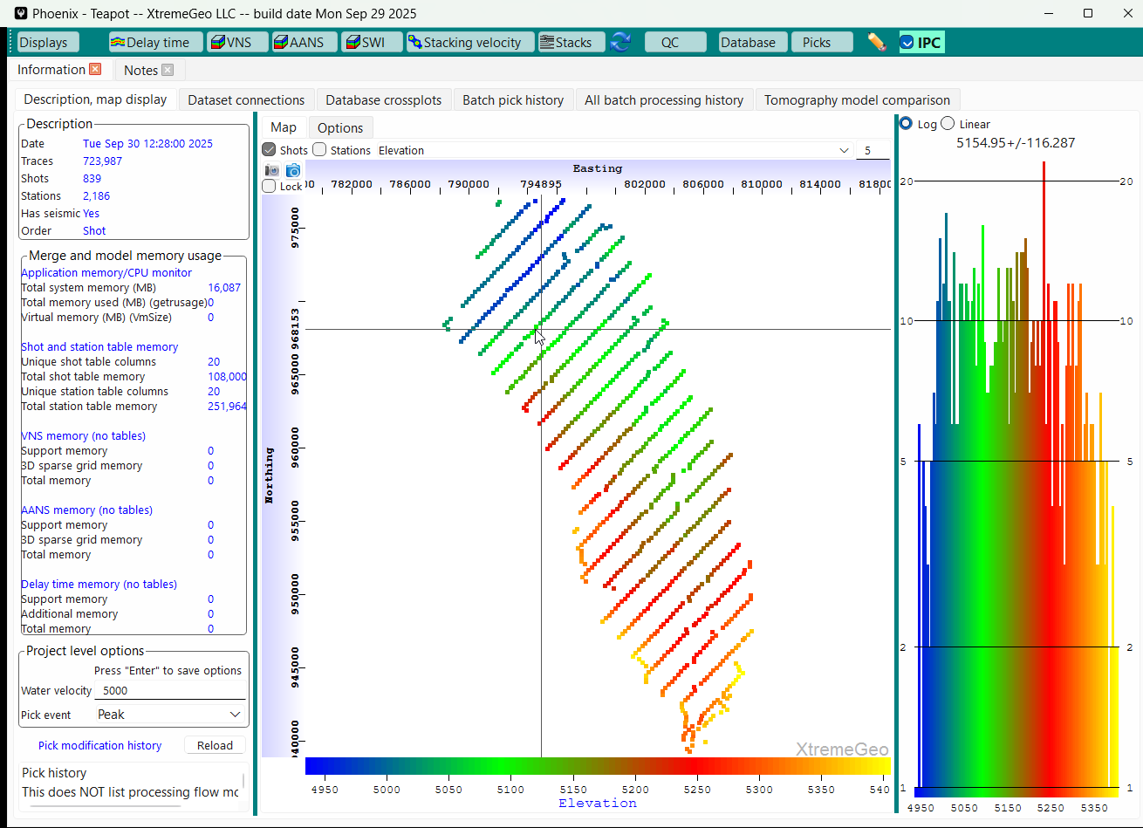
Moveout trend definition
HIGHLY RECOMMENDED!
Not required, but very useful for user picking, pick QC, etc.
May be used to generate an initial velocity field for tomography models using simplified tomographic inversion code
Click on “Displays” and select “Moveout trend definition”
When asked, open the new display in a tab

Slide 5
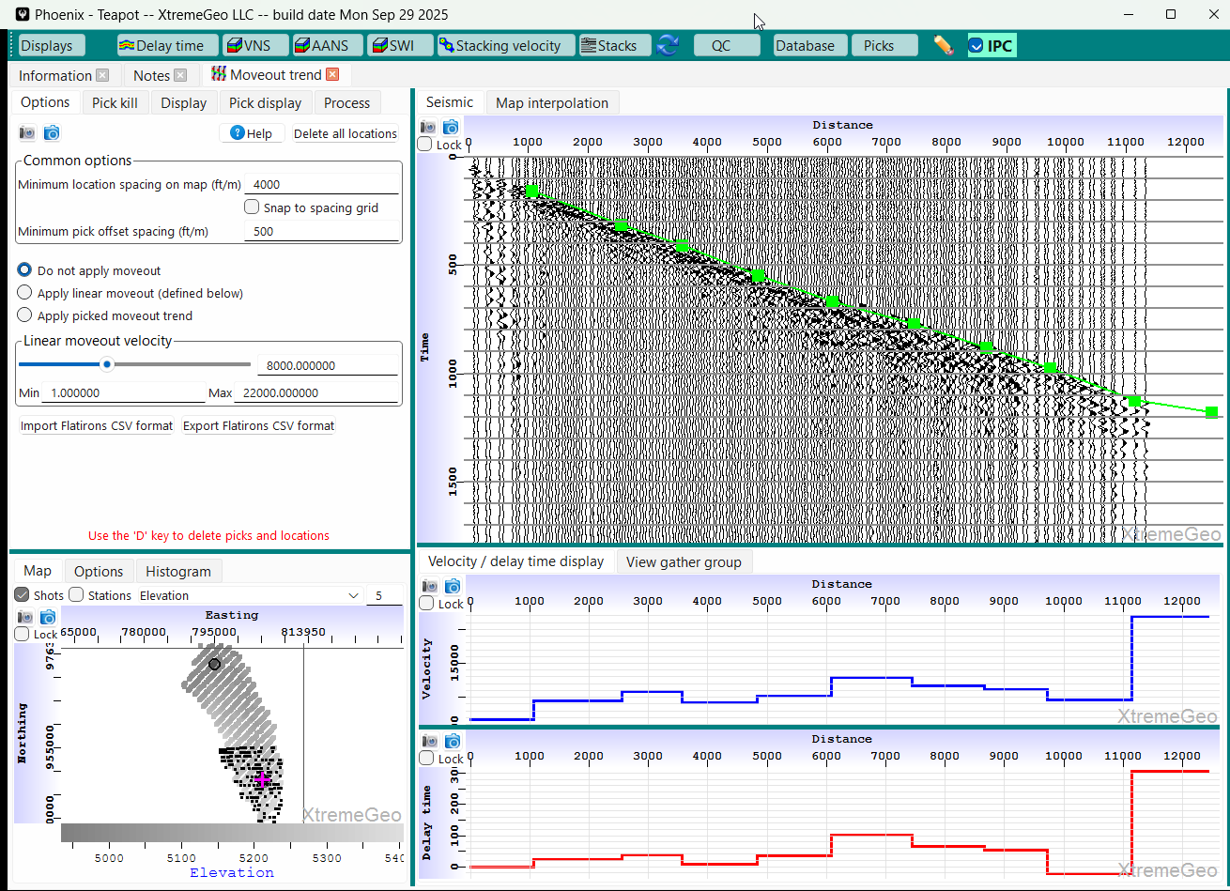
Moveout trend definition
Uncheck “Snap to spacing grid” and select minimum location spacing
Make sure the “Minimum pick offset spacing” is at least 300 feet, or 100 meters
Click on a shot in the basemap
Make some picks on the first arrivals
As picks are made the pseudo refractor velocity and delay time plots are updated

Slide 6
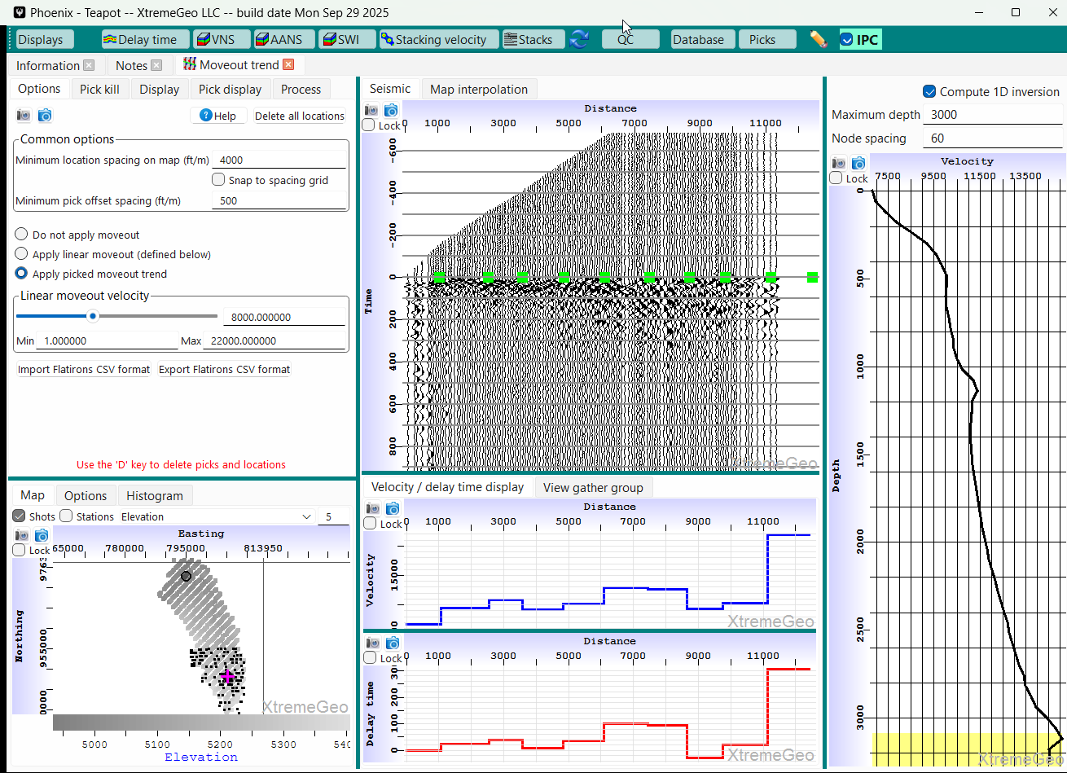
Moveout trend definition
It’s usually a good idea to flatten the gathers by selecting “Apply picked moveout trend”
Computing and displaying a 1D inversion on the right is a good visual QC
Be sure to pick enough locations to capture the spatial variability

Slide 7
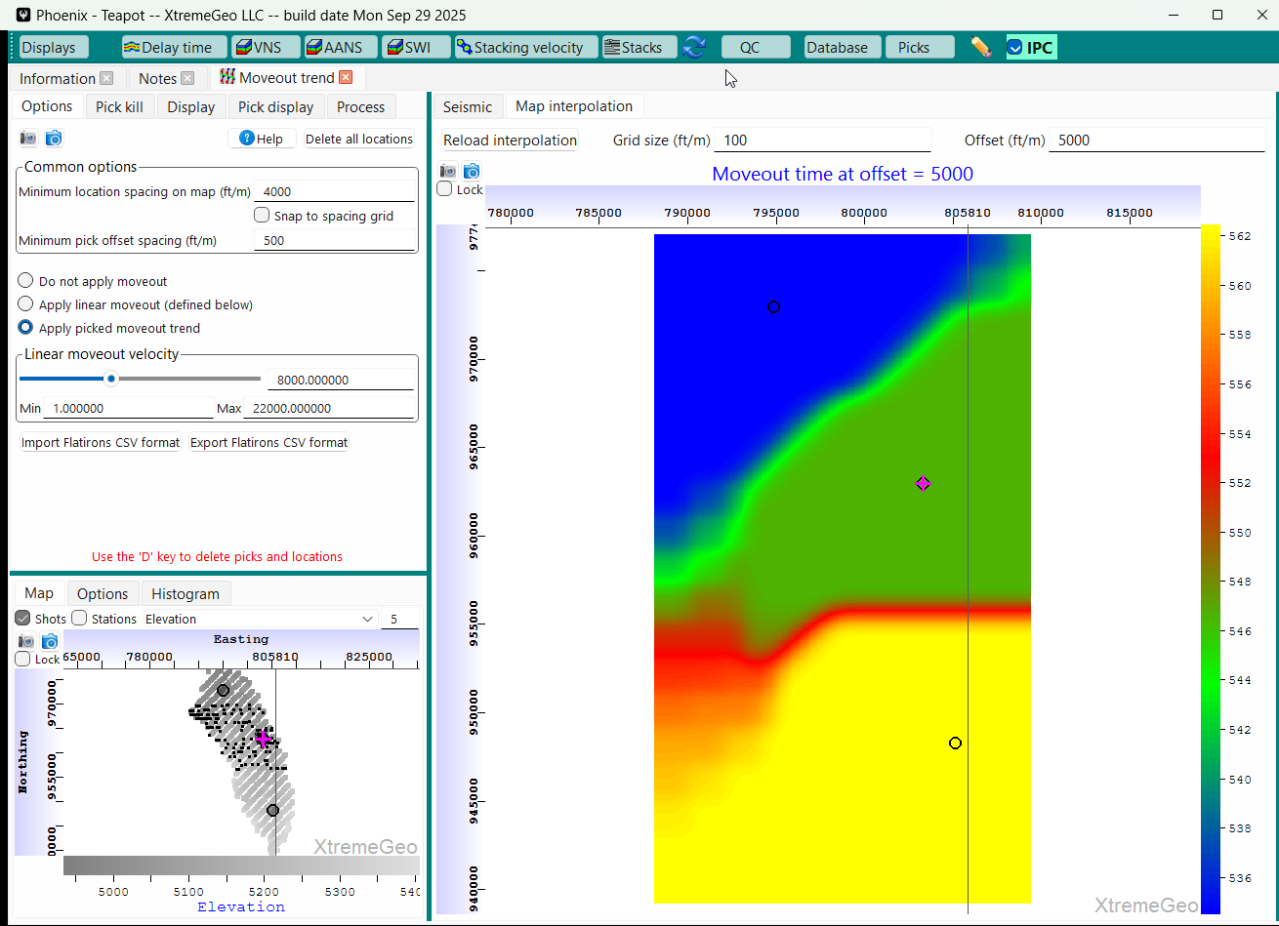
Moveout trend definition
As a final QC it may be a good idea to spatially interpolate and display the moveout times
Select the “Map interpolation” tab, select an Offset, then click “Reload interpolation”

Slide 8
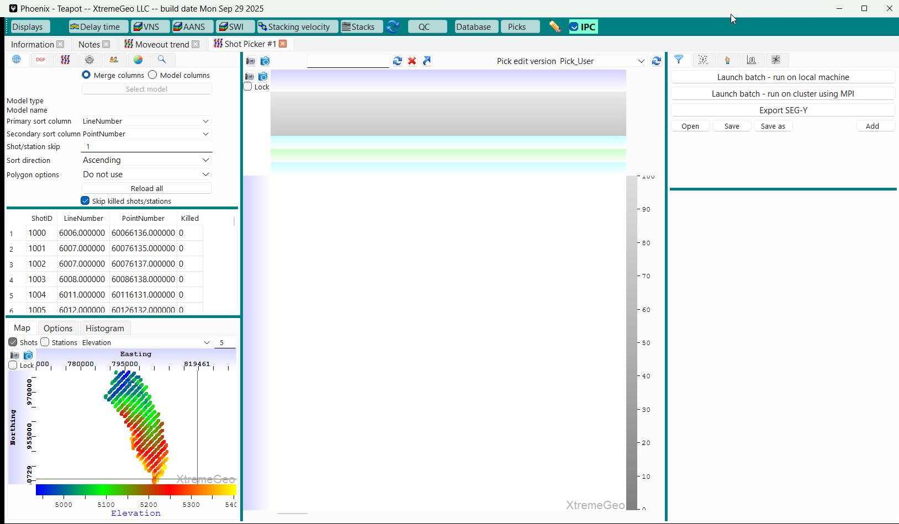
First break picker window
Click on “Displays” then select “Shot Picker”
You may have any number of picker windows open simultaneously
If you have enough screen space, open the picker in a stand-alone window. Otherwise just put it in a tab

Slide 9
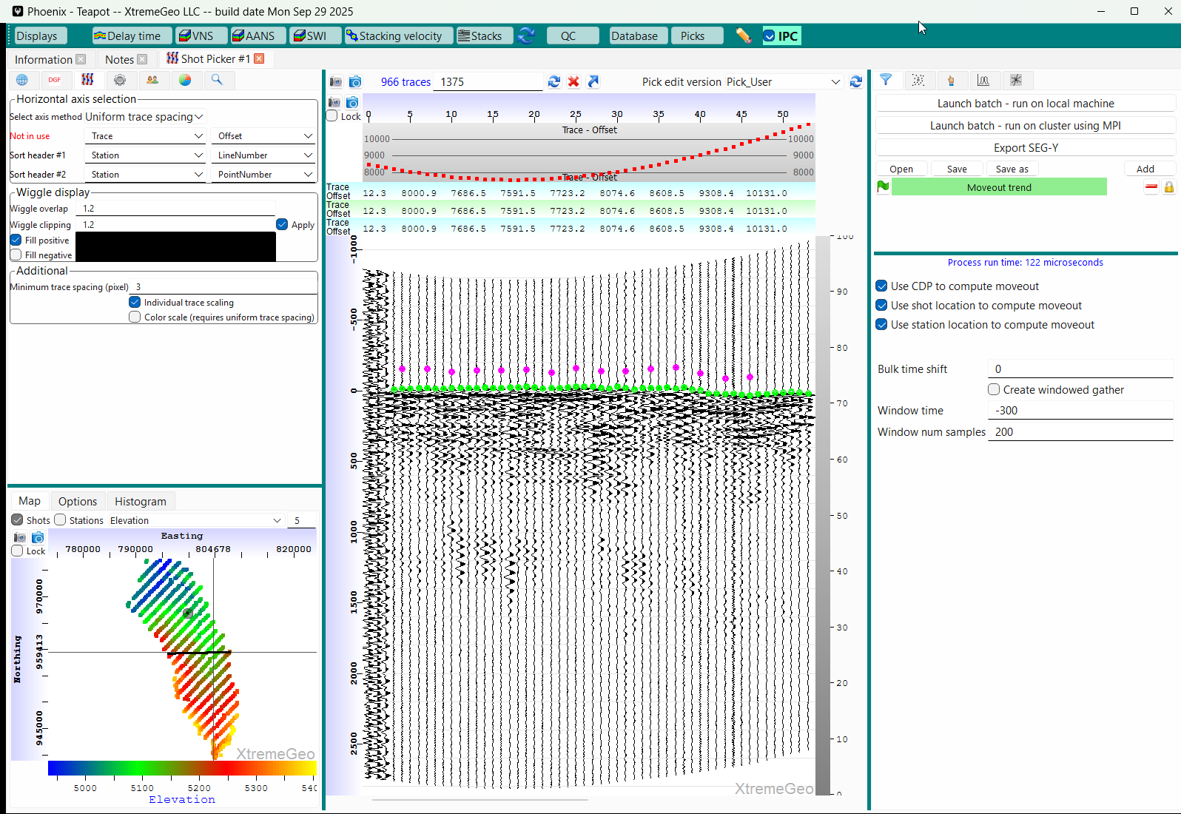
First break picker window
Click on the time axis AFTER
adding moveout trend
Add the moveout trend here
Left-click on a shot in the basemap
Next, apply the moveout trend. Click the “Add” button in the flow builder, then select “Moveout” => “Apply moveout trend”
After applying moveout, left-click on the time axis to recenter the display.
If desired, left-click and drag on the time axis to zoom and lock a time range

Slide 10
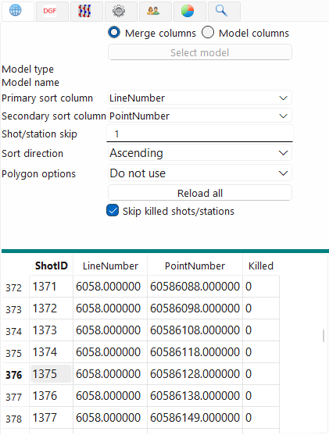
Gather navigation options
Hot keys (covered later) can be used to move from one shot to the next
The options in this tab determine the order in which shots are visited when using keyboard navigation
Select the sort columns
If “Skip” is 1 then every shot will be visited
Navigation can be limited to a polygonal are if desired
You can, if desired, select for example a delay time solution and navigate by the error term

Slide 11
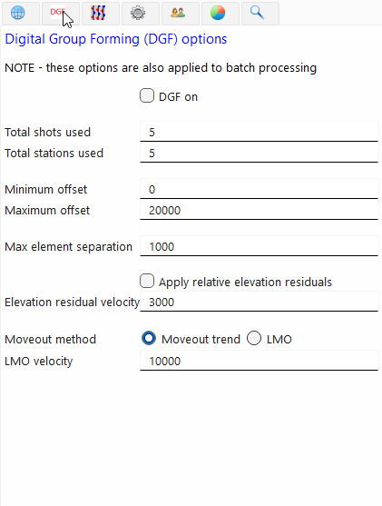
Digital Group Forming
This option is very useful for noisy data
A user-defined hot key may be used to toggle DGF on-off
Depending on options selected, it will only add a second or two to the gather load time
DGF will be applied to batch pick jobs, if selected

Slide 12
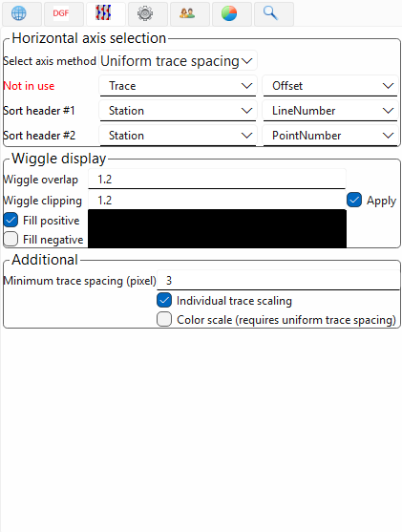
Seismic display and horizontal axis selection
Two options for the horizontal axis
Uniform Trace Spacing. Traces are sorted by the selected headers then placed uniformly along the X axis
Use header value. Traces are placed using the selected trace header
Wiggle display
Overlap
Clipping
Colors
Trace scaling

Slide 13
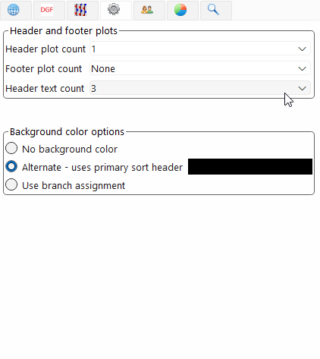
Header plots and background color options
Header and footer plot options
Background color
Alternate. This options uses the sort header defined in the horizontal axis selection tab. Usually “LineNumber” is a goof choice
Branch assignment. To use this option Delay Time moveout must be added in the flow builder (described later)

Slide 14
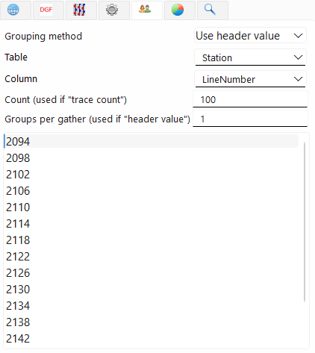
Grouping options
These options are used to display a subset of the selected gather
By default, “Use header value” is selected
Hot keys may be defined to navigate from one group to the next

Slide 15
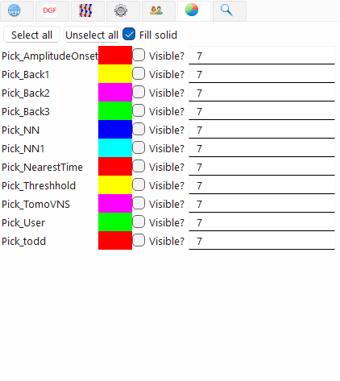
Pick display options
“Select all” turns all picks on
“Unselect all” hides all picks
NOTE – if a picker is defined in the flow window, then it will ALWAYS be visible

Slide 16
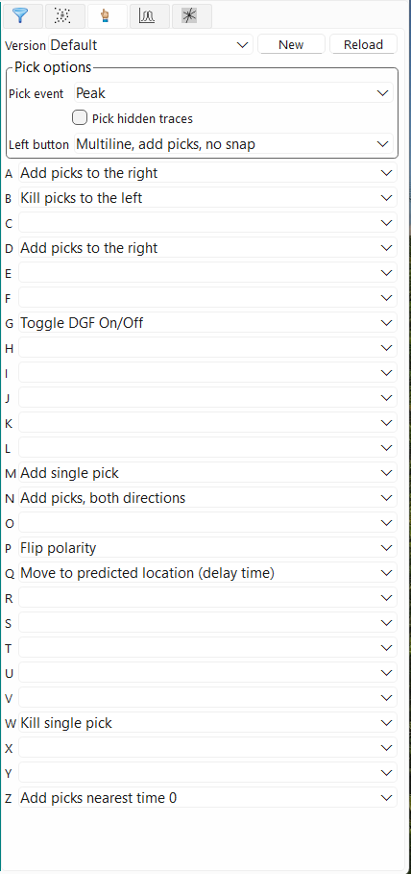
User-defined hot keys
Select pick event (Peak, trough, etc)
Define what the left mouse button does
Choose hot keys for a variety of actions
Picking
Kills
Polarity flip
DGF toggle
etc

Slide 17
Additional hot keys
Up arrow moves to next gather
Down arrow moves to prior gather
Left arrow moves to prior group
Right arrow moves to next group
Space bar moves to next group
Recall that the gather navigation order is defined in the gather navigation tab

Slide 18
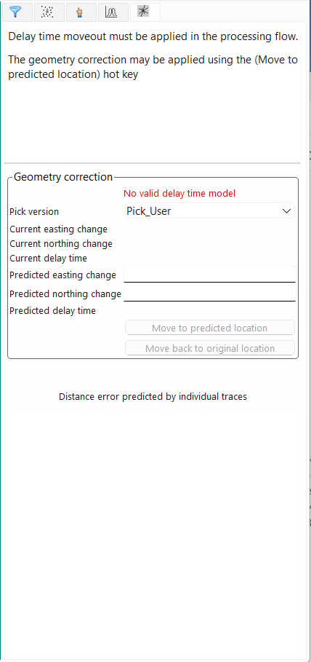
Geometry QC using delay time solution
A delay time solution must be applied in the processing flow builder
Using the selected pick version, the application will predict the actual shot location
The accuracy of the prediction depends on the accuracy of the picks and delay time solution

Slide 19
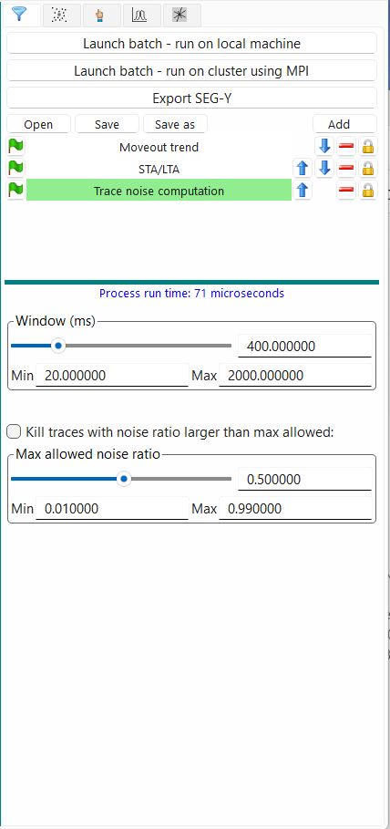
Processing flow builder
Clicking the “Add” button displays a list of available processes
Clicking the green flag next to each process will toggle it on/off
Clicking the red minus sign will delete the process
The up and down arrows reposition the process
The lock button is rather complicated but very useful. It is described on the next page

Slide 20
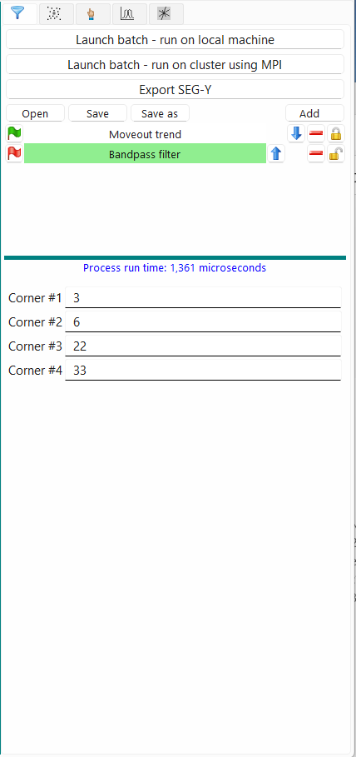
Processing flow builder
Toggling processes using the lock icon
Click the lock icon to unlock a process. More than one may be unlocked
Next define a hot key for “Toggle selected process”
Move the cursor over the seismic and click the hot key. You should see the unlocked processes flip their on/off status, and the change should be immediately visible on the seismic

Slide 21
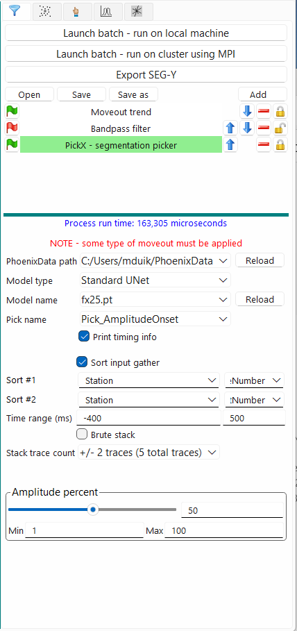
Processing flow builder
Defining a PickX batch pick job
Add a moveout process, such as either the moveout trend, VNS tomography
Add any filtering needed
DGF might help on some surveys
Add the PickX process
Be sure to select the correct model!
Select the Pick name
View the flow on several shots
If everything looks OK, click one of the “Launch batch…” options

Slide 22
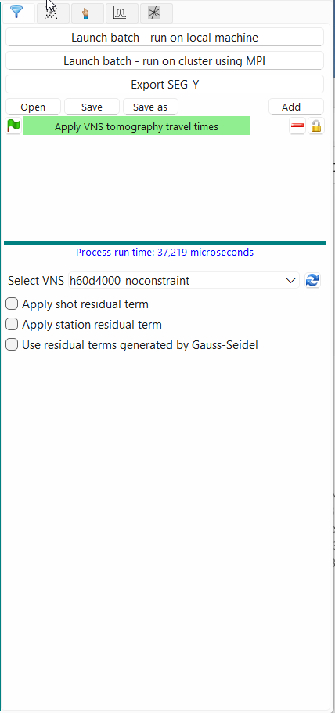
Processing flow builder
Apply model travel times
Add the process “Apply VNS tomo travel times”
Select the desired tomography model
It is usually a good idea to turn off the residual terms.
A travel time for is computed through the tomo model for each trace, and the trace is shifted by this time

Slide 23
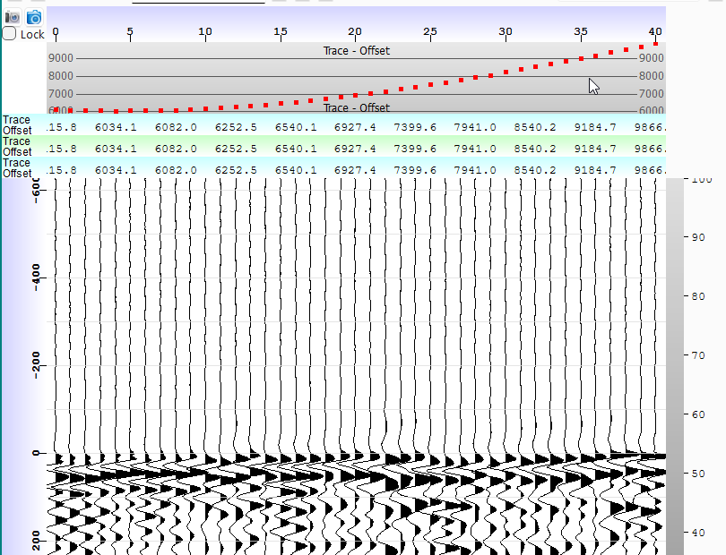
Header plot selection
Click on any of the header plots
You will be presented a list of all headers currently in the trace headers

