Slide 1
Delay Time Analysis Phoenix Training
XtremeGeo LLC
Fall 2025

Slide 2
Comments
Assumes first break picks available
Phoenix makes model creation simple, you’ll likely have several delay time solutions for each project
Delay time analysis usually provides very high-quality statics, but the physical models generally aren’t terribly realistic
Lots of decisions to make:
Refractor assignment
How many refractors?
Refractor offset ranges?
Analysis (computing velocities and delay times from picks)
Smoothing
Velocity range compression
Model generation (physical model from delay times)
Define using weathering velocity guess?
Or define using refractor elevation guess?

Slide 3
Three distinct phases
Delay time and refractor velocity computation
This step uses the first break picks and refractor offset assignment (AKA branch assignment) to compute delay times and refractor velocities for each shot and station.
The results depend strongly on pick quality and, of course, branch assignment
Geometry QC may be done during this phase
Model building
This step uses the delay times and refractor velocities to build a physical model
Velocity of each layer, and
Elevation of each refractor
Two unknowns. Define one of these and the other may be computed using the delay time formula
Weathering layer velocity
Weathering layer thickness
Statics computation

Slide 4
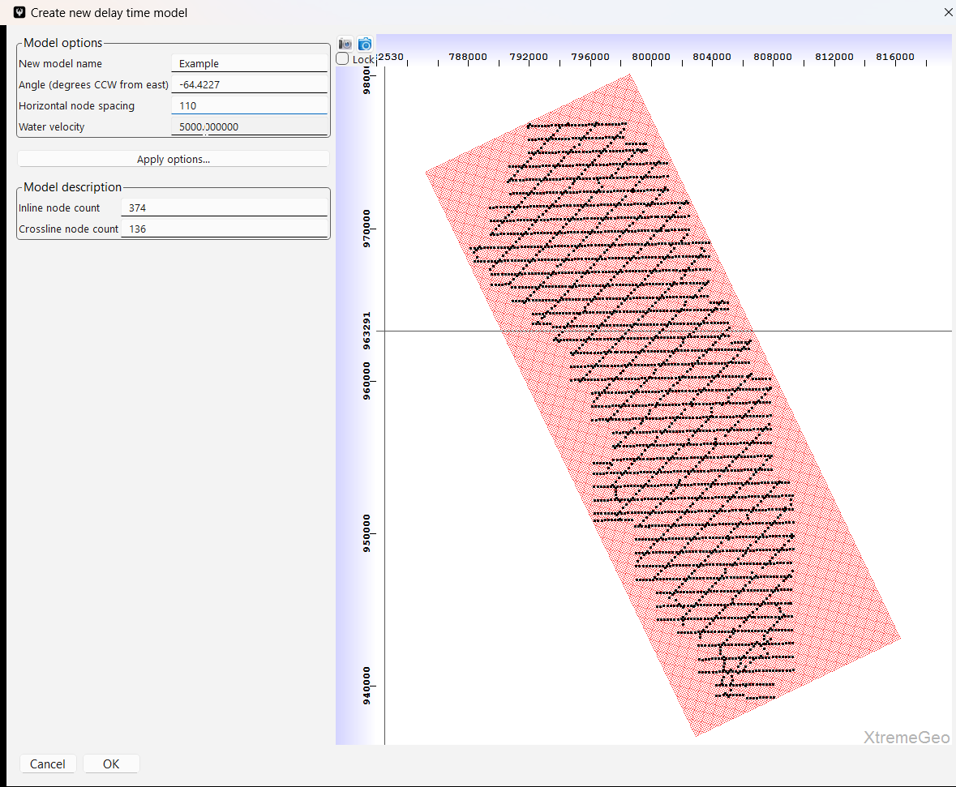
Create a new delay time solution
Make sure the Merge window is open
Click “Delay time” and select “Create new delay time solution”
Give the model a name
Select the node spacing. This is used, for example, in smoothing routines
You might want to left-click and drag on the map to change the grid angle, but this isn’t very important

Slide 5
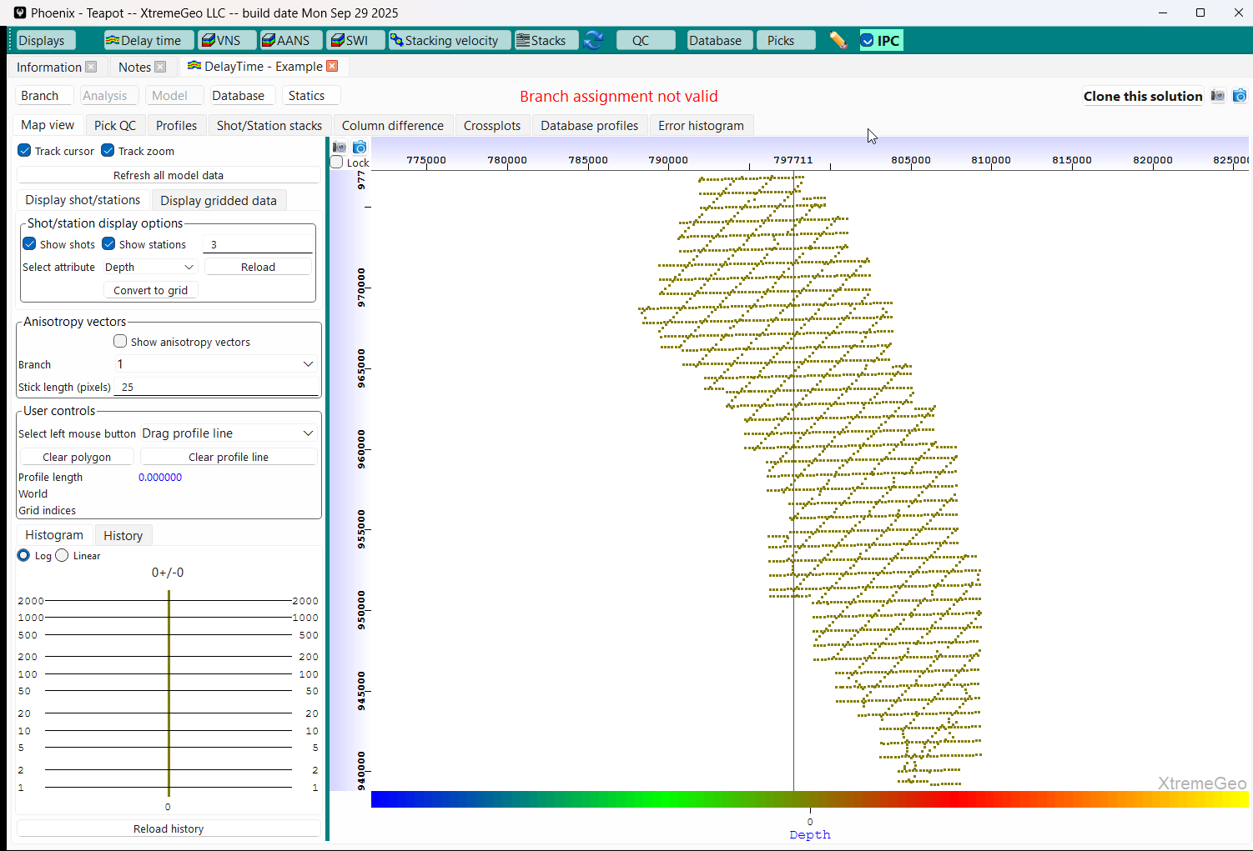
The delay time solution is under the “DelayTime – Example” tab
Click “Branch” and select
“Open branch assignment dialog”

Slide 6
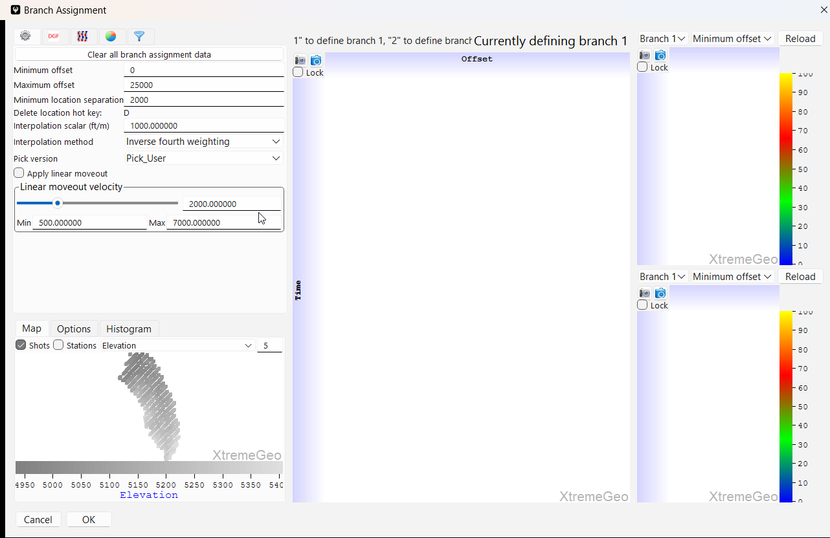
Branch assignment
Change the location separation to “2000”
Be sure to select “Apply linear moveout”
Select a shot

Slide 7
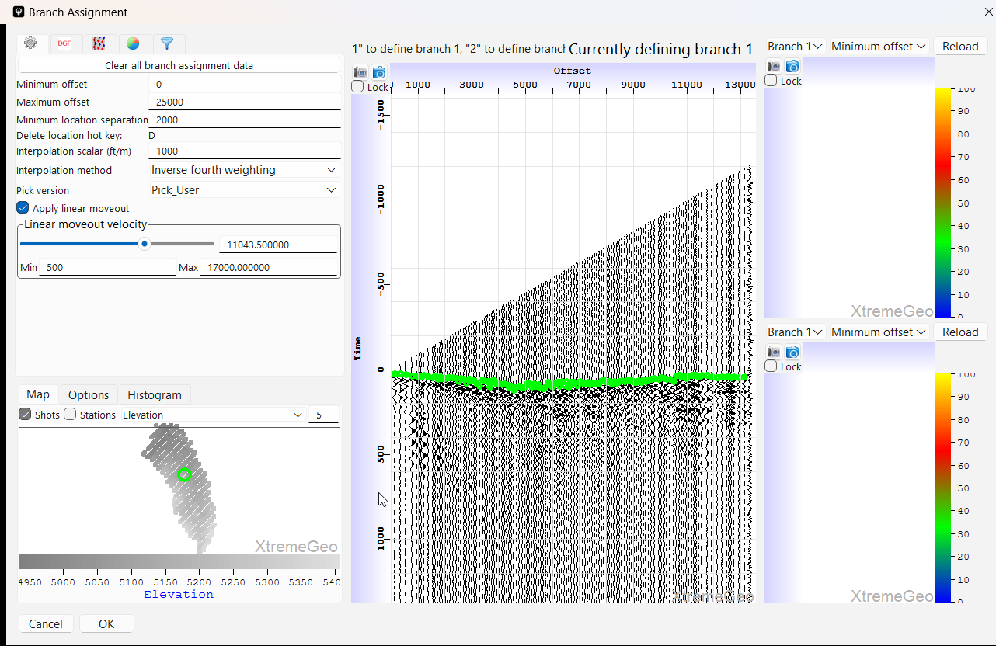
Branch assignment
Drag the slider until the first arrivals of the
refractor of interest are flat
Next, left-click and drag on the time axis to
zoom in to the first arrivals
The mouse wheel may be used to scroll the
time axis up and down

Slide 8
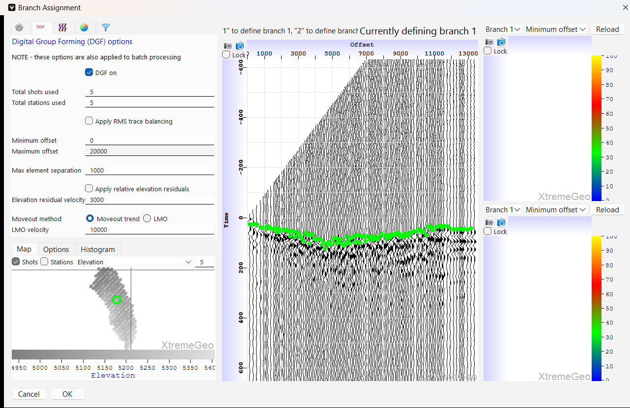
Branch assignment
Applying DGF may help with noisy data

Slide 9
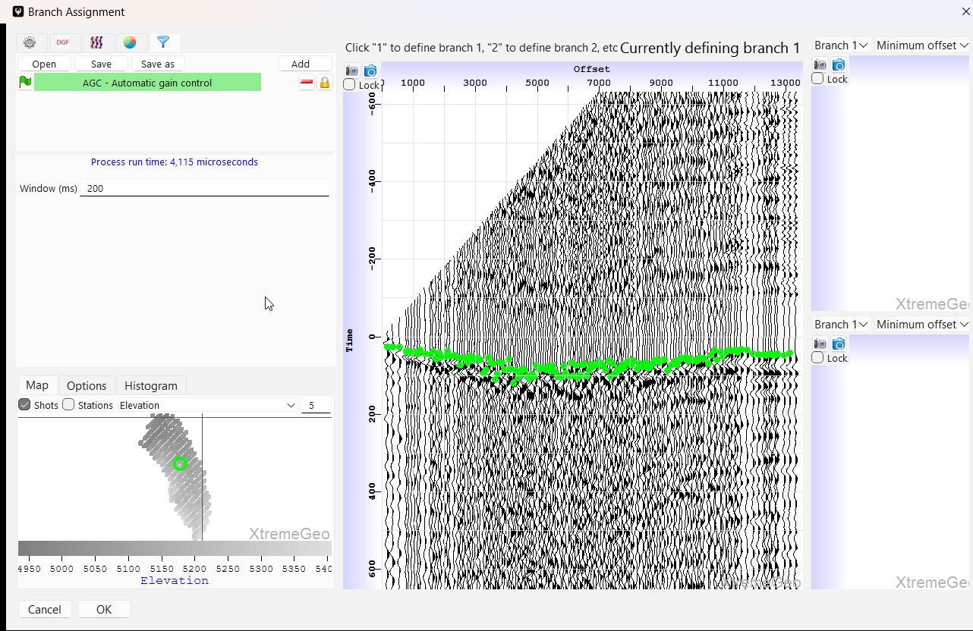
Branch assignment
Applying AGC and/or filters may help make first arrivals more clear

Slide 10
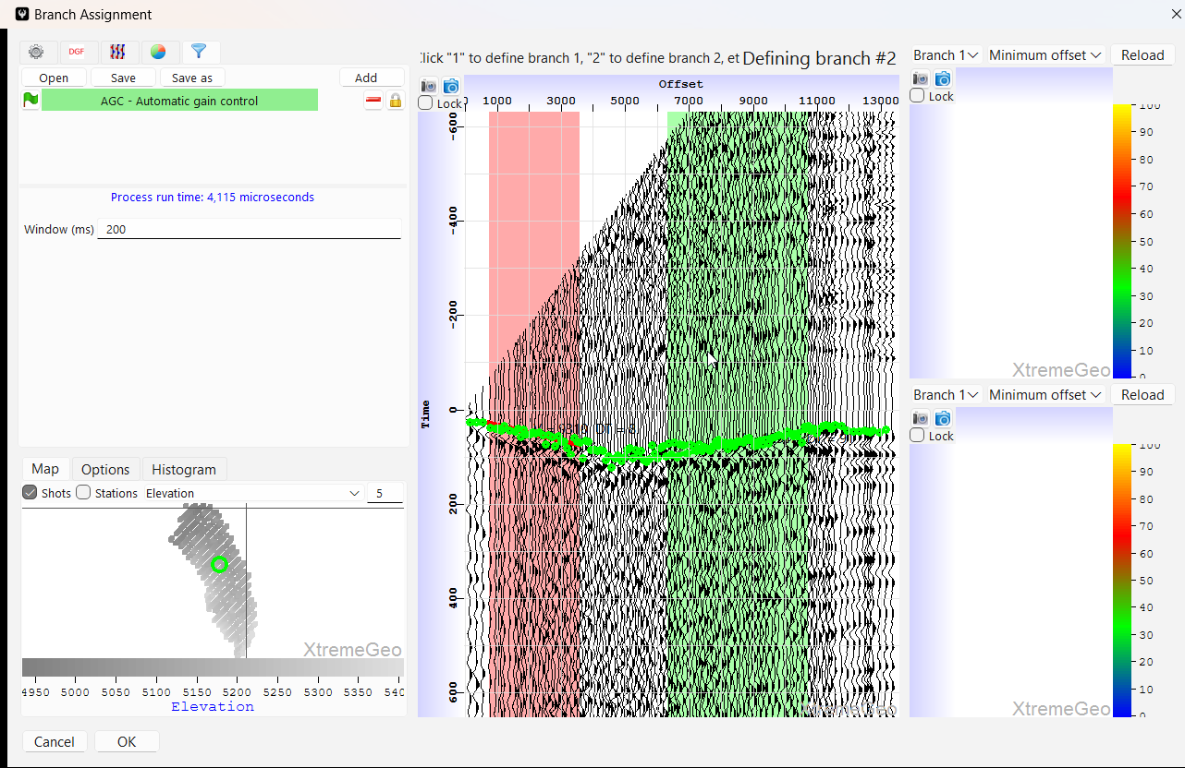
Branch assignment
Define the offset range – left-click and drag on the first arrivals
Be sure to not cross any refractor boundaries!
Try to be consistent and always choose either peaks or troughs
In addition to selecting an offset range you are also defining a refractor velocity and delay time field!
This field may be interpolated to the shots and receivers

Slide 11
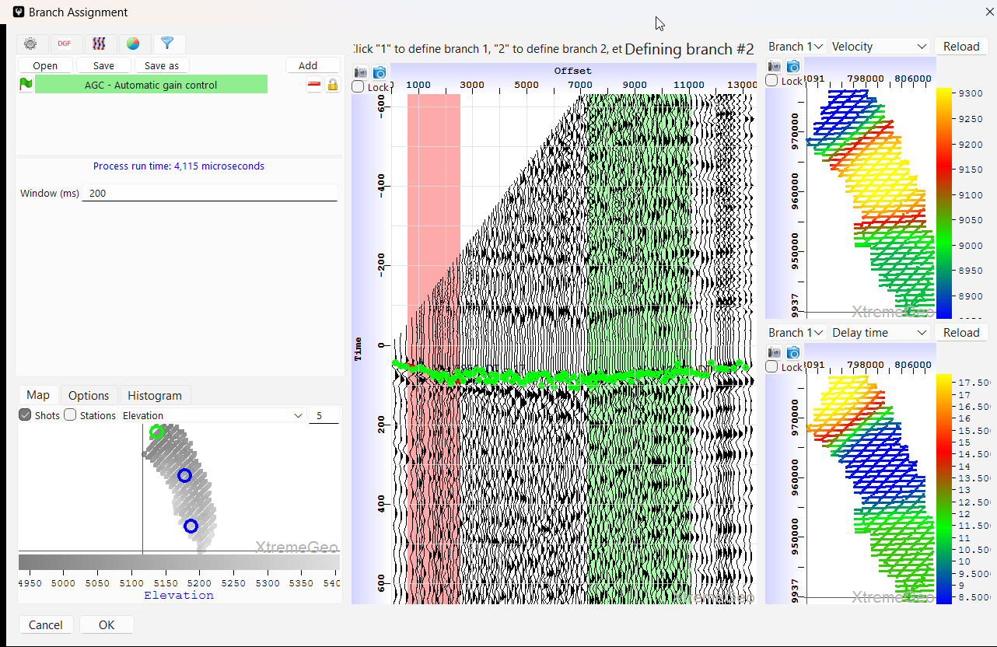
Branch assignment
Select several shots across the survey to make sure the selected refractor is somewhat consistent
In the basemaps on the right select “Velocity” for the top plot and “Delay time” for the lower. The plots don’t reload automatically, click “Reload” when a refresh is needed
This initial solution will be interpolated to the shots and receivers
When satisfied, click “OK”

Slide 12
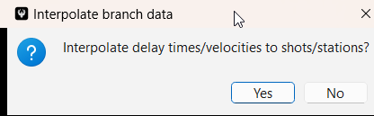
Branch assignment
Click “No”
No need to interpolate, since the next step is analysis

Slide 13
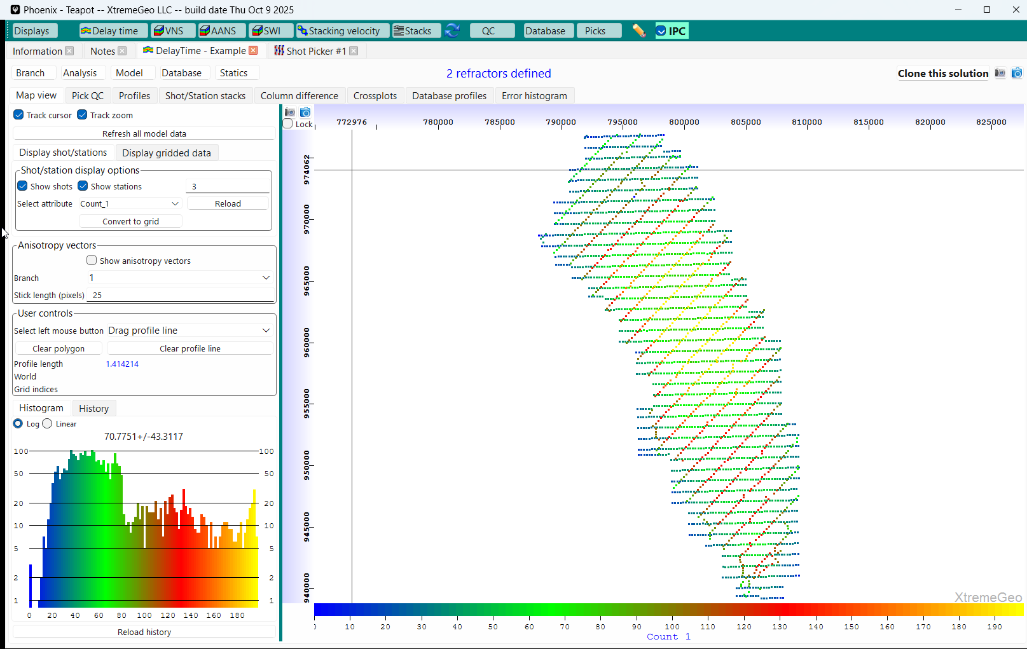
start analysis
Back in the main DelayTime window
Click Analysis then select Standard Analysis Sequence – gridded velocities not used

Slide 14
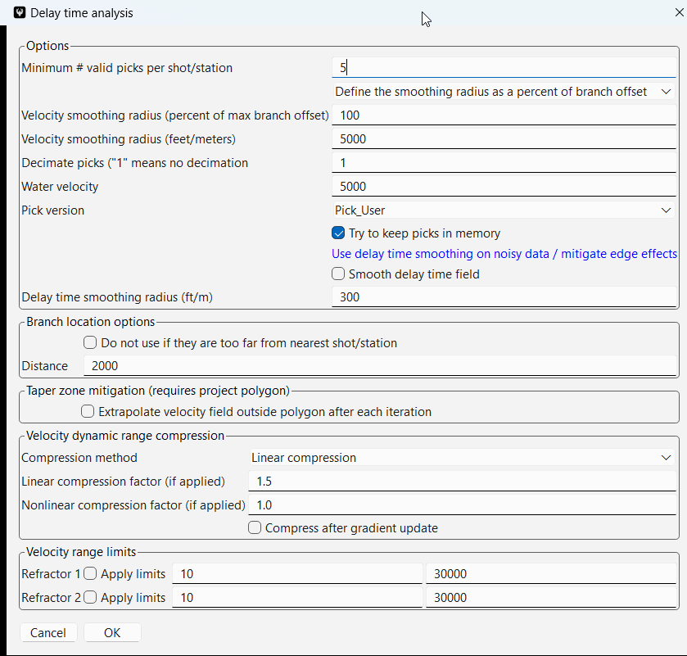
Analysis options
Minimum valid picks – Shots and Stations with fewer picks will have their delay times and velocities interpolated from nearby shots and stations
Velocity smoothing – the smoothing radius should be about the max branch offset. Smoothing is applied after each update
Pick decimation – 1 means no decimation, 2 means use every other pick, etc
Water velocity – used for various OBC and marine raypath corrections
Pick version – Don’t forget to pick correct version!

Slide 15
Analysis options
Keep picks in memory – this can dramatically speed up analysis
Smooth delay time field – should only be used for very noisy low-quality picks
Taper zone mitigation
Velocity dynamic range compression – these options can help stabilize the solution. If selected the range is compressed after smoothing and taper zone options have been applied

Slide 16
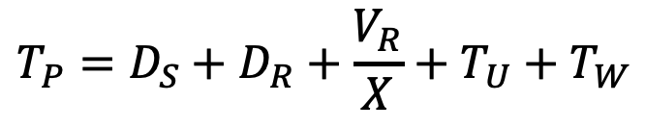
Delay time analysis
For a given pick, the delay time formula is:
$$T_{P}=D_{S}+D_{R}+\frac{V_{R}}{X}+T_{U}+T_{W}$$
Tp is the first break pick
Ds is the shot delay time
Dr is the receiver delay time
Tu is the uphole correction. The uphole correction “moves” the shot to the surface
Tw is the water bottom correction. This correction moves the shot or receiver to the
water bottom

Slide 17
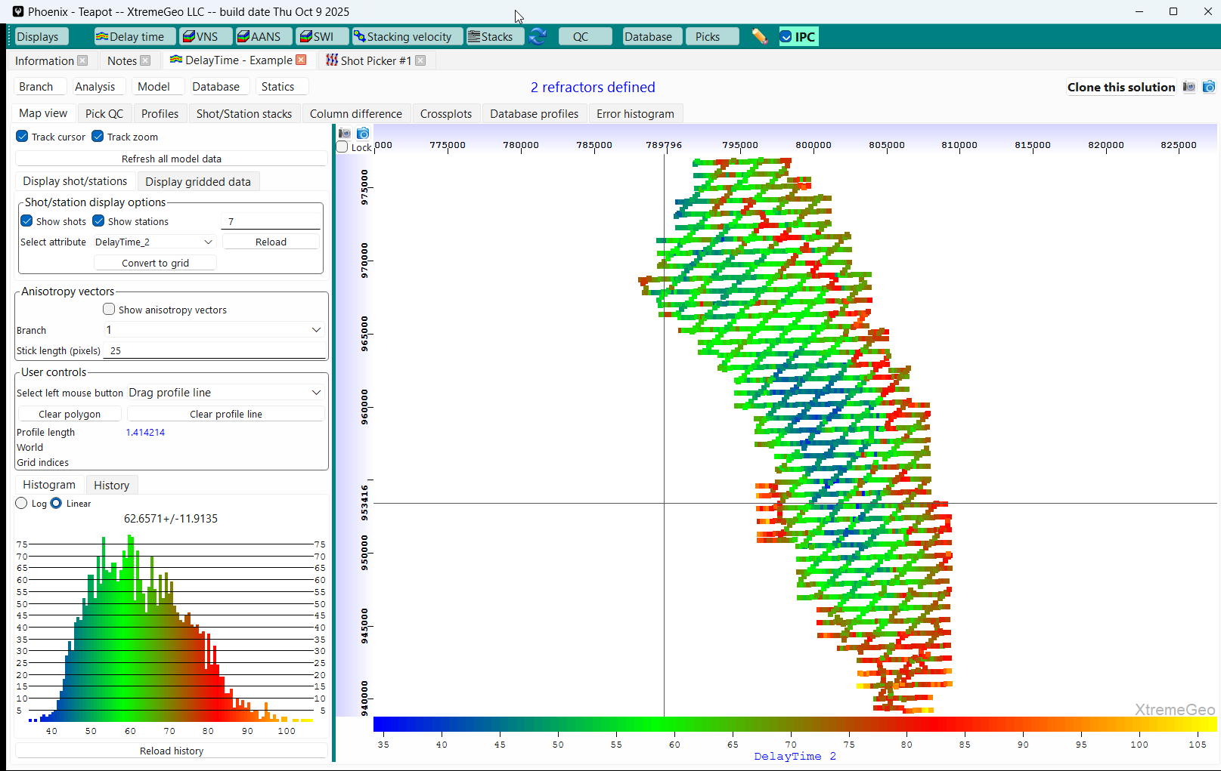
Viewing the analysis results
The delay times and refractor velocities may be viewed under the Map view
It’s a good idea to view the error terms here
View either at shot and station locations or interpolated to a grid
The histogram plot can show any outlying delay times

Slide 18
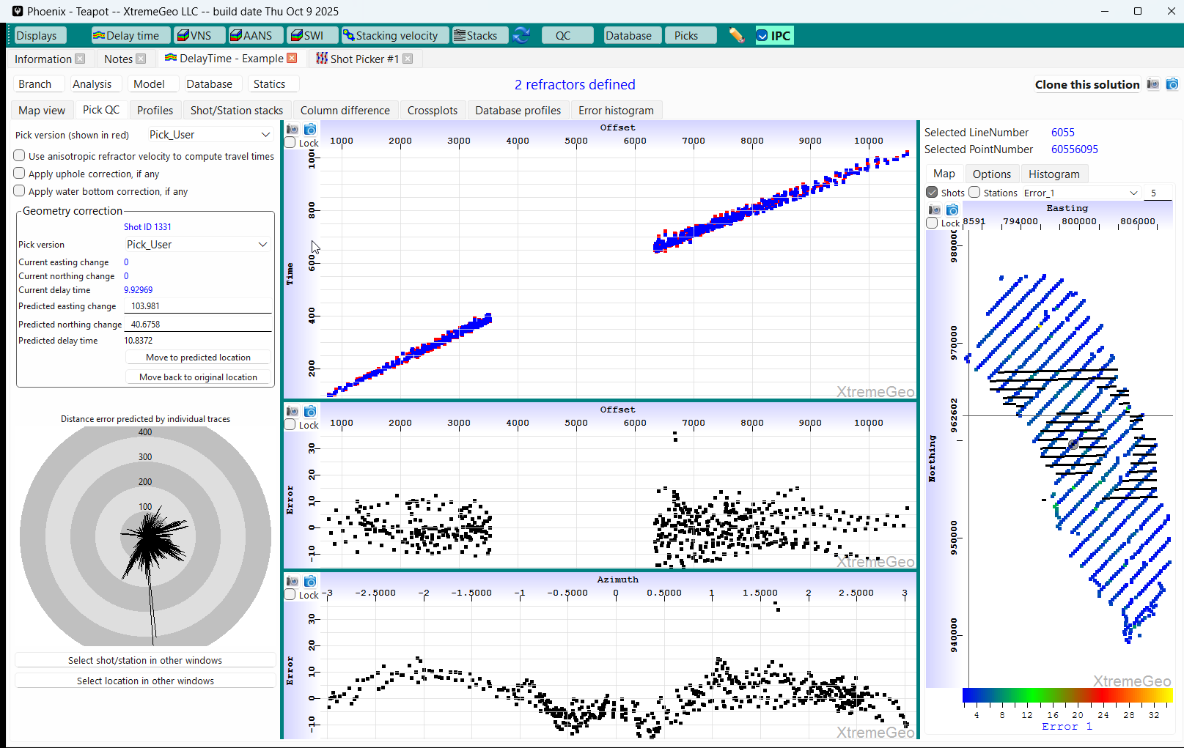
Pick QC display
Left-click on a shot in the basemap
Select the pick version used for analysis
Turn on corrections, if needed
In the upper plot the red dots are the picks, blue dots are predicted by the delay time solution
The middle plot shows the error plotted by offset. Any velocity field issues will be visible here
The lower plot shows error plotted by azimuth. Any geometry errors will be visible.
A double sine wave might indicate horizontal anisotropy

Slide 19
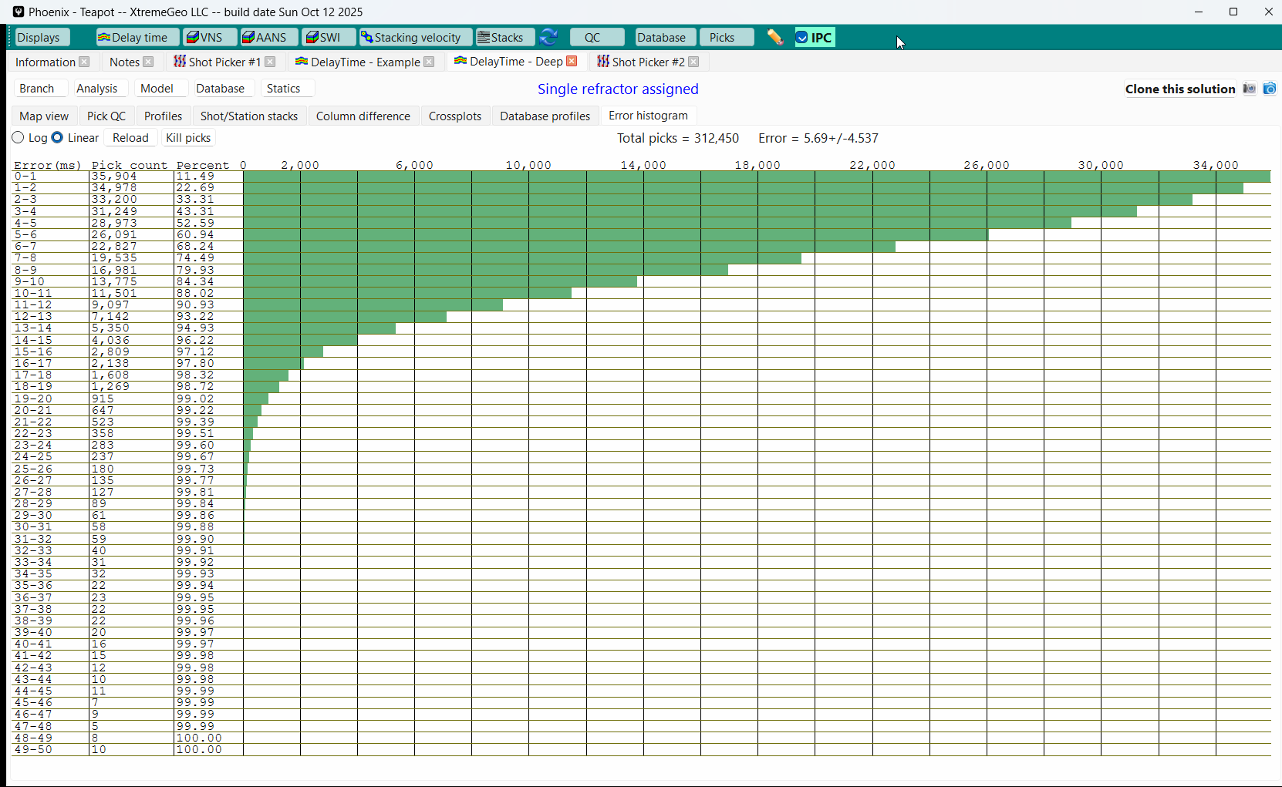
Pick error histogram

Slide 20
Shot/Station delay time stacks
Possibly the most important step!
Stacks are used to
QC and refine the delay time solution
Find misplaced shots
Repair receiver polarity flips
Creating stacks is straightforward
Gather all traces for each shot and receiver
Keep those traces within selected offset range
Shift the traces by the delay time solution, including any uphole and water bottom corrections
Stack the traces
The result is one stacked trace per shot and station
Repeat the above for all branches

Slide 21
Shot/Station delay time stacks
There are some significant differences between Flatirons and Phoenix
In Phoenix, a “Stack” consists of
Stacked traces for all the shots and stations
A complete snapshot of the current delay time solution. This makes it easy to go back to a prior solution if needed
All branches are stacked simultaneously, no need to stack one at a time
Stacking is threaded, and runs as a batch process
Picking the stacks in Flatirons causes the delay time field to be immediately updated. This is not the case in Phoenix. Instead, this step is performed after picking all shots and stations

Slide 22
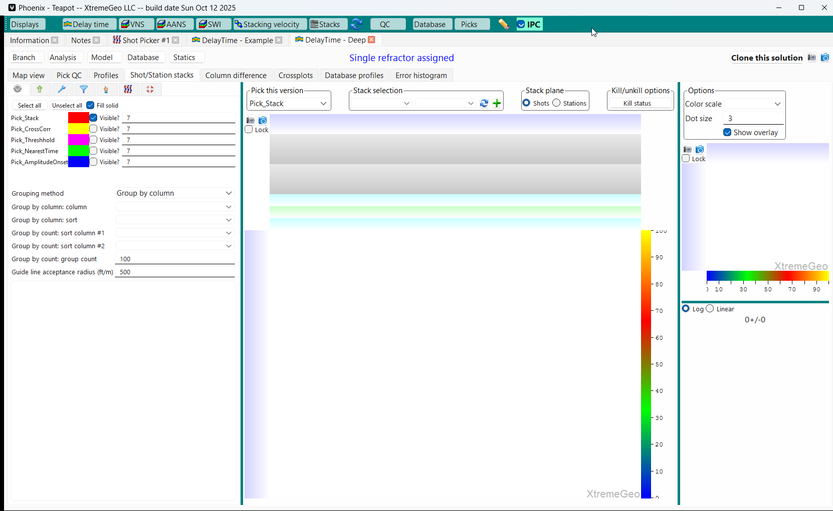
Shot/Station delay time stacks
Navigate to the Shot/Station Stacks tab
Click the green “+” button

Slide 23
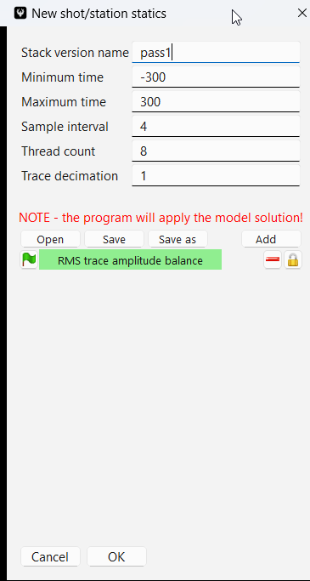
Shot/Station delay time stacks
Be sure to give the stack a name.
On large surveys trace decimation might speed things up
Adding RMS trace balance is usually a good idea
Stacking runs as a batch process on the local machine

Slide 24
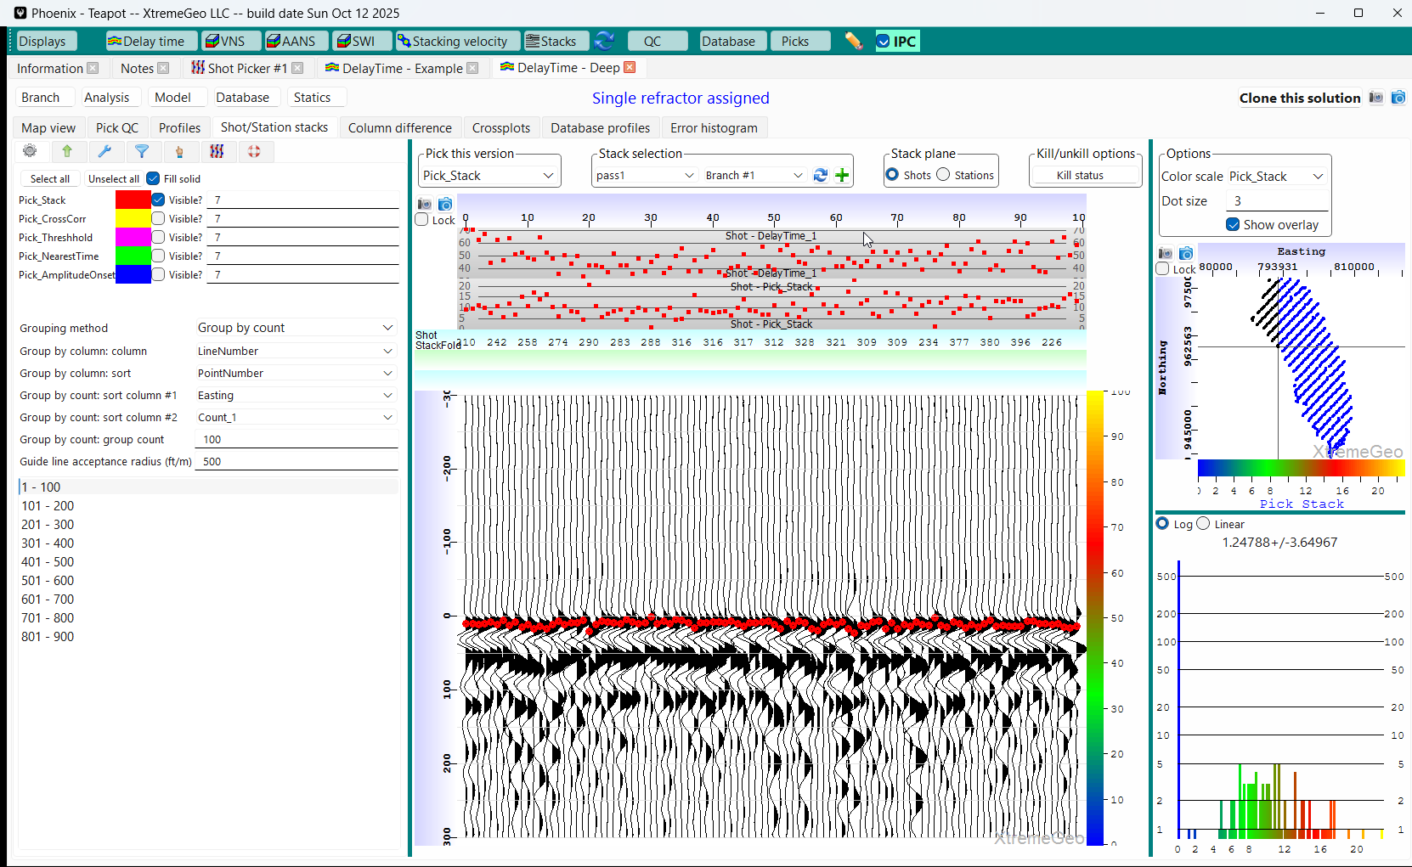
Shot/Station delay time stacks
Prep Display Options
Experiment with grouping options
Select headers
Change display to “Pick_Stack”

Slide 25
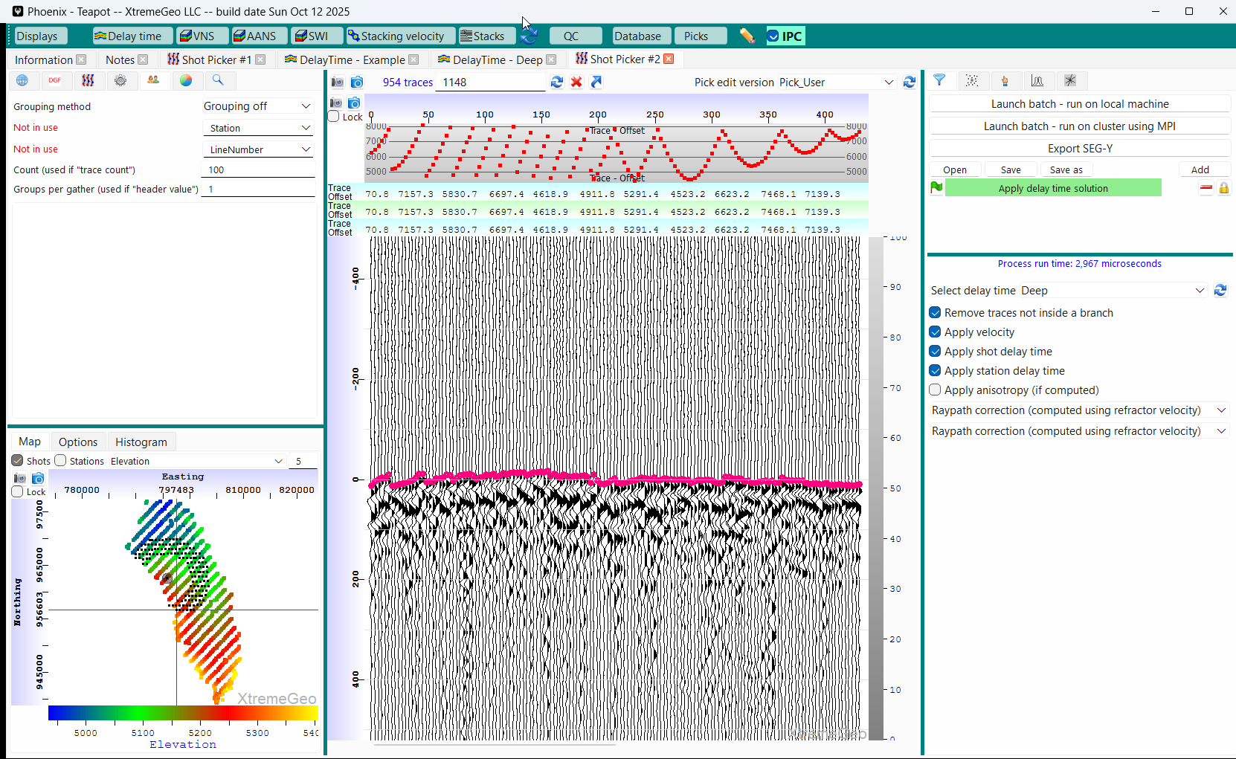
Shot/Station delay time stacks
Prepare Shot Picker
The shot picker will be used to fix geometry issues and bad picks
Open a new shot picker
Turn Grouping off
Add delay time moveout in the flow builder

Slide 26
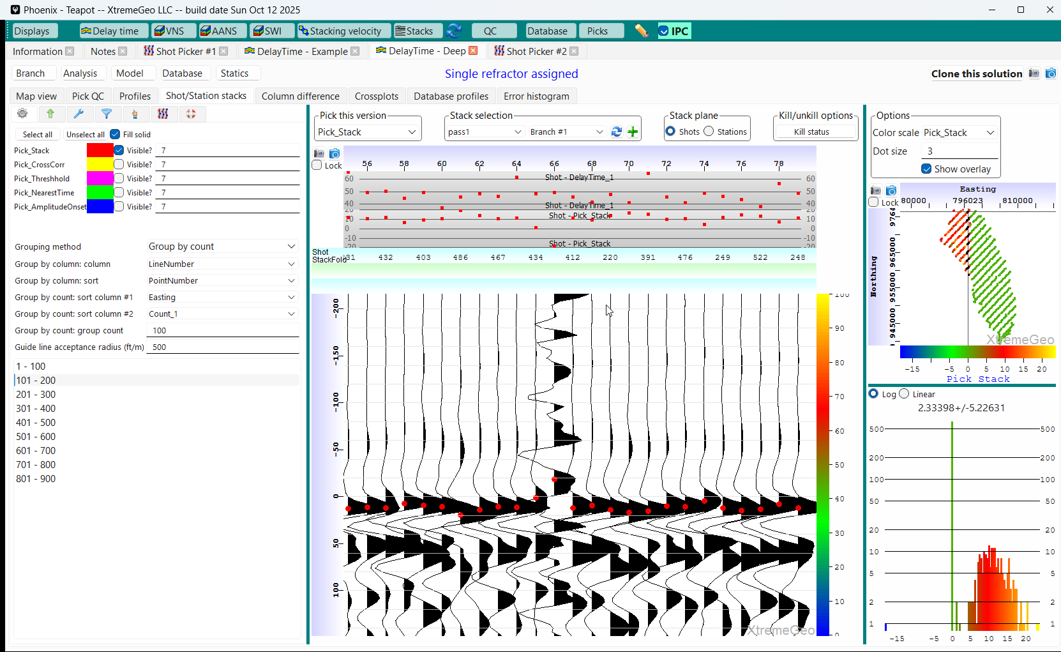
Shot/Station delay time stacks
Navigate Back to the Stacks Display
Start picking the stacks – just like picking first breaks
Pay close attention to the basemap on the right to make sure the picks are consistent
This trace shows a bad shot. Move the cursor over the trace and click the “Esc” key. This will select the shot in other displays. Navigate back to the Shot picker…

Slide 27
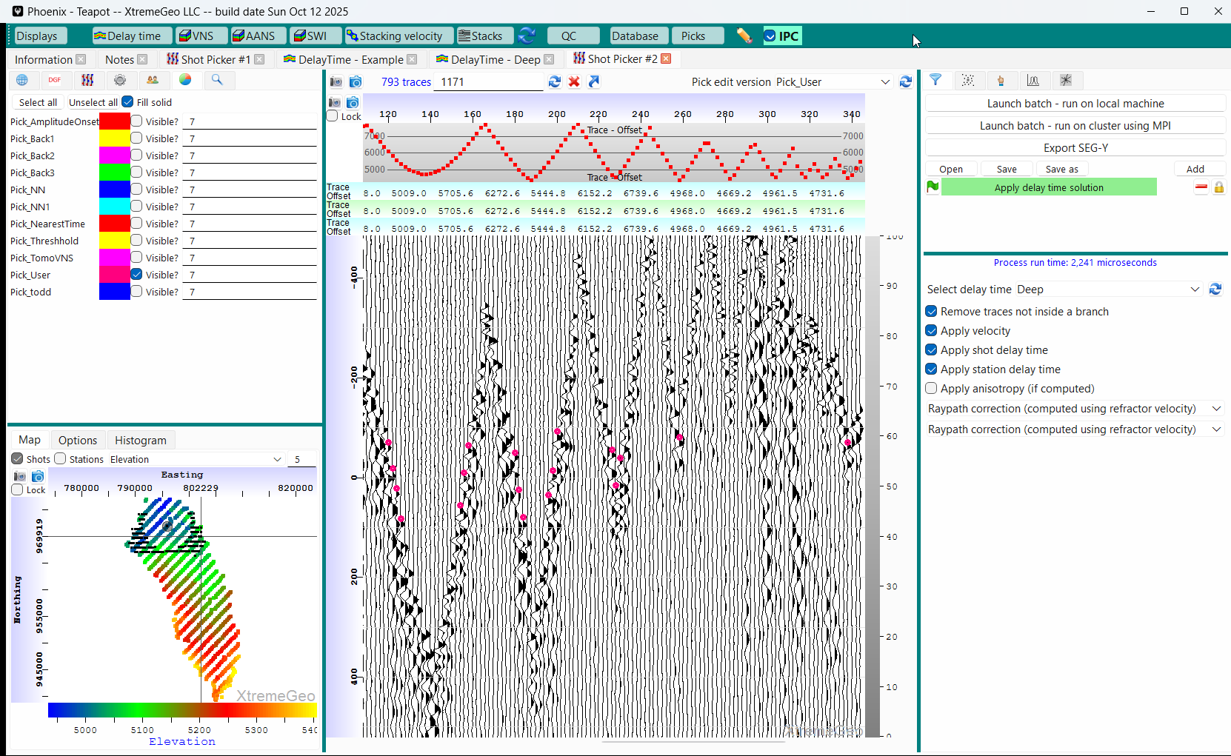
Shot/Station delay time stacks
View the Bad Shot in the Picker
This shot isn’t simply misplaced
Pattern issues?
Unsure, so for now “Kill” the shot by clicking the red “X”
Navigate back to the stack display and continue picking

Slide 28
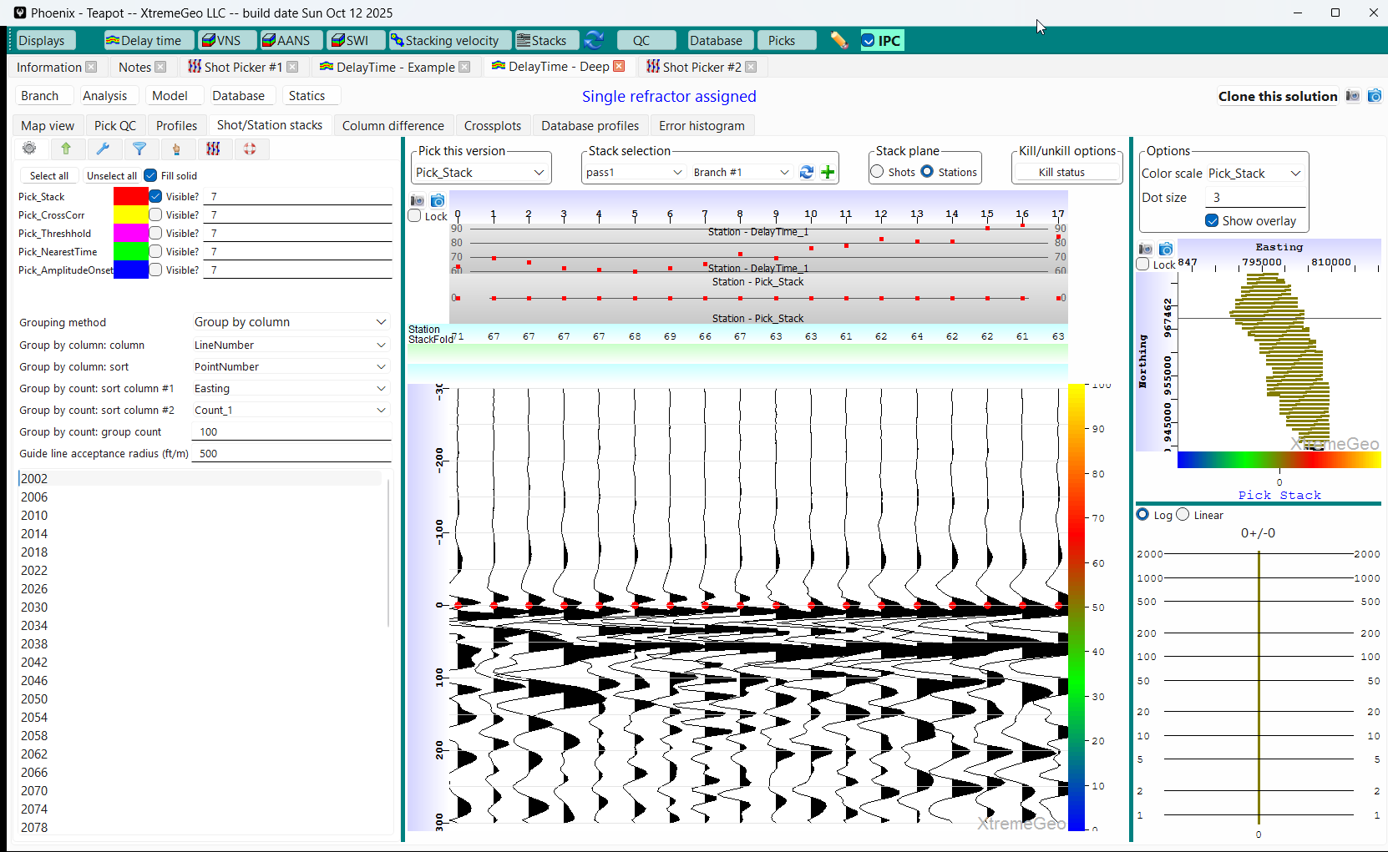
Shot/Station delay time stacks
Finish picking the shots, then select “Stations” and begin picking
The stations are grouped by “LineNumber” for easier navigation

Slide 29
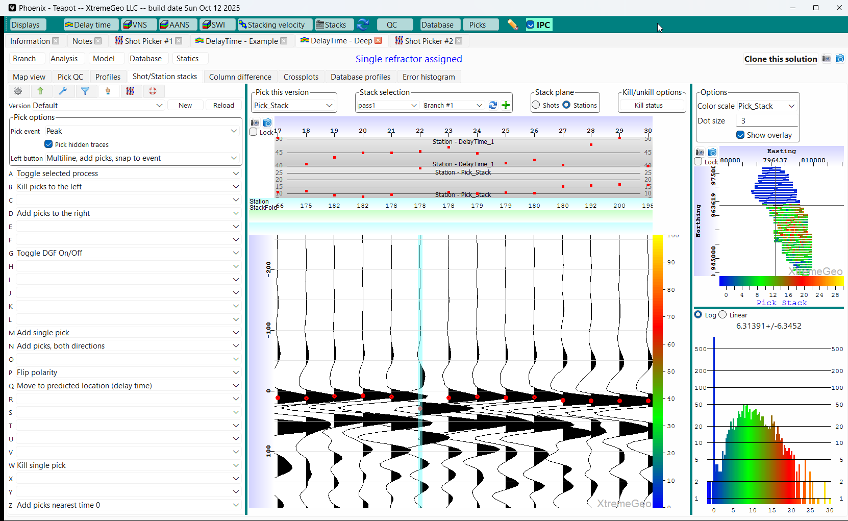
Shot/Station delay time stacks
Polarity Flip
This station clearly needs to have its polarity flipped
Make sure a Hot Key has been set to “Flip polarity”
Move the cursor over the trace and click the key
The trace will be redisplayed immediately.
Pick the flipped trace

Slide 30
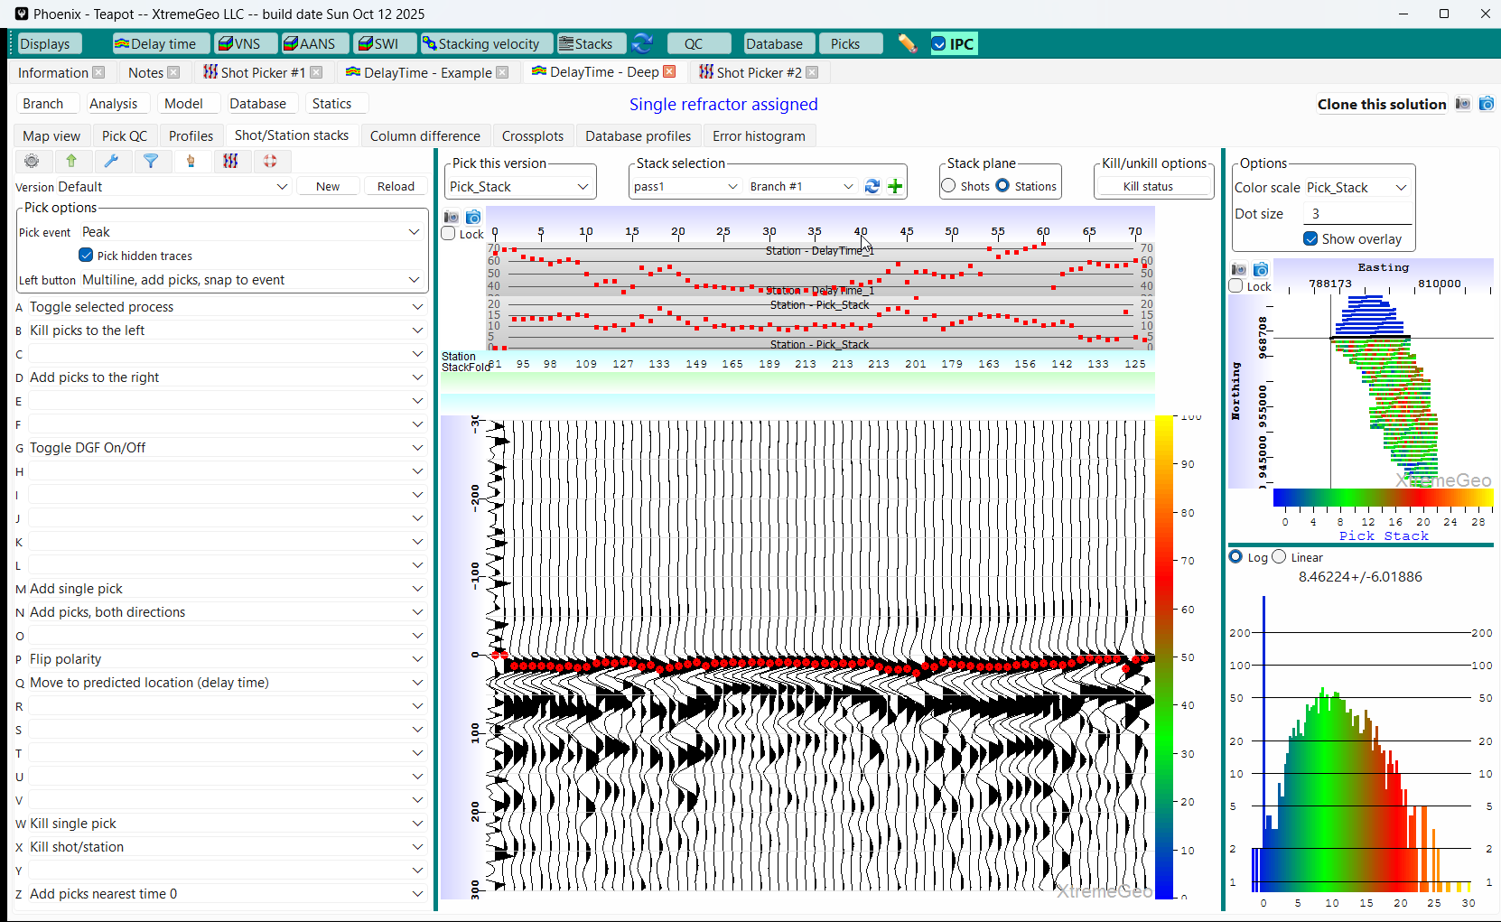
Shot/Station delay time stacks
Bad Receiver
The noisy receiver should be killed
Move the cursor over the trace and click the hot key mapped to “Kill shot/station”
The display will immediately update
Continue picking all receivers

Slide 31
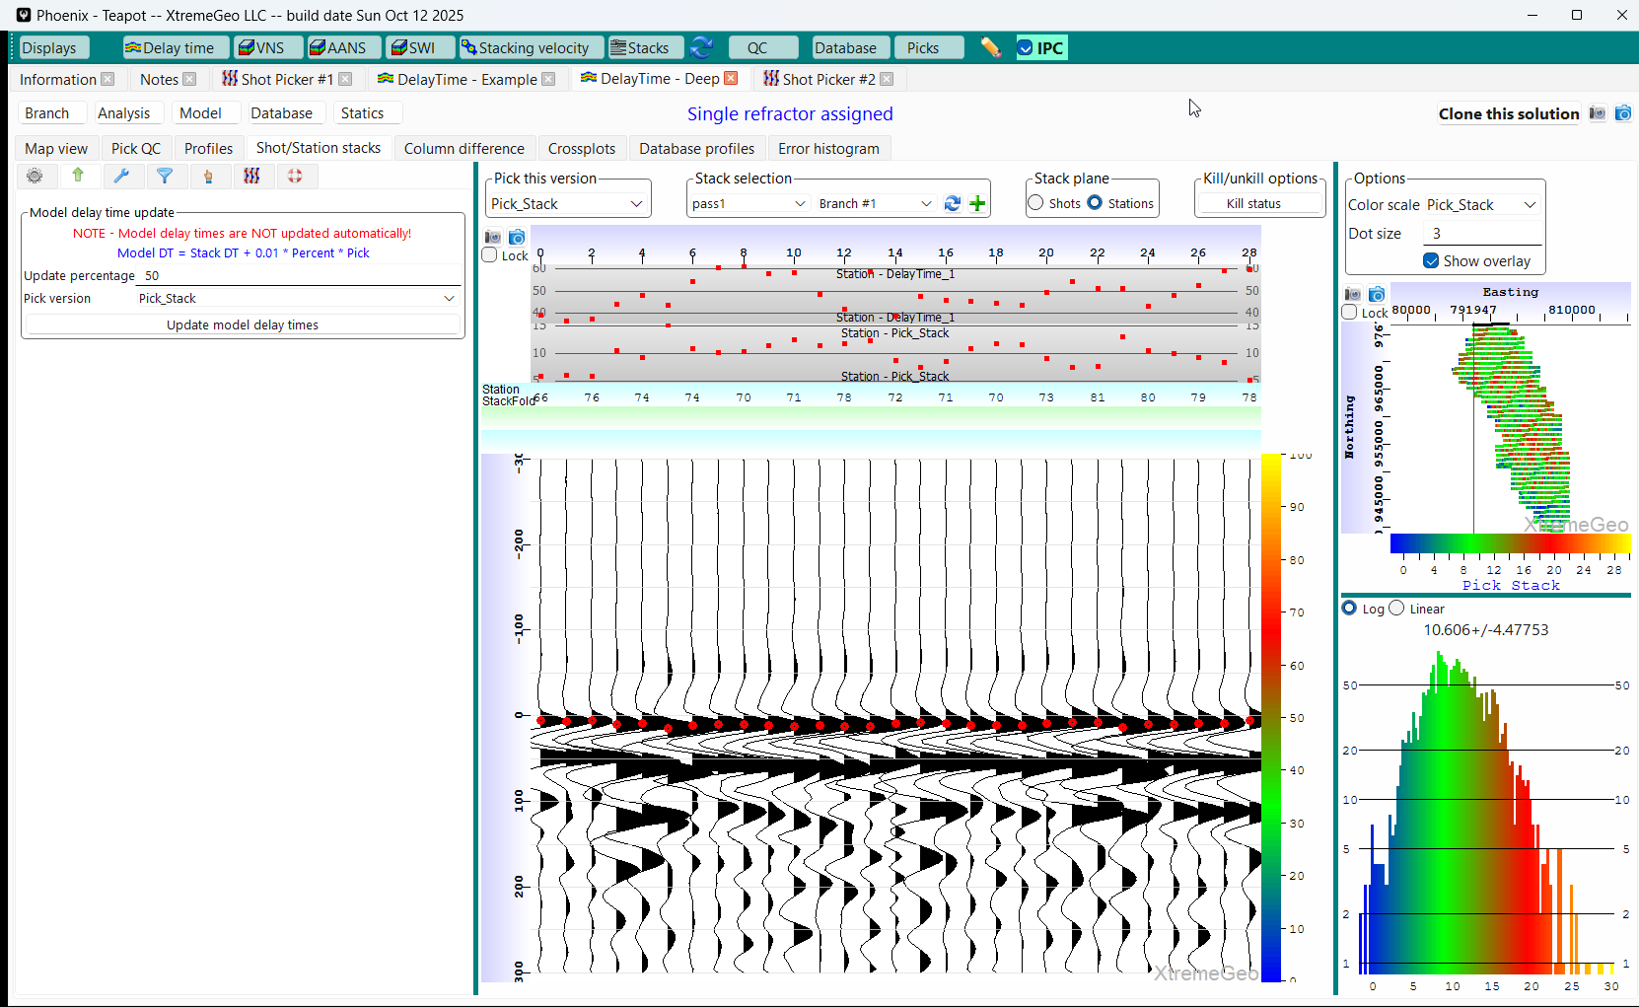
Shot/Station delay time stacks
After Making Picks, Update the Solution
Navigate to the “Update” tab
Choose an “Update percentage”. The first pass something like 50% is recommended. This can be increased in subsequent passes
NOTE – be sure to select the correct pick version!
Click “Update model delay times”

Slide 32
Shot/Station delay time stacks
After the First Pass
Did the stacks look OK? Meaning, were the picked events very close to zero time and were all geometry and polarity issues fixed?
If not, create a new set of stacks and go through the prior processes again
On a typical survey two or three passes are usually required
NOTE – The display does include batch pickers which can significantly speed up picking.

Slide 33
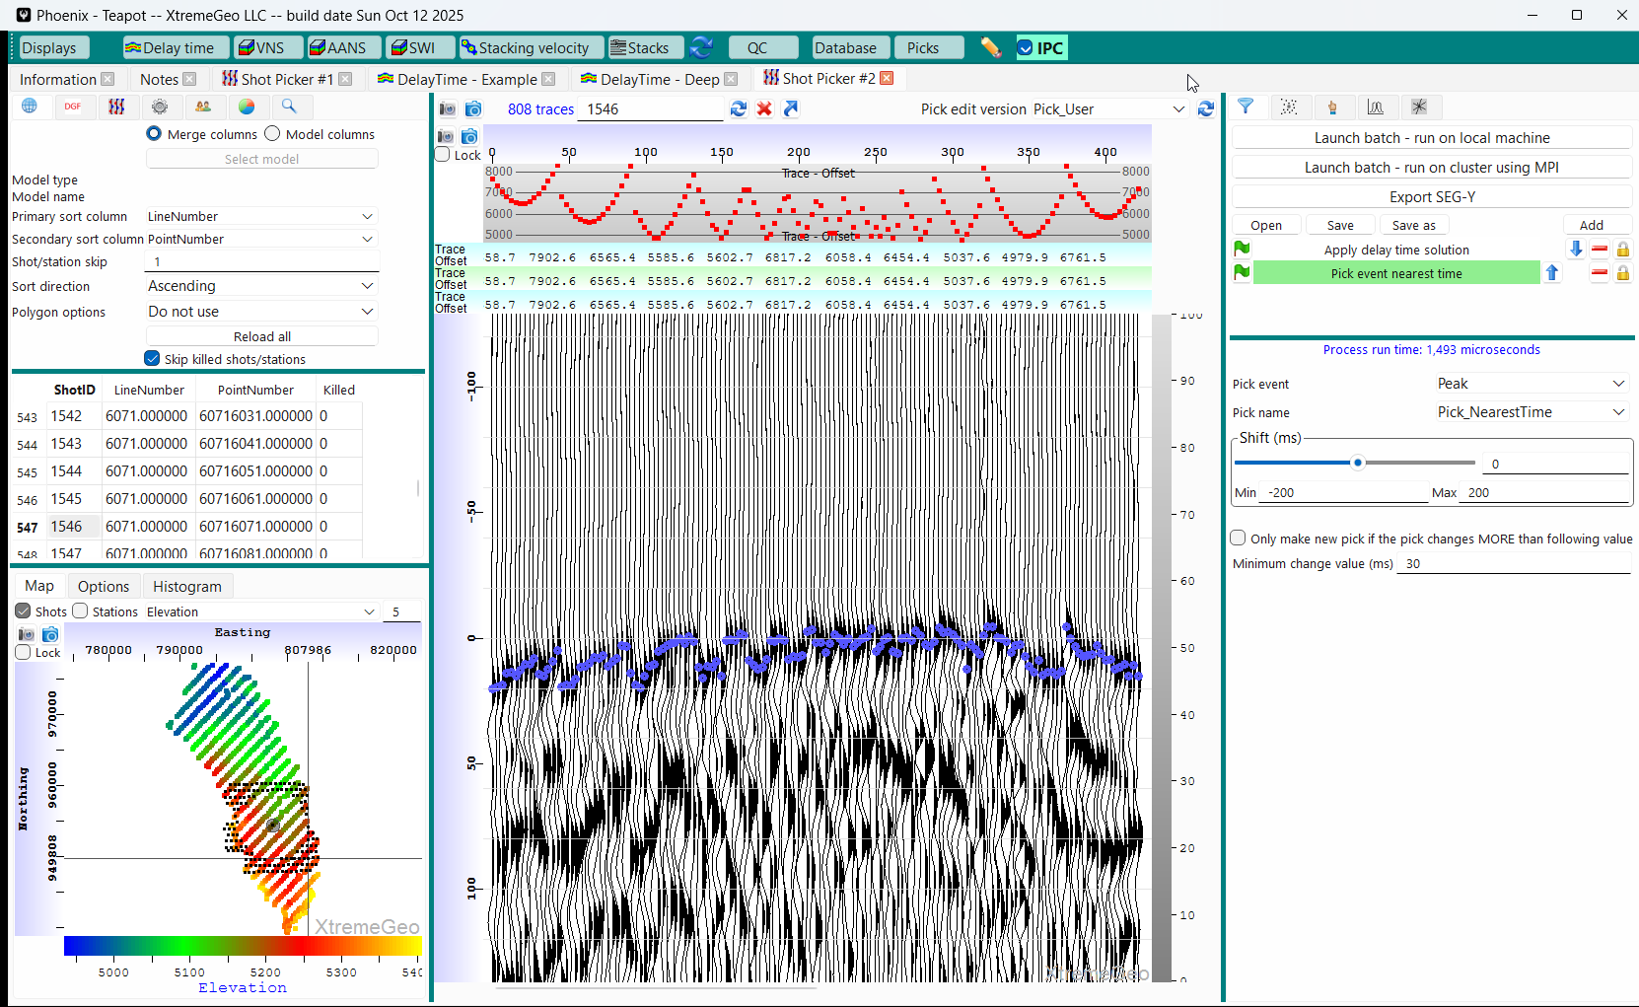
use the delay time solution to refine first break picks
Optional
This step is usually needed if geometry corrections and polarity flips have been made
Open a new picker window
Turn grouping off
Add delay time moveout
Add a picker, “Pick event nearest time”
Be sure to select correct output pick version
View several shots
If everything looks OK, click “Launch batch…”
When picking finishes, it might be a good idea to run analysis again

Slide 34
Model building
Recall that delay time modeling has three main stages:
Delay time analysis,
Geometry issues are found and fixed
Refractor velocities computed
Delay times computed
Model building
Construct physical models from delay times and velocities
Many approaches are possible…
Resulting in many different models with potentially many different statics
Statics computation

Slide 35
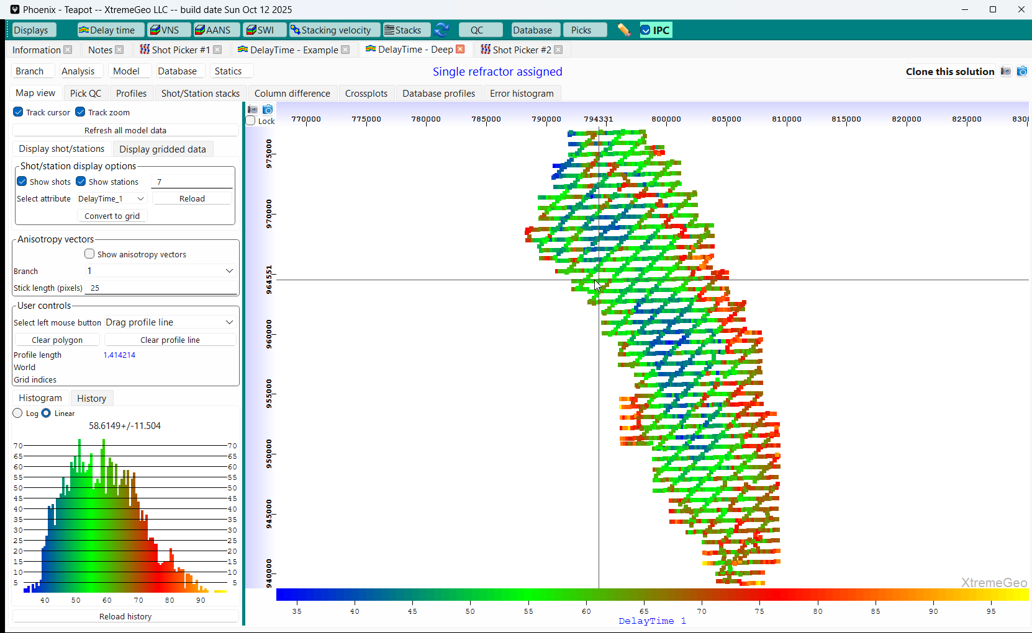
Model building
Clean Up Delay Times
Before computing a model it’s usually good idea to clean up the delay time solution
Any anomalously large (or small) delay times will negatively affect the model
Navigate to the Map view and plot the delay times. Outliers will be visible in the histogram plot
If needed, Click “Database” and select “Modify: interpolate bad values”. Select the delay time field and enter the valid range

Slide 36
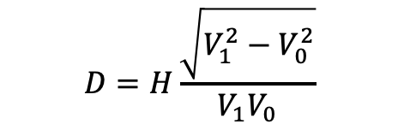
Model building
D is the delay time
H is the weathering layer thickness
V1 is the refractor velocity
V0 is the weathering layer velocity
$$D=H\frac{\sqrt{V_{1}^{2}−V_{0}^{2}}}{V_{1}V_{0}}$$
One equation with two known values (D and V1) and two unknown values (V0 and H)
D and V1 are computed during the analysis stage
If we obtain (or guess) V0 then H will be computed
If we estimate H then V0 will be computed

Slide 37
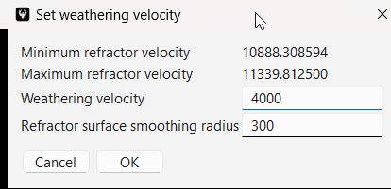
Model building
First Approach:
Guess V0
Probably the most common approach
Click “Model” then “Shortcut – assign weathering velocity”. Choose a value between 30% and 70% of the refractor velocity
The following steps are performed:
Assign V0 to every shot and receiver
Compute H at every shot and receiver using their delay times and refractor velocities
Using H, compute refractor elevation at every shot and receiver
Smooth the refractor elevation
Recompute thicknesses using new smoothed refractor elevation
Recompute V0 using new thicknesses

Slide 38
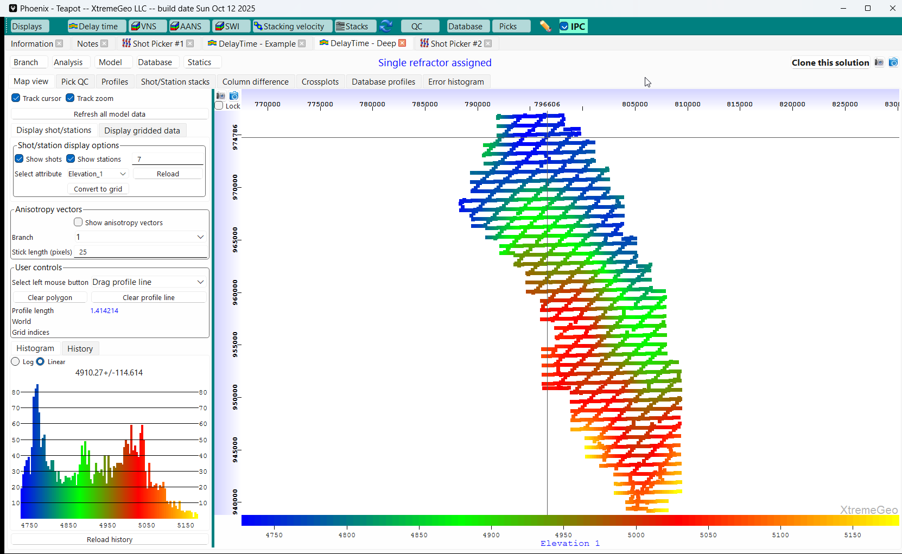
Model building
View Refractor Elevation and Weathering Velocity

Slide 39
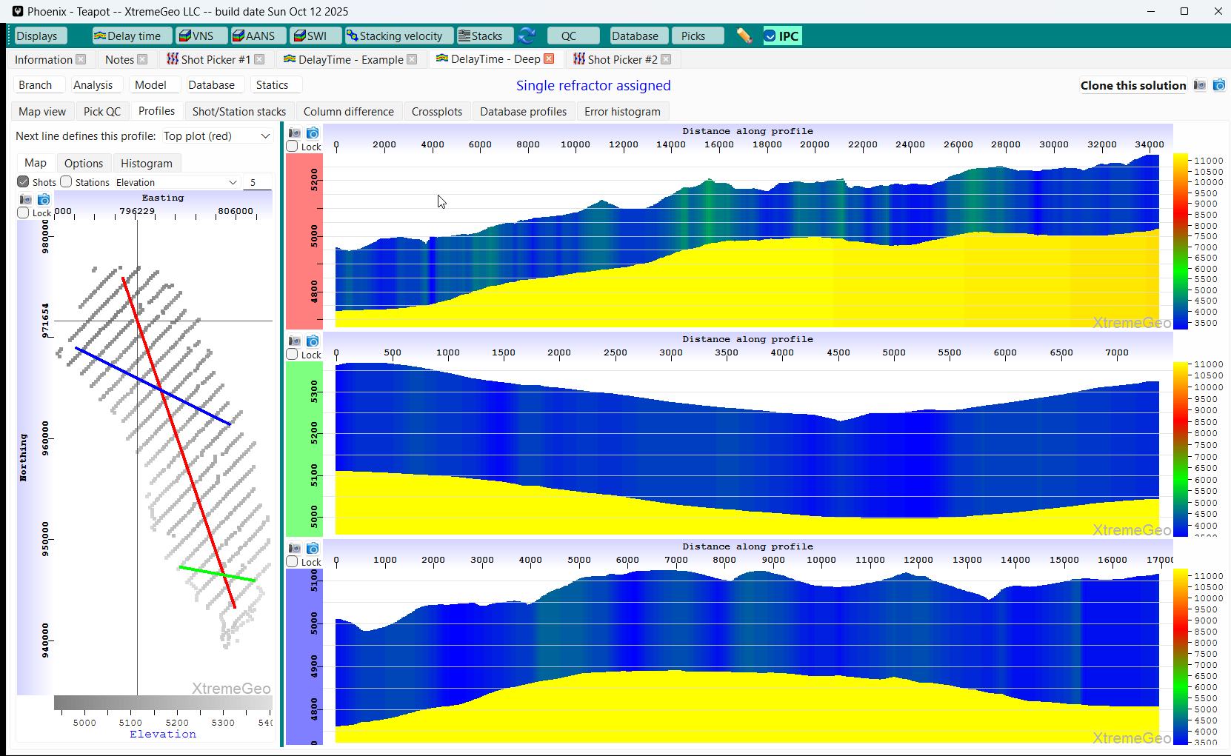
Model building
View Profiles
Note that the refractor elevation is smooth, as expected
Left-click and drag lines
on the map

Slide 40
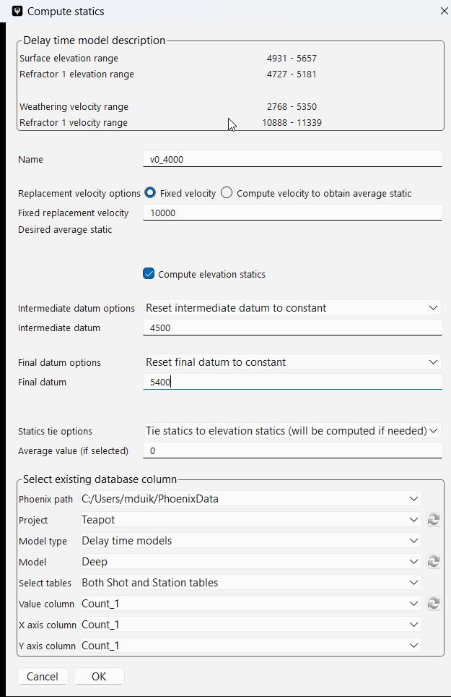
Statics computation
Will likely have many statics versions!
Click “Statics” then select “Shortcut”
The processing client will usually provide the replacement velocity and final datum
Select an intermediate datum completely below the refractor elevation.
There are many ways to define the intermediate datum, but a flat surface often works well
It can be a very good idea to “tie” the statics to elevation statics. This means that the two fields have the same average value
Or you can select the average value

Slide 41
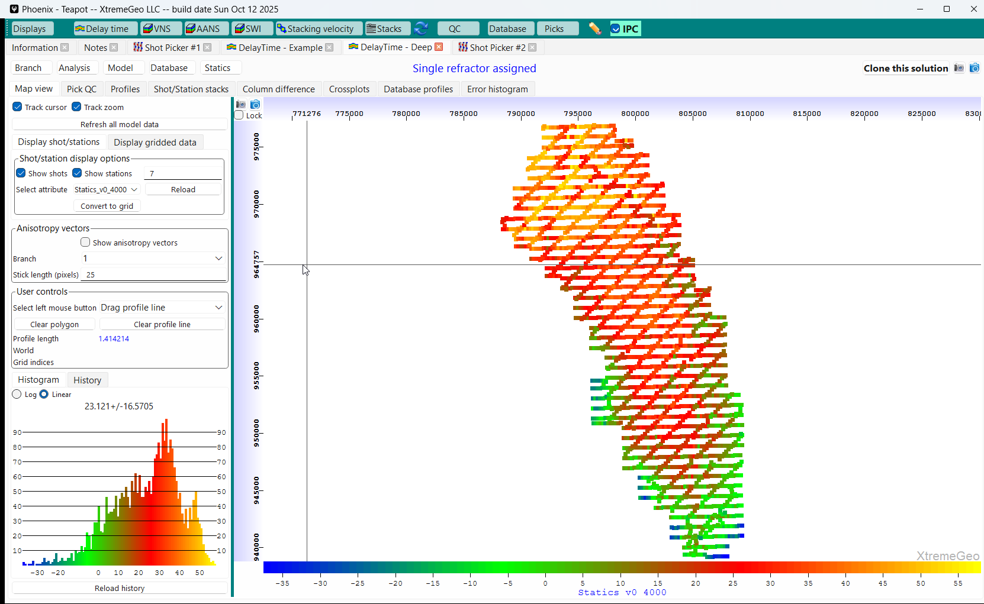
Statics
View on the Map

Slide 42
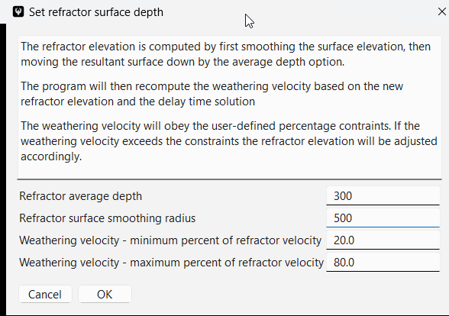
Model building
Second Approach:
Define the Refractor Surface
Click “Model” then “Use surface elevation to define the refractor surface”
Choose and average depth and smoothing radius
The following computations are done
Smooth the surface
Compute refractor surface by moving the surface down the selected amount
Compute weathering thickness at each shot and receiver
Compute weathering velocity using thicknesses and delay time solution

Slide 43
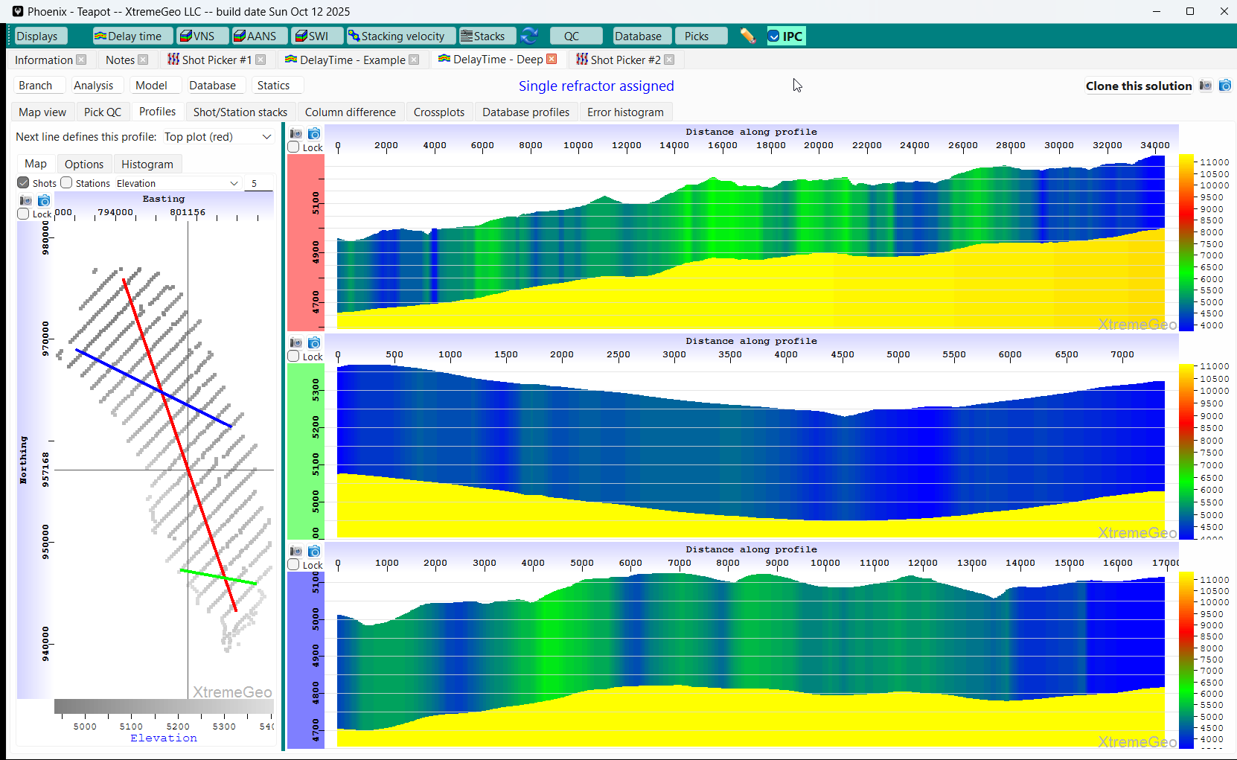
Model building
View New Profiles

Slide 44
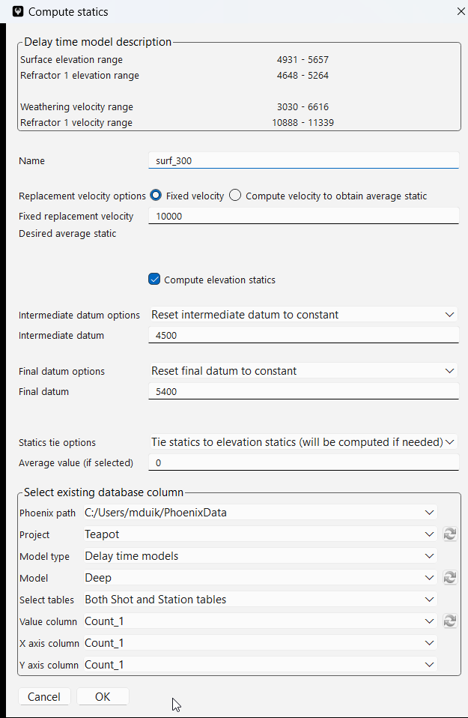
Statics computation using new model
The only difference is the name…

Slide 45
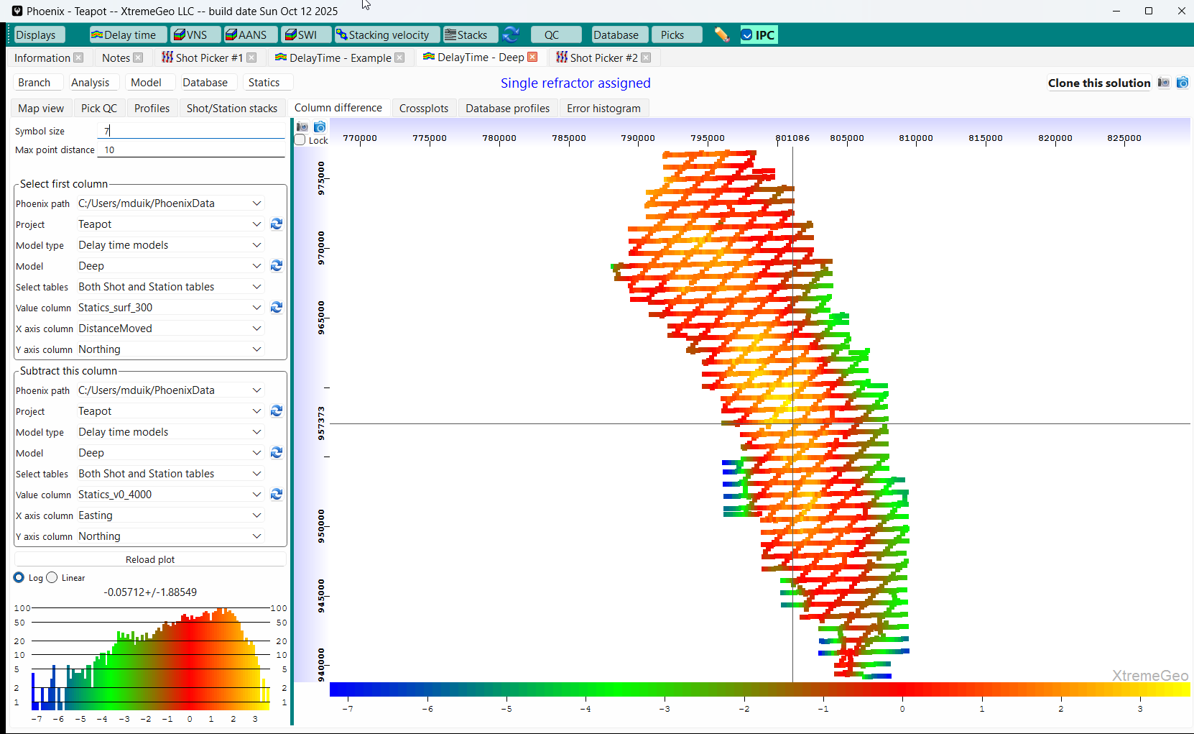
Question – how different are the statics????
Select the “Column difference” tab
The options are somewhat tedious to select, but worth the effort
The two statics fields are
significantly different!!!

